Slide 1
Overview of Mental Health and Emotional Wellbeing Services Offered During the COVID-19 Pandemic and the Crisis Response Grant From the Federal Emergency Management Agency
Stephanie Woodard, Psy.D., DHHS Senior Advisor on Behavioral Health

Slide 2
Phases of Disaster Response and Operations

Slide 3
Assembly Bill 206, enacted 2019
The Department shall develop a written plan to address behavioral health needs in an emergency or disaster.
Prescribe a process for assessing the need for behavioral health resources during or after an emergency or disaster based on the estimated impact of the emergency or disaster and the estimated depletion of resources during the emergency or disaster;
Ensure continuity of services for existing patients with a mental illness, developmental disability or intellectual disability during an emergency or disaster;
Prescribe strategies to deploy triage and psychological first aid services during an emergency or disaster;
Identify opportunities for the rendering of mutual aid during an emergency or disaster;
Prescribe procedures to address the behavioral health needs of first responders during and after an emergency or disaster; and
Prescribe measures to aid the recovery of the behavioral health system after an emergency or disaster.
On or before December 31 of each year, the Department shall: Review the plan developed pursuant to subsection 1 and revise the plan as necessary; and Transmit the plan to the Chief of the Division of Emergency Management of the Department of Public Safety

Slide 4
Disaster Response and Operations
  Every disaster is different
  Trauma affects individuals and the community
  Response strategy depends on disaster characteristics
  A disaster causes disruptions and changes

Slide 5
Key Concepts of Disasters
  A disaster is “… a sudden event that has the potential to terrify, horrify, or engender substantial losses for many people simultaneously.”
  Fran Norris, Ph.D., NCPTSD
  No one who sees a disaster is untouched by it
  Affects individuals and communities
  People pull together during and after
  Stress and grief are normal reactions
  People’s natural resilience will support individual and collective recovery
  Pandemics, such as COVID-19, are considered disasters

Slide 6
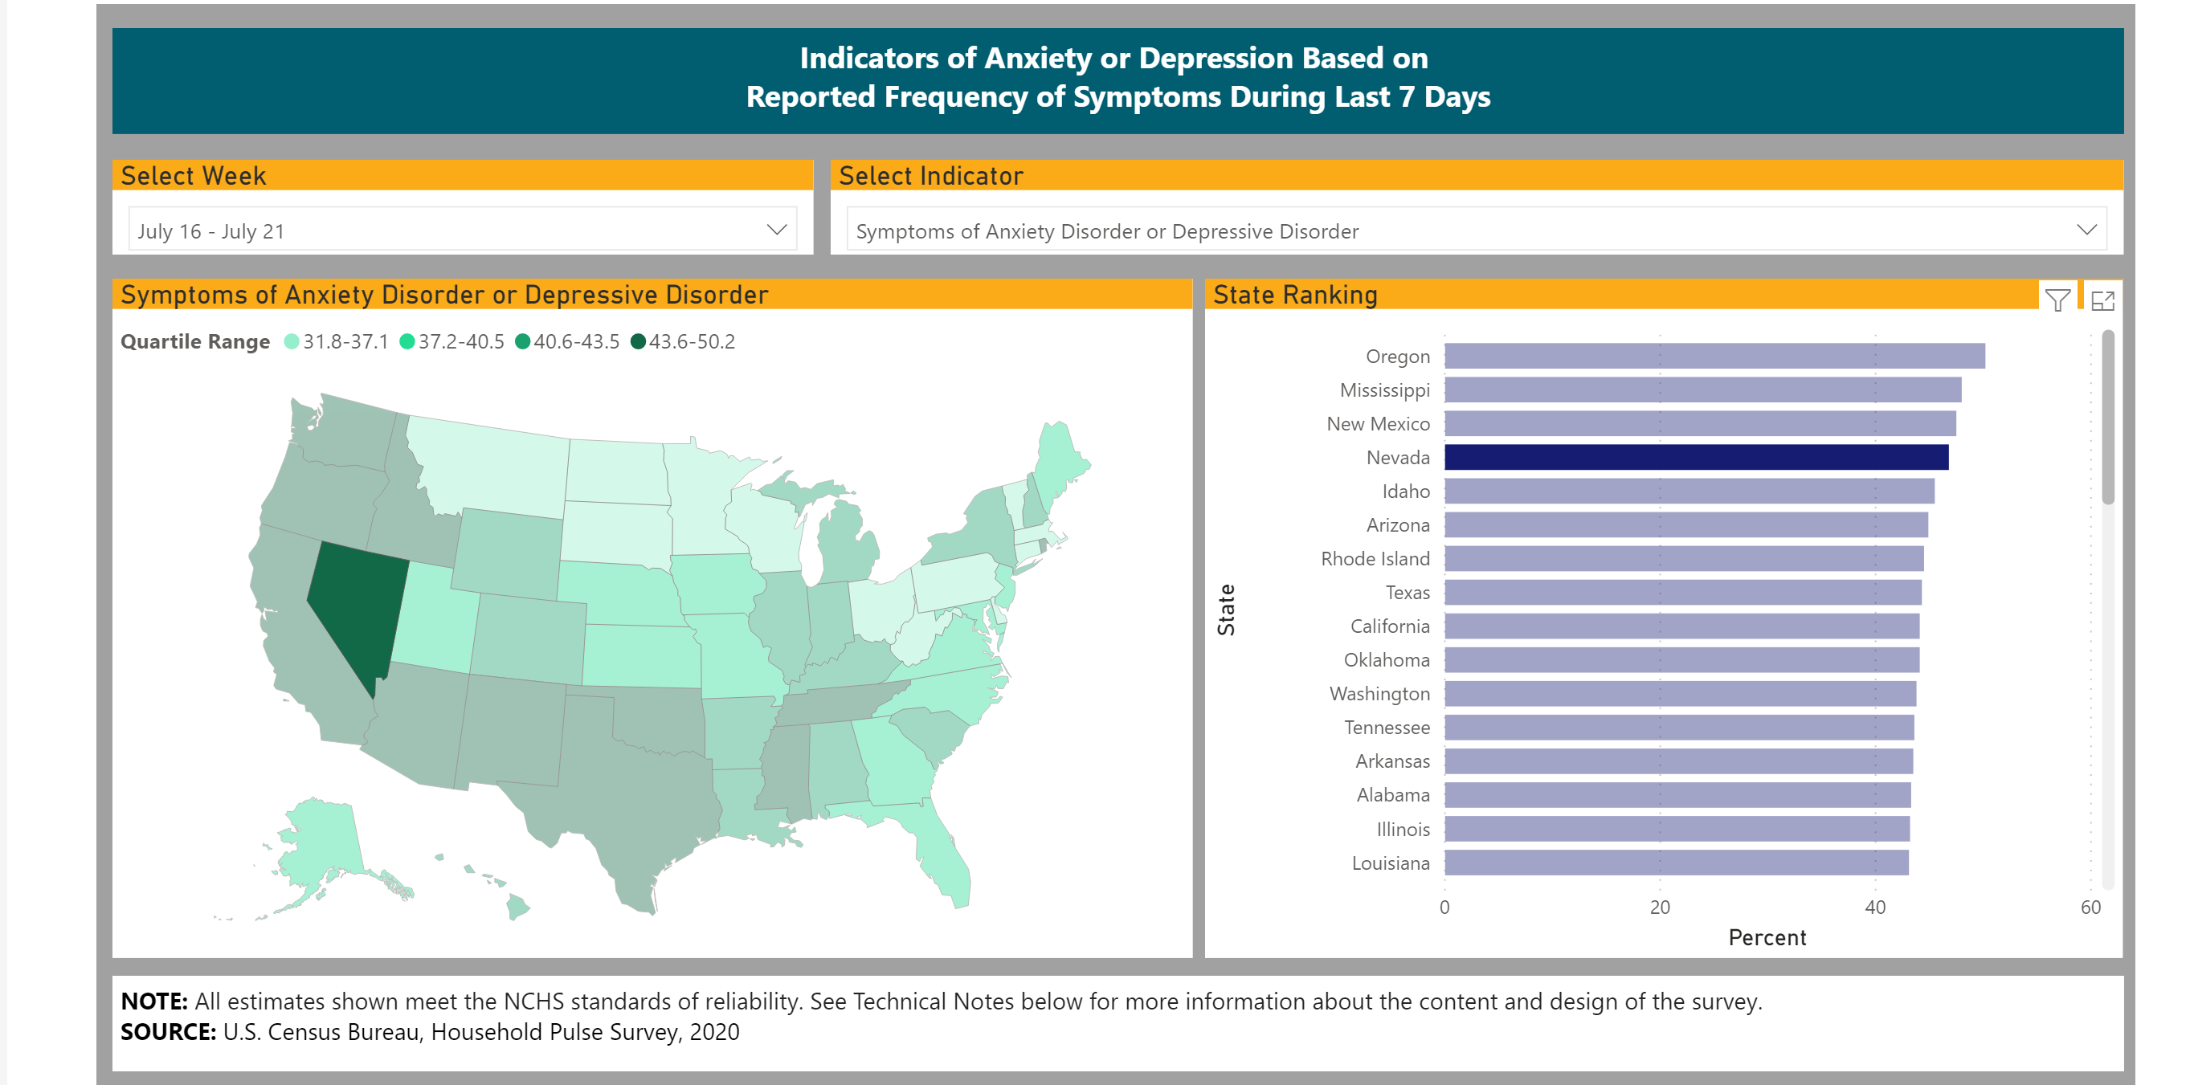
CDC Mental Health Pulse Survey

Slide 7
Early ESF 8-1 COVID-19 Activities
Established the COVID-19 BH Advisory Group.
Collaborated with Governor’s office to create the NV Health Response website
Worked with SERV-NV Battle Born Medical Corp to expand the State’s health care capability
Manage the two SERV-NV BH organizations: Mental Health Crisis Counselor (N=44) and Psychological First Aid (N=58)
Recruited/trained 500 individuals in Psychological First Aid
Support a 3-tiered support system for health care providers

Slide 8
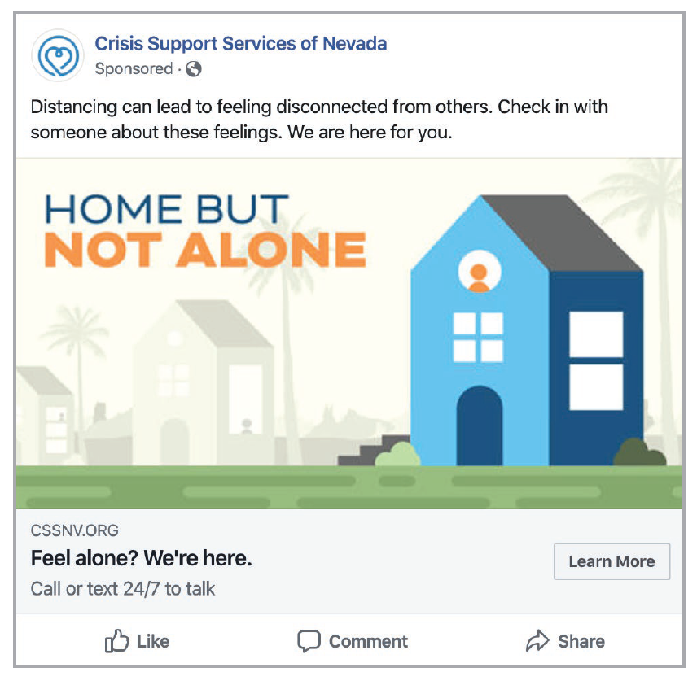
Outreach for Crisis Support Services of Nevada

Slide 9
State Emergency Registry of Volunteers (SERV-NV)
Mental Health Crisis Counselors (MHCC) Volunteers:
Licensed or certified mental health professionals
Formally trained in crisis mental health counseling and in psychological/mental health first aid/or an equivalent
Psychological First Aid (PFA) Volunteers:
Non-traditional, natural community-based helpers, healers, and peer supporters
Formally trained in psychological/mental health first aid or an equivalent

Slide 10
Psychological First Aid (PFA)
Safety
Calmness
Connectedness
Self and Community Efficacy
Hope

Slide 11
8 Core Actions of PFA
Contact and Engagement
Safety and Comfort
Stabilization
Information Gathering
Practical Assistance
Connection with Social Supports
Information on Coping
Linkage with Collaborative Services

Slide 12
Behavioral Health Resource Request Process
All behavioral health resource requests begin at the local level where the requestor initiates the process by sending the request to the Emergency Operations Center using the NDEM/SEOC Resource Request Form. The requests only proceed up to the next governmental EOC level if the request can not be filled at the lower level.

Slide 13
ESF 8-1 COVID-19 Activities
Maintain a one-stop resource list of crisis support services for health care workers/first responders.
Work with Regional BH Coordinators to provide consistent messaging and to promote access to services.
Ensure continuity of BH services.
Work to reduce pressure on EDs.
Worked with ADSD to establish the Nevada CAN project.

Slide 14
Behavioral Health COVID-19 Response and Recovery Activities
Collaboration with Divisions of Emergency Management
Support providers in stabilizing services
Promote telehealth
Develop workforce
Implement behavioral health prevention and early intervention
Ensure access to services throughout the continuum
Plan for Nevada COVID-19 Behavioral Health Recovery
Evaluate data to determine unmet or anticipated need
Leverage existing funding; provide flexibilities
Apply for additional federal funding
Liaison with providers and federal partners
Launch the Crisis Counseling Assistance and Training Program

Slide 15
Nevada’s Substance Abuse Prevention and Treatment, Block Grant (SABG)
The Bureau of Behavioral Health Wellness and Prevention Team (BBHWP) worked to engage SABG Prevention Coalitions as of March 27, 2020 to discuss the needs of primary needs and needs of the community as well as key concerns. During the initial call, Coalition Directors were given the opportunity to discuss
Key Concerns:
Communication
Financial stability of community programs
Connectivity Equipment
Long term solutions
BBHWP Responses:
Established Weekly Meetings to ensure connectivity between all partners and to disseminate real time information as well as COVID-19 updates from Governor and SAMHSA
Project officers worked within the federal and state guidelines to provide as much flexibility of funding due to the COVID-19 restrictions.
Delivered immediate feedback and support to Coalitions to achieve
equipment/ tools and resources to stay connected with our Youth.
Guidance on creative initiatives, best practices for short and long term
solutions.

Slide 16
Nevada Opioid Treatment Providers (OTP’s): COVID-19 Preparedness & Ongoing Supports
The Nevada Department of Health and Human Services, Division of Public and Behavioral Health (DPBH) provided direct supports with the assistance of Bureau of Health Care Quality and Compliance (HCQC).
Opioid Treatment Provider’s (OTP’s) under the guidance provided by SAMHSA, State and program efforts focused on continuing services to vulnerable populations by developing quickly how to meet those needs. All OTP’s immediately adopted emergency management plans submitted to the State Opioid Treatment Authority.
OTP’s had the option to submit a blanket exception requested through SAMHSA concerning policies or procedure changing during COVID-19, which was supported by DPBH and HCQC to continue to support ongoing services during the pandemic. Per the Federal COVID-19 guidance the following was allowed to assist outreach and the continuation of treatment for Opioid use disorder (OUD).
Blanket take home medication for high risk populations: Medical provider could determine a safe number of take-home doses, taking into consideration the patient’s stability in treatment and ability to safely store and protect medication, not to exceed 14 days of medication.
Provider took immediate steps to identify patients with significant medical comorbidities and provided other locations away from the general public for ongoing evaluation and medication dispensing.
For selected patients with only one take home schedule could be staggered, reducing traffic and supporting social distancing guidelines
Patients in any population deemed unsafe for take homes continued to be provided daily dosing in the clinic with all mandatory precautions for social distancing and for the patient's safety.

Slide 17
State Opioid Response (SOR)
Grant - COVID
The SOR team:
Developed outlines for emergency preparedness specific to medication assisted treatment (MAT) and treating patients with an opioid use disorder in Nevada.
Established guidelines and provided Emergency Preparedness memo for all Nevada OTP facilities.
Expanded telehealth services for opioid related treatments.
Provided take home MAT
Med delivery (as requested by patient)

Slide 18
Medicaid Telehealth Guidance Expanded Service Eligibility
March 17, 2020
Federal regulations lifted restrictions on telehealth services. Previously only crisis intervention and targeted case management were allowed telephonically.
March 19, 2020
DPBH lifted restrictions allowing group therapy to be delivered via telehealth.
March 30, 2020
The Office of Civil Rights at the Federal Department of Health and Human Services released guidance relaxing HIPAA enforcement of technology platforms utilizing telehealth. This allowed health care providers to utilize popular platforms for video hosting to include Apple FaceTime, Facebook Messenger, Google Hangouts video, Zoom, and Skype, to provide telehealth without risk of penalties for noncompliance with the HIPAA Rules related to the good faith provision of telehealth during the COVID-19.
April 13,2020
DPBH announced Psychosocial Rehabilitation (PSR) services would be permitted through traditional telehealth audiovisual communication for individuals under the age of 18 throughout the period of the COVID-19 pandemic, as a disruption in services is not in the best interest of the youth served by Medicaid.
DPBH adjusted grant funding for non-profits to ensure purchase and engagement of telehealth equipment across Nevada.

Slide 19
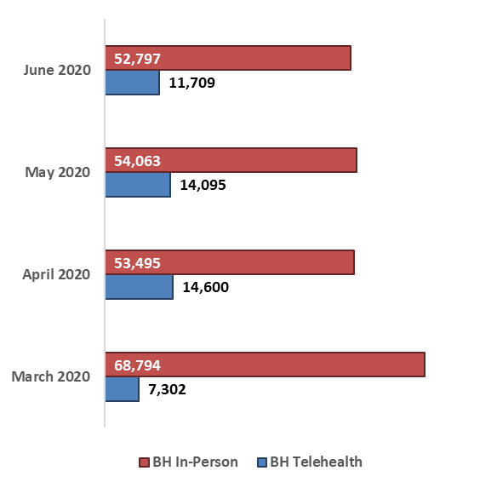
Medicaid Behavioral Health (BH) Telehealth Utilization
From March 1, 2020 to March 31, 2020
There were 7,302 BH patients using telehealth services and 68,794 BH patients using in-person services. In March, Medicaid paid $1,372,419 for BH telehealth services and $121,354,816 for BH
in-person services.
BH patients using telehealth services accounted for 10% of all BH patients and 1% of the total amount paid for these BH services this month.
From April 1, 2020 to April 30, 2020
Since March 2020, the number of patients using BH telehealth services increased by 100% and spending by 172%. In-person patients decreased by 22% with an 8% decrease in spending.
Telehealth patients accounted for 21% of all BH patient services and 3% of total paid for these BH patients this month.
From May 1, 2020 to May 31, 2020
A decrease in BH telehealth patients by 3% and payments by 7%. An increase in BH in-person patients by 1% and decrease in payments by 3%.
BH telehealth services accounted for 21% of all BH patients and 3% of all payments made for BH services this month.
From June 1, 2020 to June 30, 2020
A decrease in telehealth patients by 17% and in spending by 17%. A decrease in in-person patients by 2% and payments by 14%.
BH telehealth patients accounted for 18% of all BH patients and payments were 3% of all BH service payments.

Slide 20
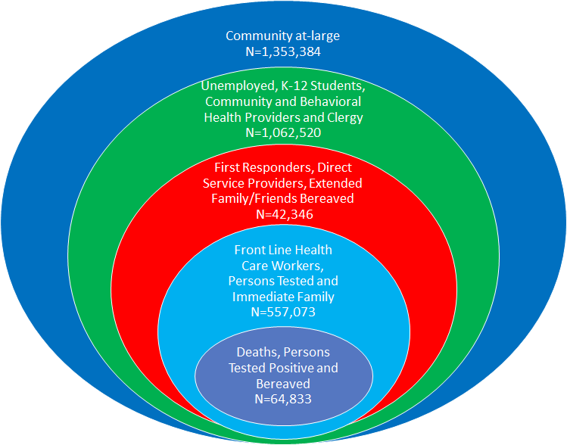
Population Exposure Model*
*Unlike static models, the Nevada model is dynamic and addresses the changing needs of the community based on the data-driven impacts of COVID. Updated 08/19/2020

Slide 21
Vulnerable Populations
Individuals and families who are bereaved may have complicated bereavement due to circumstances surrounding COVID-19 Individuals awaiting testing results, required on isolation, quarantine, or hospitalized due to illness
Children, youth, adolescents, and their parents/caregivers are experiencing significant stressors following the closure of schools.
Individuals and families with economic concerns, job loss, and unemployment, economic uncertainty, homelessness, food insecurity and loss of health care insurance
Health care providers, law enforcement, emergency medical technicians, and firefighters
Ethnic minorities, especially people who are non-English speaking, or individuals who have facilitated communication needs
Tribal population
Aging population
Victims of Domestic Violence
Individuals with pre-existing behavioral health issues or at-risk

Slide 22
Crisis Counseling Assistance and Training
FEMA Funding authorized under the Emergency Declaration
Immediate Services Program: FEMA: 60 days, began 4/30/2020, ending 8/28/2020
Regular Services Program: SAMHSA: 6 months, begins 8/29/2020
CCP Grant Activities
  Primary
    Telephone, Virtual, Social Media outreach
    Establishing or expanding existing helplines
    Establishing generic, branded email address
    Virtual individual support & support groups
    Print & electronic psychoeducational resources and creative ways to distribute
  Secondary
    Establish branded program presence on popular channels: Facebook, Twitter, Instagram
    Webinars or information sessions
    Broadcast information on coping and stress management

Slide 23
The CCP Model
  Strengths based
  Anonymous
  Outreach oriented
  Culturally competent
  Conducted in nontraditional settings
  Designed to strengthen existing community support systems
  Assumes natural resilience and competence

Slide 24
Nevada Resilience Project
DPBH Immediate Service Program (ISP) also referred to as the Crisis Counselor Program (CCP) awarded through the Federal Emergency Management Agency (FEMA) and Substance Abuse Mental Health Administration (SAMHSA).
DPBH developed the program to ensure counselors, also referred to as community ambassadors, are linguistically and culturally appropriate and diverse to serve all regions in the state. This includes a third of the current counselors being bilingual. The current distribution is based on a population exposure model to target the impacts of COVID.
Current partners include, but may change based on the needs of the population:
Washoe County Human Services, who are also coordinating with Family Resource Centers
Boys and Girls Clubs across the state
Southern Nevada Health District
Frontier Community Coalition
Crisis Support Services of Nevada
Division of Aging and Disability – Nevada CAN

Slide 25
Ambassadors Region Locations
Connected Partners | Deployed Ambassadors
Washoe County Human Services Agency and Family Resource Centers (FRC) | Washoe County Ambassadors (6)
Boys and Girls Club of Truckee Meadows - William W. Pennington Facility - Donald L. Carano Facility - Lemmon Valley Facility - Neil Road Youth Facility - Boys and Girls Club of Fernley - Boys and Girls Club of Winnemucca | Washoe County Child Ambassadors (2) Rural Child Ambassador (1) Northern Nevada Child Ambassador (1)
Carson Health and Human Services and Community Partners | Northern Nevada Ambassadors (3)
Clark County Nevada - Southern Nevada Health District - Pending Onboarding Ambassadors during RSP | Total Clark County Ambassadors (14) - Southern Nevada Health District Ambassadors (6) - Future Ambassadors for Clark County (8)
Boys and Girls Club of Southern Nevada - Lied Memorial - Andre Agassi Club - Boulder Highway Club - Desert Pine Club - Donald W. Reynolds Club - Downtown Club - James Club - John C. Kish Club - John D. "Jackie" Gaughan Club - May and Sam Boyd Club - Natlie Gulbis Club - Ralph and Betty Engelstad - Southern Highlands | Clark County Child Ambassadors (3)
Frontier Community Coalition | Rural Nevada Ambassadors (2)
Crisis Support Services of Nevada | Crisis Hotline Ambassadors (5)
Nevada Care Connection | Nevada ADSD Ambassadors (2)

Slide 26
Ambassadors Allowable Activities
The key difference between traditional mental health services and crisis counseling is the way services are provided. The Nevada Resilience Project Ambassadors serves to engage people and encourage them to talk about their experiences and teaches way to manage stress. Non-allowable activities include, but are not limited to contact tracing, interpreter services, and professional mental health or behavioral services. Allowable services are: ​
  1. Individual Counseling: Helps survivors understand their reactions, improve coping strategies, review their options, and connect with other individuals and agencies that may assist them.​
  2. Basic Educational Support: General support and information on resources and services available to disaster survivors.​
  3. Group Crisis Counseling: Group sessions led by trained ambassadors who offer skills to help survivors cope with their situations and reactions. ​
  4. Public Education: Information and education about typical reactions, helpful coping strategies, and available disaster-related resources..​
  5. Assessment, referral and resource linkage: Adult and child needs assessment and referral to additional disaster relief services or mental health or substance abuse treatment.

Slide 27
Constituent Engagement
Facebook, Instagram and Twitter ads in Spanish and English
Directed engagement through television and radio in Spanish and English
Free advertisements through partner agencies to include Clark County Channel 4 and electronic billboards, which targets areas in tribal communities as well as socially and economically disadvantaged communities.
Resources through distribution of materials at locations where citizens can receive various types of support (food banks, medical, etc.)

Slide 28
Addressing Racial/Ethnic and Cultural Disparities
Qualitative and Quantitative Analysis of disparities
Community Based Participatory Engagement
Bilingual/multilingual Resilience Ambassadors
Culturally representative staffing through community-based organizations
Community Listening Sessions and Resilience Based Discussions with Regional Behavioral Health Coordinators and Nevada Resilience Project
Black, Indigenous, People of Color (BIPOC) support network within DHHS

Slide 29
Questions?

Slide 30
Contact Information
Stephanie Woodard, Psy.D.
Senior Advisor on Behavioral Health
swoodard@health.nv.gov

Slide 31
Acronyms
ADSD – Aging and Disability Services Division
BBHWP - Bureau of Behavioral Health Wellness and Prevention Team
BH – Behavioral Health
BIPOC - Black, Indigenous, People of Color
CCP - Crisis Counseling Assistance and Training Program Model
DPBH – Division of Public and Behavioral Health
ED - Emergency Department
ESF - Emergency Support Functions
FEMA - Federal Emergency Management Agency
FRC – Family Resource Center
HCQC - Bureau of Health Care Quality and Compliance
HIPAA – Health Insurance Portability and Accountability Act
ISP - Immediate Service Program
MAT - medication Assisted Treatment
MHCC - Mental Health Crisis Counselors
Nevada CAN – Nevada COVID Action Network
NCPTSD – National Center for Post-Traumatic Stress Disorder
NDEM – Nevada Division of Emergency Management
OTP - Opioid Treatment Provider
OUD - Opioid use disorder
PFA - Psychological First Aid
PSR - Psychosocial Rehabilitation
PTSD - Post-Traumatic Stress Disorder
RSF - Recovery Support Function
SABG - Substance Abuse Prevention and Treatment, Block Grant
SAMHSA - Substance Abuse Mental Health Services Administration
SEOC – State Emergency Operations Center
SERV-NV - State Emergency Registry of Volunteers
SMI - Serious Mental Health
SOR - State Opioid Response

