Slide 1
Nevada Division of Public and Behavioral Health Environmental Health Section
Temporary Events Information
Food Booth

Slide 2
What is a Temporary Food Establishment at a Special Event?
A food establishment that operates for a period of no more than 14 consecutive days in conjunction with a single event or celebration.
Regulations may be found at the Nevada Law Library. Nevada Revised Statute and Nevada Administrative Code, Chapter 446

Slide 3
Fees for Special Events
Per Unit | Fee
Single Temporary Event Permit (One location) | $50.00
For A Temporary Food Establishment, Which Is Operated By A Religious, Charitable Or Other Non-Profit Organization, If The Sale Of Food From The Establishment Occurs Off The Premises Of The Organization (Provide Tax I.D. Number) | $25.00
Please submit temporary event permits a minimum of 5 Days before the start of the event.
Permits received after this deadline will not be processed.

Slide 4
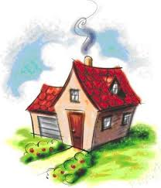
Cottage Food Vendors
Registered cottage food vendors must have a permit for a temporary food establishment if they want to sample food items at temporary events.

Slide 5
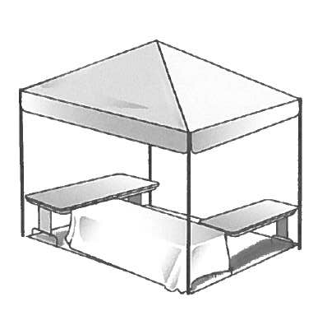
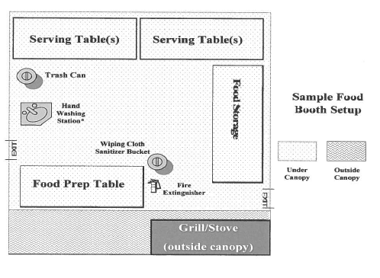
Canopy Set Up

Slide 6
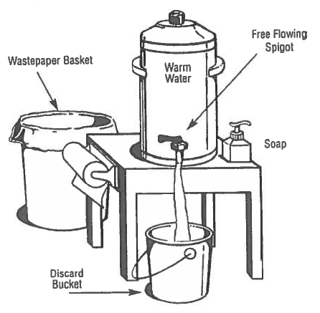
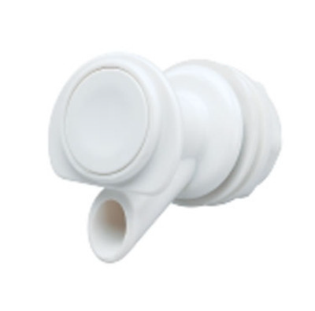


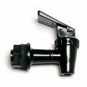
Approved Hand Wash Station
Clean Water: An adequate amount of running potable water from an approved source
Soap: A pump soap dispenser
Towels: Individual towels for drying hands
Approved Spout: Approved water dispenser with “spigot spout” (not push-button) providing continuous flow
Catch Basin: Provide watertight bucket or container to catch waste water
Approved spout
No push-button spout

Slide 7
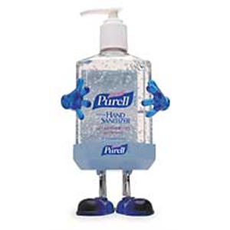
Hand Sanitizers
Hand sanitizers may be used after washing hands but does not replace hand washing with soap and water.

Slide 8
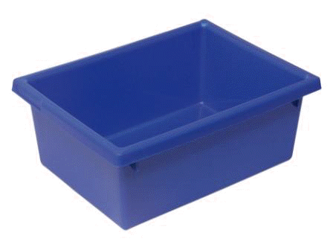
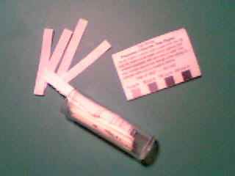
APPROVED DISHWASHING STATION
3 basins or sink compartments set-up
First basin/sink compartment (left-most) for washing - must have dishwashing soap.
Second/middle basin or sink compartment for rinsing - must use clean water.
Third basin/sink compartment (right-most) for sanitizing; e.g., a mixture of water & 50 ppm minimum to 100 ppm maximum Chlorine bleach.
Test strips
wash
rinse
sanitize

Slide 9
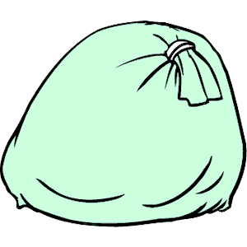
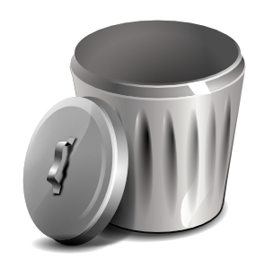
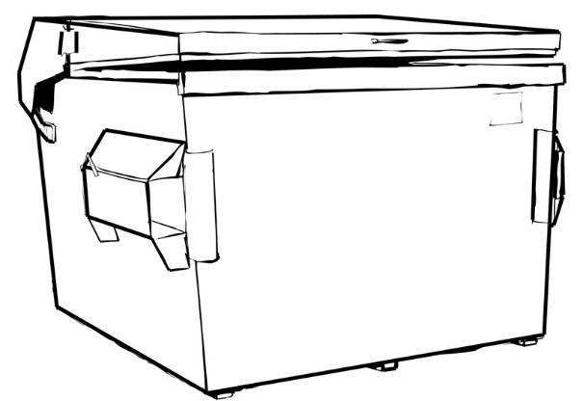
Booth Structure & Maintenance
Garbage must be secured in an approved manner.
Ensure waste receptacles are leak proof
Dispose of grease in grease receptacles

Slide 10
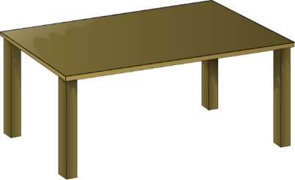
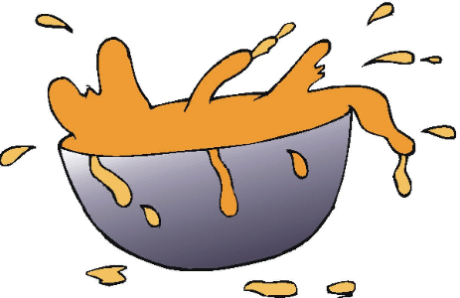
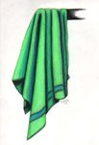

Keep Food Areas Clean
Clean regularly behind, around, and under all equipment.
Wipe up food spills immediately.
Use a
Bleach Bucket
@ 50-100 PPM Chlorine

Slide 11
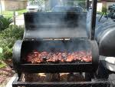
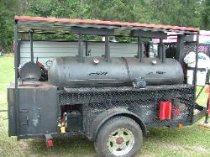
Grills
Grills need to be on smooth, nonabsorbent surfaces.
Grills should not be placed under the canopy for fire safety.

Slide 12
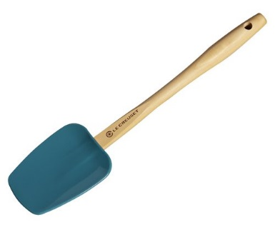
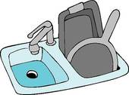
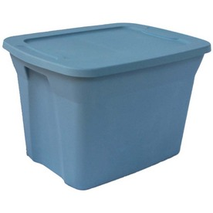
Approved Kitchen Utensils
Use Utensils shall be smooth, in good condition, easily cleanable and made of non-toxic materials.
The sink compartments and drain boards must be large enough to accommodate the largest utensil or piece of equipment to facilitate proper washing and sanitizing.
Store utensils away from dust and dirt.

Slide 13
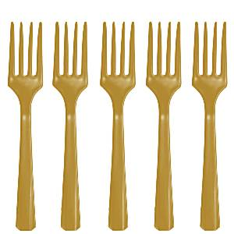
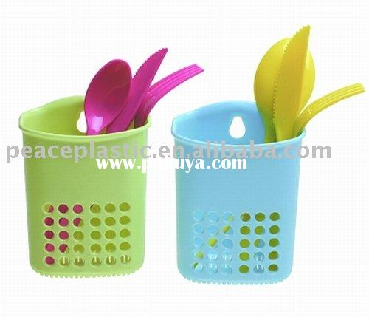
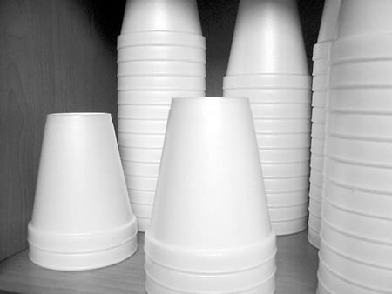
Properly Store Eating Utensils
Store forks user end down →
Store forks and spoons so that the food contact surface are protected from handling.
Store cups upside down
Store cups inside of the package

Slide 14




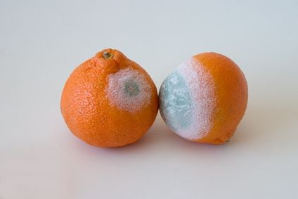
Approved Source for Food
All food items must be approved by the Health Department
Do NOT use food which was prepared at home
Do not use food that is in the Danger Zone, has an unpleasant odor, is moldy, or canned goods that are damaged or swollen.

Slide 15




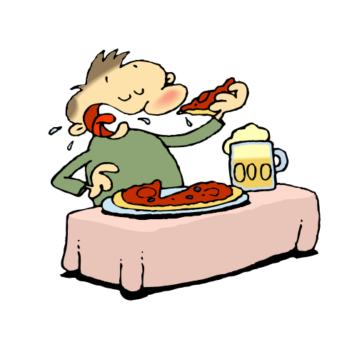
Food Handler Responsibilities
All food service workers must wear clean clothing.
Hair must be restrained by a hat and/or hairnet.
Nails must be kept clean and closely trimmed, no fingernail polish or acrylic nails are allowed.
Do not smoke, eat, or drink in food areas.

Slide 16

Hand Washing
Hands must be washed frequently
With soap and warm water for 20
seconds, then dried using only disposable paper towels.
Hand washing is to be done any time you return to the booth, before you prepare food, before putting on new gloves, when changing tasks, and as often as necessary.
Gloves & Hand Sanitizers do not replace hand washing.

Slide 17

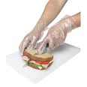
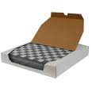
Proper Food Handling
No Bare Hand Contact with a Ready to Eat Food Items
A physical barrier must be provided between hands and Ready to Eat foods.
Gloves
Tongs
Deli tissue
Forks
Ladles

Slide 18
Using Gloves Properly
Wash hands every time you change or put on gloves.
Never reuse gloves.
When to change gloves
every time you change tasks.
every 2 hours if doing the same task.
if gloves become torn.
if moving from working with raw foods to ready to eat foods.
any time the glove becomes contaminated or at
any time you would wash your hands.

Slide 19
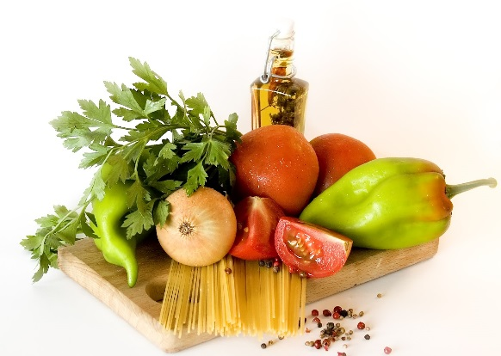
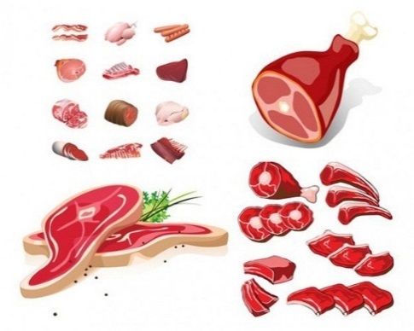
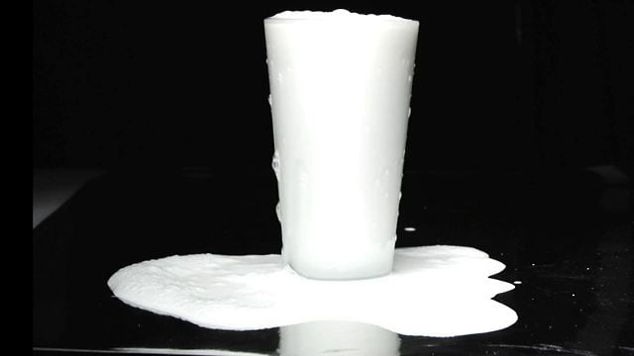
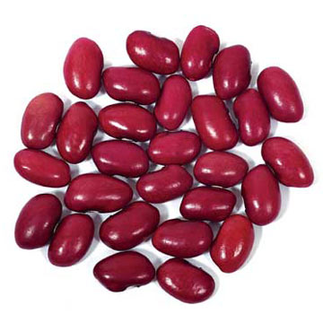
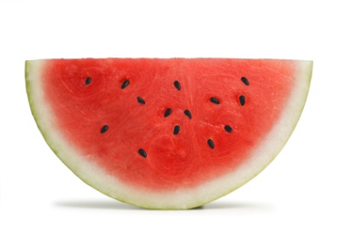
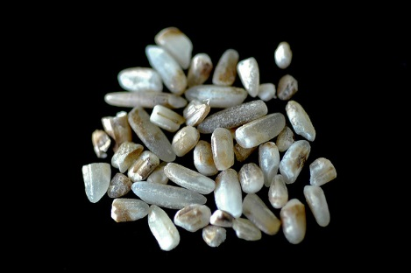
Potentially Hazardous Foods
Meat
Dairy Products
Vegetables
Rice
Beans
Sliced Fruits

Slide 20

Food Preparation and Storage
Separate Food Products
Don’t let bacteria spread from one food to another.
Keep raw meat, poultry, seafood and their juices away from other foods in your refrigerator.

Slide 21
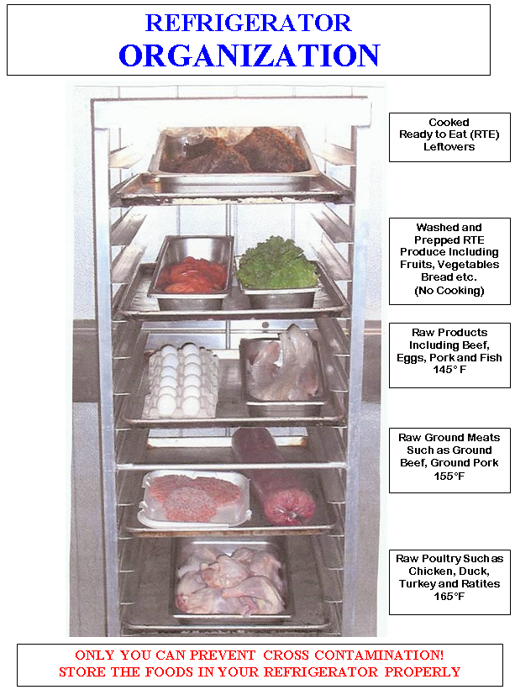
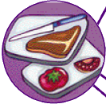
Food Preparation and Storage
If possible use a different cutting board for preparing raw meats.
If Not, Wash Between Products
Or Prepare Fish before Meat

Slide 22

Danger Zone
135 degrees F.
Danger Zone
41degrees F

Slide 23
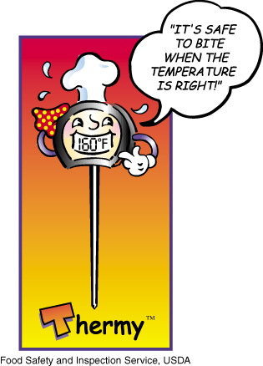
Cooking Food
Use a metal stem or digital thermometer to check internal temperatures of food to make sure that it is cooked to the proper temperature inside.
Remember different foods have to reach different temperatures
Infrared thermometers ONLY read surface temperatures.

Slide 24
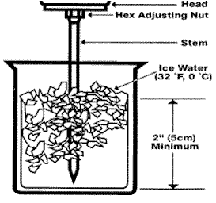
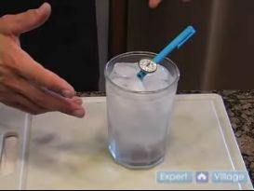
How to Check a Food Thermometer
Calibrate the thermometer using an ice bath (see picture)
►Fill an insulated cup with crushed ice and water. ►The cup must have enough crushed ice to provide an environment of 32°F, so you may need to pack more ice into the cup during the process. ► When the mixture of the water has stabilized in about four or five minutes, insert the thermometer to be calibrated to the appropriate immersion depth. ►Be sure to hold the stem of the instrument away from the bottom and sides of the container (preferably one inch) to avoid error.
► If your thermometer is not accurate within +/- 2°F of 32°F., adjust the thermometer accordingly. The ice point method permits calibration to within 0.1°F.

Slide 25
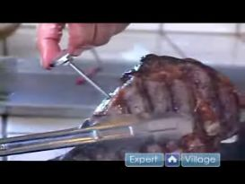
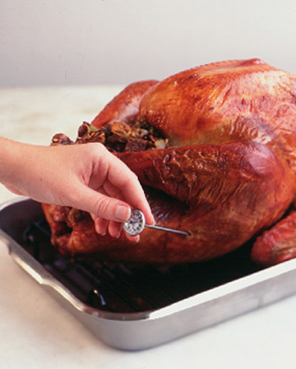
How to Use a Food Thermometer
Wash, rinse, and sanitize before and after each use.
Don't let sensor touch the sides or bottom of container.
Insert into the thickest part of the product, avoiding bone.
Wait 15 seconds to record the temperature.
Infrared thermometers do not take internal temperature and may incorporate heat generated from cooking source. They are not recommended for use.

Slide 26
Cooking Food
Cook raw foods to the correct minimum cooking temperature listed below to kill bacteria in that specific food type
Potentially Hazardous Foods | Minimum Cooking Temperature
Poultry, stuffing containing meats | 165ºF
Ground Beef (hamburger) | 155ºF
Pork and Pork products | 155ºF
All other Potentially Hazardous Foods | 145ºF
Except Rare roast beef/beef steaks | 130ºF
Make sure cooked food is safe to eat.

Slide 27
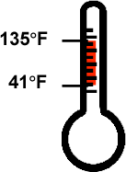


Food Preparation and Storage
Most disease causing bacteria grow faster when between 41˚F and 135˚F.
Checking food temperatures routinely is very important. If food is left in the Danger Zone for four or more hours,
throw it away!

Slide 28
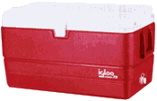
Cold Holding and Storage
Food should be keep in refrigerator or ice chest to maintain food temperature of 41○F or lower.
Transport with care. If food needs to be transported from one location to another, keep it well covered and provide adequate temperature controls. Use refrigerated trucks or insulated containers to keep cold foods cold (below 41°F) and hot foods hot (above 140°F).
Cold-holding:
41º F or less
• Packed in ice up to the rim of container or REFRIGERATED at 41º F or less.

Slide 29
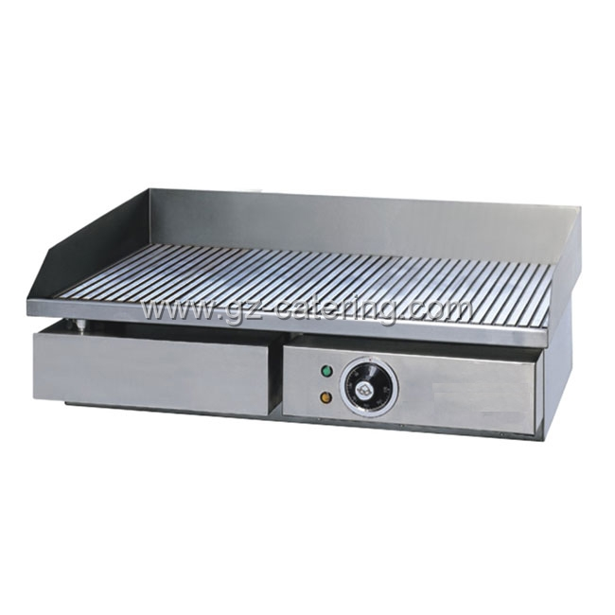
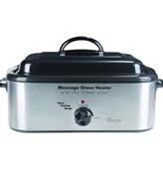
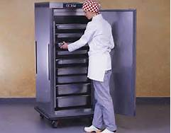
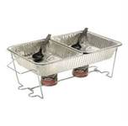
Hot Holding Methods
Hot-holding: 135º F or greater
Electric or grill
NO STERNO

Slide 30
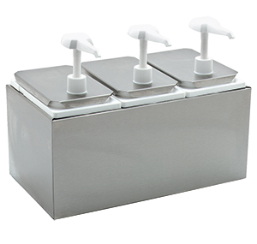
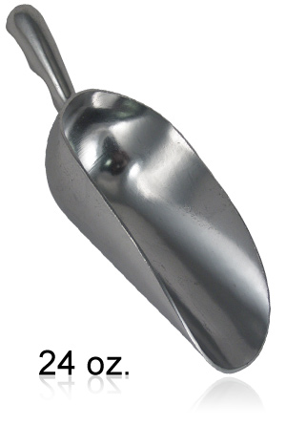
Condiments and Scoop Storage
Condiments (ketchup, mustard, mayonnaise) should come in packages or pump dispensers.
Self service items (lettuce, onions, tomato) must be covered when not for immediate service.
Ice scoops must be stored with the handle upright (in ice) or on a clean, dry surface.

Slide 31

Don’t Serve Food Sick
Stay home if you have vomiting or diarrhea

Slide 32

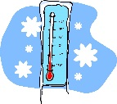
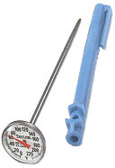



FOOD SAFETY
Keep it Clean
Keep it Hot
Keep it Cold
Cook it Thoroughly
NO bare hands
No food from an unsafe Source
No food from home
How to Keep People from becoming Ill

Slide 33

Have a Safe Food Event
If you have questions email us at: EHSCustomerService@health.nv.gov
Call your local field office:
Reno: 775-684-5280
Elko 775-753-1138
Fallon and Tonopah: 775-423-2281
Pahrump: 775-751-7436
Winnemucca: 775-623-6588
Ely: 775-289-3325

