Slide 1
Nevada’s Behavioral Health COVID-19 Response, Recovery and Resilience Plan
Stephanie Woodard, Psy.D., DHHS Senior Advisor on Behavioral Health

Slide 2
Response, Recovery and Resilience
Strengthen—and promote access to—public health, health care, and social services: Strong day-to-day systems can be better leveraged to support health resilience during disasters and emergencies. In capable systems people know how to access care and are not limited by real or perceived barriers to services.
Promote health and wellness alongside disaster preparedness: Information and education that involve public health, behavioral health, emergency preparedness, and community health resilience interventions can help people face everyday challenges as well as major disruptions or disasters. Optimal levels of physical and psychological health and well-being within the population facilitate the community’s rapid recovery.
Expand communication and collaboration: Build networks that include social services, behavioral health, community organizations, businesses, academia, at-risk individuals, and faith-based stakeholders in addition to traditional public health, health care, and emergency management partners.
Engage at-risk individuals and the programs that serve them: Engaging individuals with potential vulnerabilities to take an active part in protecting their health and aiding their community’s resilience strengthens the community as a whole. Assist programs that serve at-risk individuals to develop robust disaster and continuity of operations plans.
Build social connectedness: People are more empowered to help one another after a major disturbance in communities in which members are regularly involved in each other’s lives. Building social connectedness can be an important emergency preparedness action.
National Preparedness and Response Science Board’s Community Health Resilience Recommendations; https://www.phe.gov/Preparedness/planning/abc/Pages/community-resilience.aspx

Slide 3
Behavioral Health COVID-19 Response and Recovery Activities
The following are activities taken by Nevada Department of Health and Human Services, Division of Public and Behavioral Health:
  Collaboration with Divisions of Emergency Management
  Support providers in stabilizing services
  Promote telehealth
  Develop workforce
  Implement behavioral health prevention and early intervention
  Ensure access to services throughout the continuum
  Plan for Nevada COVID-19 Behavioral Health Recovery
  Evaluate data to determine unmet or anticipated need
  Leverage existing funding; provide flexibilities
  Apply for additional federal funding
  Liaison with providers and federal partners

Slide 4
Population Exposure Model*
Community at-large
N=1,116,114
Bereaved extended networks, First Responders N=39,646
All persons tested, family members of those positive, front line health care providers
N=313,632
Bereaved, COVID-19 positive
N=6,311
Unemployed, K-12 students, social service providers, clergy, behavioral health providers N=1,064,453
*Data retrieved May 5,2020

Slide 5
Vulnerable Populations
Individuals and families who are bereaved may have complicated bereavement due to circumstances surrounding COVID-19 Individuals awaiting testing results, required on isolation, quarantine, or hospitalized due to illness
Children, youth, adolescents, and their parents/caregivers are experiencing significant stressors following the closure of schools.
Individuals and families with economic concerns, job loss, and unemployment, economic uncertainty, homelessness, food insecurity and loss of health care insurance
Health care providers, law enforcement, emergency medical technicians, and firefighters
Ethnic minorities, especially people who are non-English speaking, or individuals who have facilitated communication needs
Tribal population
Aging population
Victims of domestic violence
Individuals with pre-existing behavioral health issues or at-risk

Slide 6
Crisis Counseling Assistance and Training
FEMA funding authorized under the Emergency Declaration
Immediate Services Program: FEMA: 60 days, beginning 4/30/2020
Regular Services Program: SAMHSA: 6 months
CCP ISP Grant Activities
  Primary
    Telephone, virtual, social media outreach
    Establishing or expanding existing helplines
    Establishing generic, branded email address
    Virtual individual support and support groups
    Print and electronic psycho-educational resources and creative ways to distribute
  Secondary
    Establish branded program presence on popular channels: Facebook, Twitter, Instagram
    Webinars or information sessions
    Broadcast information on coping and stress management

Slide 7
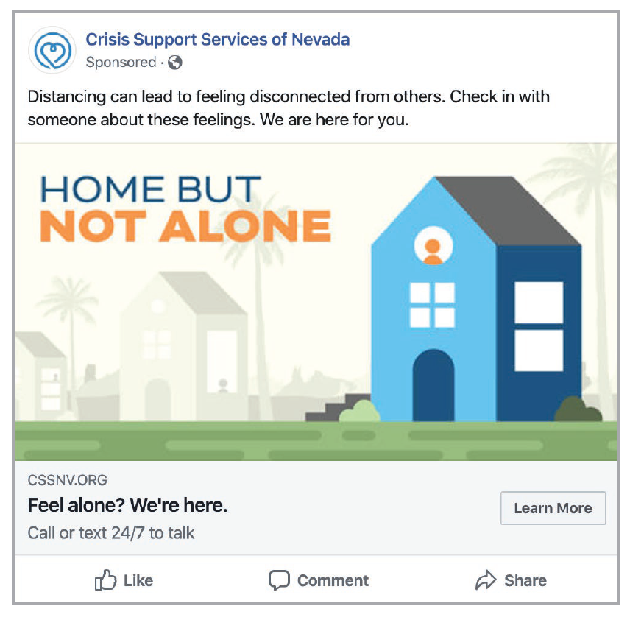
Crisis Support Services of Nevada

Slide 8
Questions?

Slide 9
Contact Information
Stephanie Woodard, Psy.D.
Senior Advisor on Behavioral Health
swoodard@health.nv.gov

Slide 10
Acronyms
CCP – Crisis Counseling Assistance and Training Program
FEMA – Federal Emergency Management Administration
ISP - Immediate Services Program
SAMHSA – Substance Abuse and Mental Health Services Administration

