Slide 1
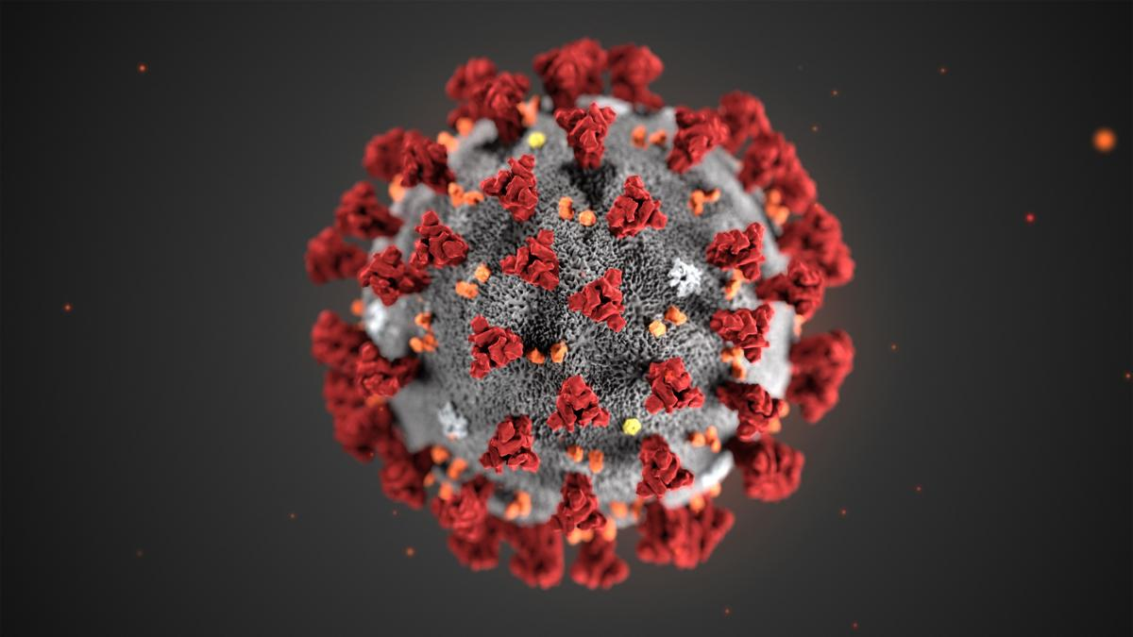
Nasopharyngeal Swab Collection for covid-19

Slide 2
LEARNING OBJECTIVE
BY THE END OF THE LEARNING ACTIVITY THE STUDENT WILL:
  BE ABLE TO GATHER EQUIPMENT NEEDED FOR TESTING;
  VERBALIZE STEPS REQUIRED FOR TESTING INCLUDING PRE AND POST PROCEDURE;
  EDUCATE PATIENTS REGARDING THE PROCEDURE AND PARTICIPATION;
  DEMONSTRATE PROPER TESTING TECHNIQUE; AND
  DEMONSTRATE PROPER HANDLING OF SPECMEN

Slide 3
Supplies Needed
Nonsterile gloves, gown, or face mask , and google or face shield⁽¹⁾ ⁽²⁾ ⁽³⁾ ⁽⁵⁾
Specimen collection kit(s) intended to detect SARS-CoV-2, including swabs with synthetic tip and plastic (not wooden) shaft⁽⁷⁾ ⁽⁸⁾⁾ ⁽⁵⁾ ⁽⁷⁾
Small sterile specimen container if collecting a sputum sample
Biohazard bag

Slide 4
Pre-Procedure Steps
Review patient's identification and review the process with them:
  Appropriate patient position and comfort
  explain process and that their may be some slight discomfort
Replace swab into the transport tube and secure
Make sure that specimen is handed off to lab technician
Follow standard pre-procedure steps, as appropriate.⁽¹²⁾

Slide 5
Procedure Steps
Use meticulous hand washing and aseptic non-touch technique throughout procedure to prevent disease transmission.
Put on a gown, gloves, face mask or, and googles or face shield in the correct order before initiating specimen collection ⁽¹⁾ ⁽²⁾ ⁽³⁾ ⁽⁵⁾
Have patient sit upright for specimen collection, if possible.
To obtain nasopharyngeal specimen (priority specimen type for diagnosis):⁽¹⁾ ⁽⁵⁾ ⁽⁷⁾ ⁽⁸⁾
  Have patient tilt their head back 70°. Use non-dominant hand to support back of head, as needed.
  Inspect nasal passages for obstruction. Avoid collecting specimen collection from an obstructed nostril.
  If there is a lot of mucus in nose, have patient wipe or blow nose because mucus can interfere with obtaining a good specimen.
  Open test kit and remove swab. Verify swab is intended for nasopharyngeal specimen collection. Do not allow swab to come into contact with any surface.
  Holding swab at score line, insert swab into nostril parallel to palate until tip is roughly at level of anterior ear.
  If resistance is met, withdraw swab slightly, elevate tip, and reinsert. Do not use force when inserting swab.
  Rotate swab several times to obtain specimen. Leave in place a few seconds to allow absorption.
  Remove swab and place in collection tube with sterile transport medium.
  Break swab at score line. Place lid on collection tube and close tightly.

Slide 6


Slide 7
PATIENT EDUCATION
Inform individual that results will be sent to both them and employer ⁽⁶⁾ ⁽⁷⁾
Evaluate person briefly for any nasal injury

Slide 8
POST-PROCEDURE
Remove gloves, goggles or face shield, and gown in appropriate order
  Discard personal protective equipment in an appropriate waste container.

Slide 9
REFERENCES
Case histories, case studies
Holshue ML, DeBolt C, Lindquist S, et al; Washington State 2019-nCoV Case Investigation Team. First case of 2019 novel coronavirus in the United States. N Engl J Med. 2020;382(10):929-936. doi:10.1056/NEJMoa2001191
Tang A, Tong ZD, Wang HL, et al. Detection of novel coronavirus by RT-PCR in stool specimen from asymptomatic child, China [published online June 17, 2020]. Emerg Infect Dis. 2020;26(2). doi:10.3201/eid2606.200301
Published guidelines
Centers for Disease Control and Prevention (CDC). Interim infection prevention and control recommendations for patients with suspected or confirmed coronavirus disease 2019 (COVID-19) in healthcare settings. https://www.cdc.gov/coronavirus/2019-ncov/infection-control/control-recommendations.html. Updated April 1, 2020. Accessed April 2, 2020.
Centers for Disease Control and Prevention. Evaluating and testing persons for coronavirus disease 2019 (COVID-19). https://www.cdc.gov/coronavirus/2019-ncov/hcp/clinical-criteria.html. Updated March 14, 2020. Accessed April 2, 2020.
Ontario Agency for Health Protection and Promotion. Coronavirus disease 2019 (COVID-19) testing. https://www.publichealthontario.ca/en/laboratory-services/test-information-index/wuhan-novel-coronavirus. Updated March 17, 2020. Accessed April 2, 2020.
The Joint Commission (TJC). National patient safety goals effective January 2020: hospital accreditation program. https://www.jointcommission.org/-/media/tjc/documents/standards/national-patient-safety-goals/npsg_chapter_hap_jan2020.pdf. Published 2020. Accessed April 2, 2020.
Public Health England. Suspected COVID-19 cases: sampling and packaging. https://assets.publishing.service.gov.uk/government/uploads/system/uploads/attachment_data/file/866632/COVID-19_Sample_Packaging_Instructions_PHE_A3_poster_12.pdf. Published 2020. Accessed March 20, 2020.
Maryland Department of Health. COVID-19 (2019 novel coronavirus) guidance. https://health.maryland.gov/laboratories/Pages/Novel-Coronavirus.aspx. Accessed April 2, 2020.
General or background information/texts/reports
World Health Organization (WHO). Q&A on coronaviruses (COVID-19). https://www.who.int/news-room/q-a-detail/q-a-coronaviruses#:~:text=symptoms. Published March 9, 2020. Accessed April 2, 2020.
Lynn, P. Laboratory specimen collection. In: Taylor’s Clinical Nursing Skills: A Nursing Process Approach. 5th ed. Philadelphia, PA: Wolters Kluwer;2019:1036-1037.
Centers for Disease Control and Prevention. Coronavirus disease 2019 (COVID-19). Frequently asked questions about laboratory biosafety and SARS-CoV-2: specimen handling. https://www.cdc.gov/coronavirus/2019-ncov/lab/biosafety-faqs.html. Updated March 19, 2020. Accessed April 2, 2020.
Food and Drug Administration. Fact sheet for healthcare providers: CDC - 2019-nCoV real-time RT-PCR diagnostic panel. https://www.fda.gov/media/134920/download. Published February 4, 2020. Updated April 2, 2020. Accessed April 2, 2020.
Published government report
European Centre for Disease Prevention and Control (ECDC). ECDC technical report: personal protective equipment (PPE) needs in healthcare settings for the care of patients with suspected or confirmed novel coronavirus (2019-nCoV). ECDC: Stockholm; 2020. https://www.ecdc.europa.eu/sites/default/files/documents/novel-coronavirus-personal-protective-equipment-needs-healthcare-settings.pdf. Accessed March 20, 2020.
Policies, procedures, protocols
Centers for Disease Control and Prevention. Sequence for putting on personal protective equipment (PPE). https://www.cdc.gov/hai/pdfs/ppe/ppe-sequence.pdf. Accessed April 1, 2020.
Yukon Health and Social Services. Nasopharyngeal swab procedure. http://www.hss.gov.yk.ca/pdf/npswab.pdf. Published October 2015. Accessed April 2, 2020.
State of Rhode Island Department of Health. 2019-novel coronavirus (COVID-19) specimen collection kit instructions. https://health.ri.gov/publications/instructions/COVID-19-Specimen-Collection-Kit.pdf. Published March 2020. Accessed April 2, 2020.
Published research (not randomized controlled trial)
Chen N, Zhou M, Dong X, et al. Epidemiological and clinical characteristics of 99 cases of 2019 novel coronavirus pneumonia in Wuhan, China: a descriptive study. Lancet. 2020;395(10223):507-513. doi:10.1016/S0140-6736(20)30211-7
Xu XW, Wu XX, Jiang XG, et al. Clinical findings in a group of patients infected with the 2019 novel coronavirus (SARS-Cov-2) outside of Wuhan, China: retrospective case series. BMJ. 2020;368: m606. doi:10.1136/bmj.m606
Smieja M, Castriciano S, Carruthers S, et al. Development and evaluation of a flocked nasal midturbinate swab for self-collection in respiratory virus infection diagnostic testing. J Clin Microbiol. 2010; 48(9):3340-3342. doi:10.1128/JCM.02235-09
Li Z, Yi Y, Luo X, et al. Development and clinical application of a rapid IgM-IgG combined antibody test for SARS-CoV-2 infection diagnosis [published online February 27, 2020]. J Med Virol. doi:10.1002/jmv.25727
Published systematic or integrative literature review
Pang J, Wang MX, Ang IYH, et al. Potential rapid diagnostics, vaccine and therapeutics for 2019 novel coronavirus (2019-nCoV): a systematic review. J Clin Med. 2020;9(3):E623. doi:10.3390/jcm9030623

