Slide 1
Clark County 2016 Antibiogram
2017 HAI Conference
Zuwen Qiu-Shultz, MPH, CPH, Epidemiologist
Office of Epidemiology and Disease Surveillance
Southern Nevada Health District
August 15th, 2017

Slide 2
Overview
Brief description of antibiogram
Demo of online Clark County 2016 Antibiogram

Slide 3
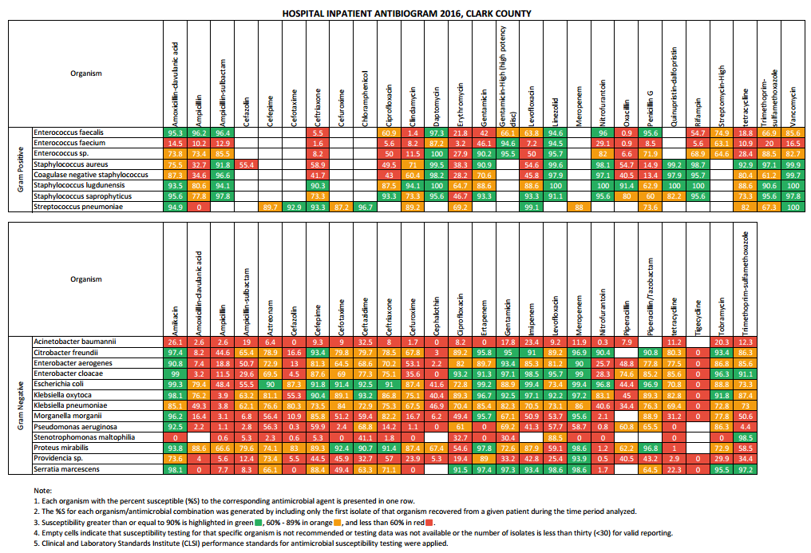
What is Antibiogram?
An overall profile of organisms’ susceptibility to a panel of antibiotics

Slide 4
Why Do We Need Antibiogram?
Problem of Antibiotic Resistance
  In U.S. 2 million people become infected with bacteria that are resistant to antibiotics, and at least 23,000 people die each year as a direct result of these infections.
Empiric Antimicrobial Treatment
Antibiotic Resistance Pattern
Antimicrobial Stewardship Program
  The Joint Commission’s Antimicrobial Stewardship Standard became effective on January 1, 2017.

Slide 5
Clark County 2016 Antibiogram
Data Source
  Inpatient and outpatient data from two healthcare system laboratories, two hospital laboratories and one commercial laboratory in Clark County
Time Frame
  January 1, 2016 to December 31, 2016
Data Inclusion Criteria
  Bacterial isolates from all sources collected for diagnostic purposes
  Final, verified test results from the first isolate per person
  Organisms with testing data for ≥ 30 isolates are included

Slide 6
Demo
http://www.southernnevadahealthdistrict.org/stats-reports/antibiogram

Slide 7

Questions? Comments?
Contact Information
Zuwen Qiu-Shultz, MPH, CPH
Epidemiologist
Office of Epidemiology and Disease Surveillance
Southern Nevada Health District
Phone: (702) 759-1300
E-mail: qiu@snhdmail.org

