Slide 1
NHSN Reporting Toolkit for
Skilled Nursing Facilities
Kimisha Causey, Jennifer Connolly, and Fathia Osman
July 24, 2023

Slide 2
2

Slide 3
Agenda
Review state and federal mandate for NHSN reporting for skilled nursing facilities (SNF).
Guide SNFs on COVID-19 and healthcare-associated infection (HAI) reporting methods within the National Healthcare Safety Network (NSHN).

Slide 4
Toolkit Material
This toolkit will provide instructions on:
Conferring rights ................................................................................................................................10
NHSN Users:
  Adding New User ....…………………………………………………………………………………………18
  Changing Facility Administrator …...……………………………………………………………23
  New Facility Enrollment .………………………………………………………………………………24
NHSN Adding Locations ...……………………………………………………………………………………………..25
COVID-19 Reporting Module …...................................................................................................29
Manual Data Entry .………………………………………………………………………………………………………..41
Weekly HCP & Resident COVID-19 Vaccination Reporting………………………………..45
Healthcare Personnel Safety Module (HPS-Vaccinations).........................................51
Long-Term Care Module (LTC- HAI’s)......................................................................................59
UTI, MDRO, and CDI Event Reporting.....................................................................................63
Summary Reporting..........................................................................................................................72
Internal Data Validation …..............................................................................................................80
Helpful Links……………….…....................................................................................................................88

Slide 5
State Mandate
As of Jan. 1, 2015, SNFs are required to report all healthcare acquired catheter associated urinary tract infections (CAUTI) into the NHSN according to NAC 439.935.
As of Jan. 1, 2016, SNFs are required to report all Clostridium difficile (CDI) also known as Clostridioides difficile infections into NHSN.
As of Oct. 1, 2016, SNFs are required to report all healthcare worker vaccination rates into the Healthcare Personnel Safety Module within NHSN.

Slide 6
State Mandate
According to NRS 439.847, each medical facility and SNF which provided medical services and care to an average of 25 or more patient in the immediately preceding calendar year shall within 120 days after becoming eligible report into the NHSN.
According to NAC 439.925, to determine whether a SNF provides medical services and care to an average of 25 or more patients during each business day in the immediately preceding calendar year:
  Divide the sum of the daily censuses of patients during the preceding calendar year by 365.

Slide 7
State Mandate
All mandatory reporters must confer rights with the state for their data to be viewable.
All SNFs are responsible for submitting the following monthly:
  COVID-19 data into the COVID-19 module
  HAI data into the LTC Module (reporting plans, events, and summary reports)
The state recommends facilities that are not mandatory reporters according to NAC 439.847 confer rights as well.
Conferring rights allows the state to:
  View data entered into NHSN
  Assist with reporting errors
  Provide state data on infections reported and vaccination rates

Slide 8
Federal Mandate
The Centers for Medicare and Medicaid Services (CMS) published a final rule in the Federal Register for the CMS Skilled Nursing Facility Quality Reporting Program (QRP) requirements on August 3, 2022, that included healthcare personnel (HCP) influenza vaccination summary data reporting from SNFs via the NHSN beginning with the 2022-2023 influenza season.
Centers for Medicare and Medicaid Services (CMS) released an Interim Final Rule May 1, 2020, which required all Medicare and/or Medicaid-certified nursing homes to report information about COVID-19 at least weekly to the CDC Long-Term Care Facility Module in the NHSN.

Slide 9
Federal Mandate
On May 11, 2021, CMS published an additional interim final rule with comment which described requirements for CMS-certified nursing homes to report weekly COVID-19 vaccination data to NHSN for both residents and staff and therapeutics treatment information for residents.
Reporting requirements for vaccination went into effect on June 14, 2021.

Slide 10
Conferring Rights
Conferring rights with the state group allows the state to view the data submitted into NHSN by each health care facility.
Even if a facility enters its monthly data, if it has not conferred rights the state cannot review the information and the facility will be out of compliance with the state law.

Slide 11
Conferring Rights
Data that is made accessible to the state is for viewing purposes only.
Data cannot be edited or deleted by the state.

Slide 12
Conferring Rights
To confer rights, follow the steps below:
Log into your account and click NHSN reporting.
Select the Long-Term Care Facility (LTCF) module/component on the landing page then click submit. Then follow the steps on slide 13.
Select the Healthcare Personnel Safety (HPS) module/component on the landing page then click submit. Then follow the steps on slide 13.

Slide 13
Conferring Rights
Click Group > confer rights
Enter Group ID: 15183
Enter Group Joining Password: NSHDj0in (the o in join is a zero) > click join group
Click ok on the small box > click accept at the bottom of the screen.

Slide 14
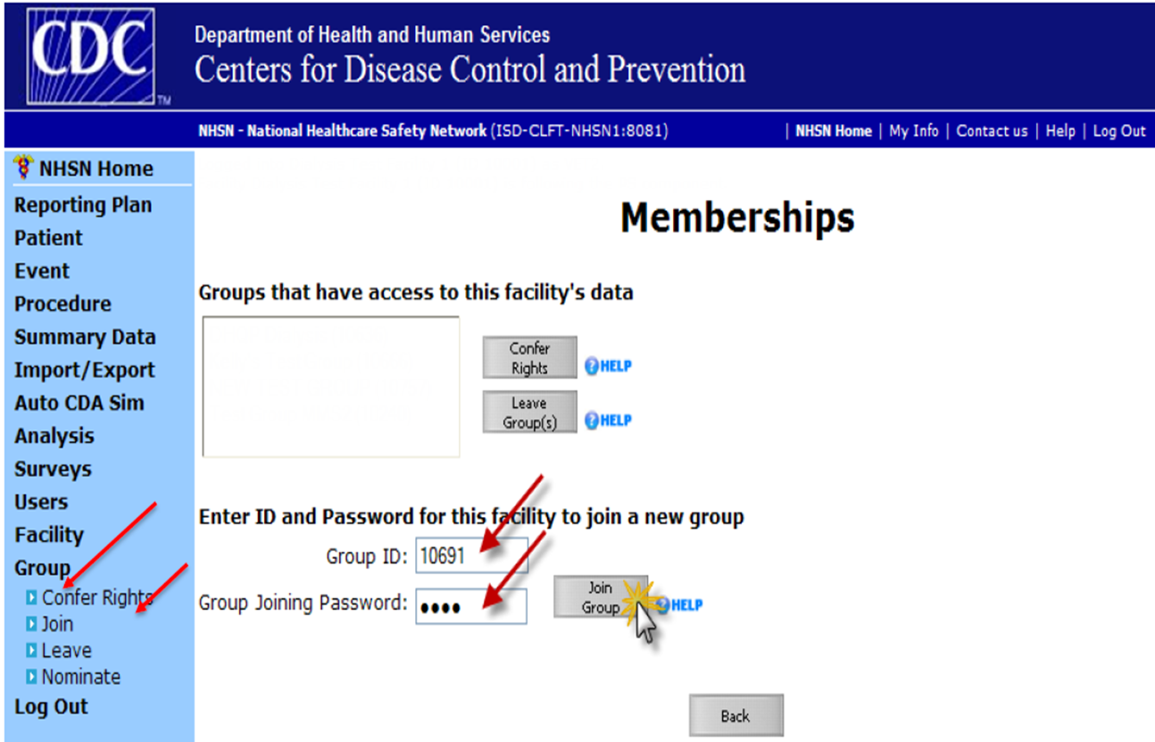
Conferring Rights

Slide 15
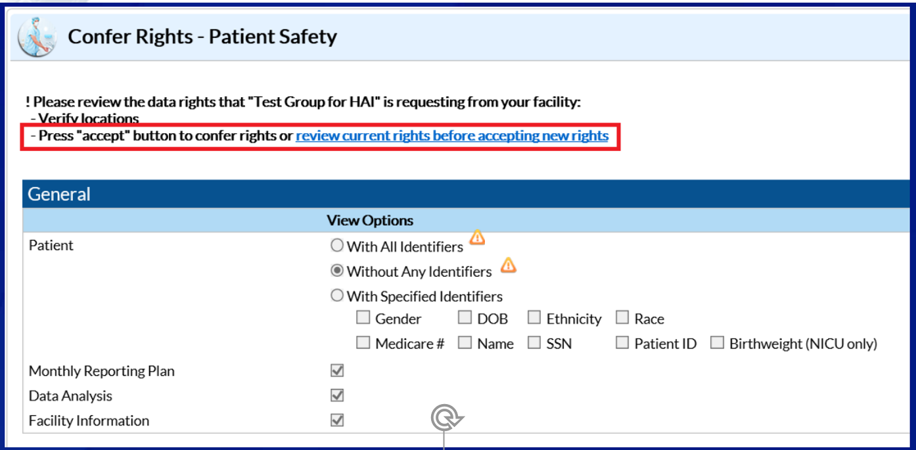
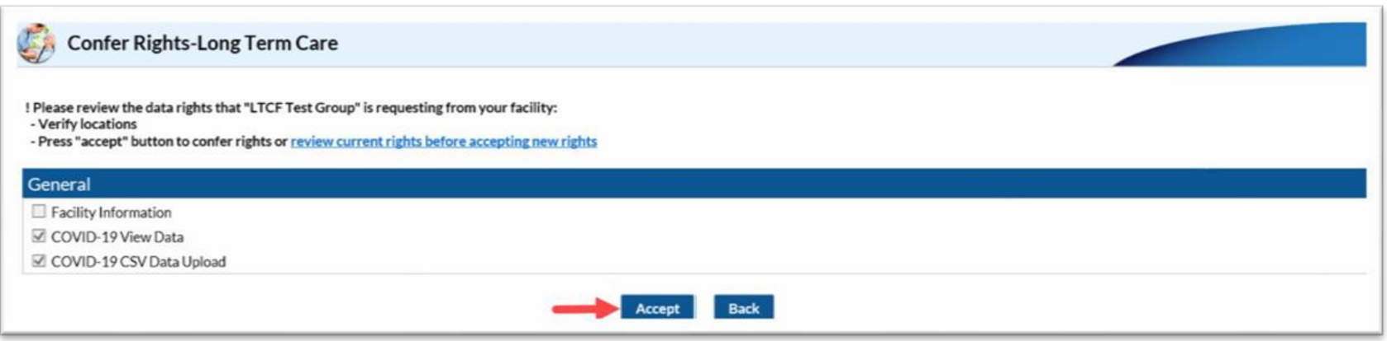
Conferring Rights

Slide 16
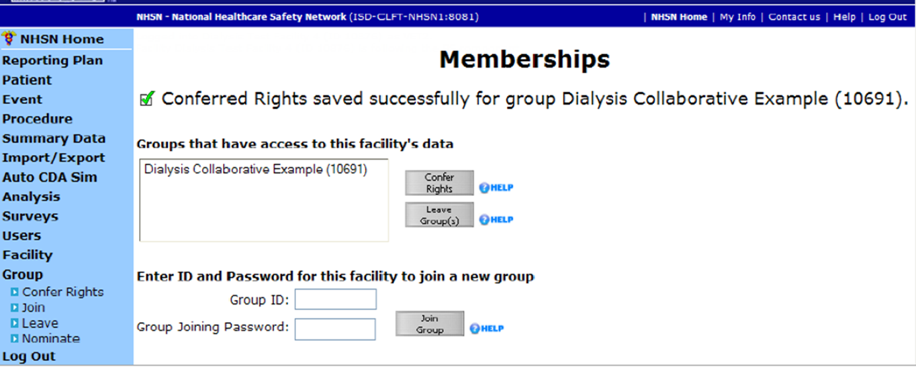
Conferring Rights
After you click “accept” you will see the following screen saying you have conferred.

Slide 17
NHSN Users

Slide 18
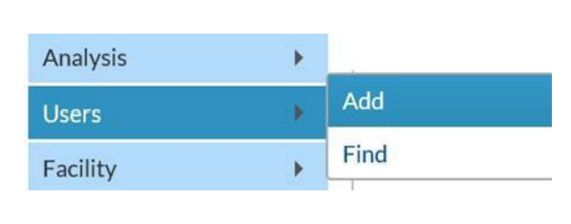
NHSN Adding New User
If you have never had access to NHSN, someone with administrator access to your facilities NHSN account will need to “Add a New User.” Instructions can be found online here.
To Add Users:
The NHSN Facility Administrator will log into SAMS at https://sams.cdc.gov/ to access NHSN.
On the left-hand navigation panel of the NHSN homepage - near the bottom of the screen, select >Users>>Add.
When the Add User screen appears, complete all the required fields marked with an asterisk (*).
  Create a username (ex. first initial and last name - ASmith)
    Can have up to 32 characters or numbers
    Cannot be an email address
    Cannot contain any special characters (i.e. %, $,&, etc.)
The NHSN User ID is a unique identifier used to identify users in the NHSN application, that is created by the NHSN Facility Administrator.*
  The email address entered must be the same one used to request their SAMS invitation.

Slide 19
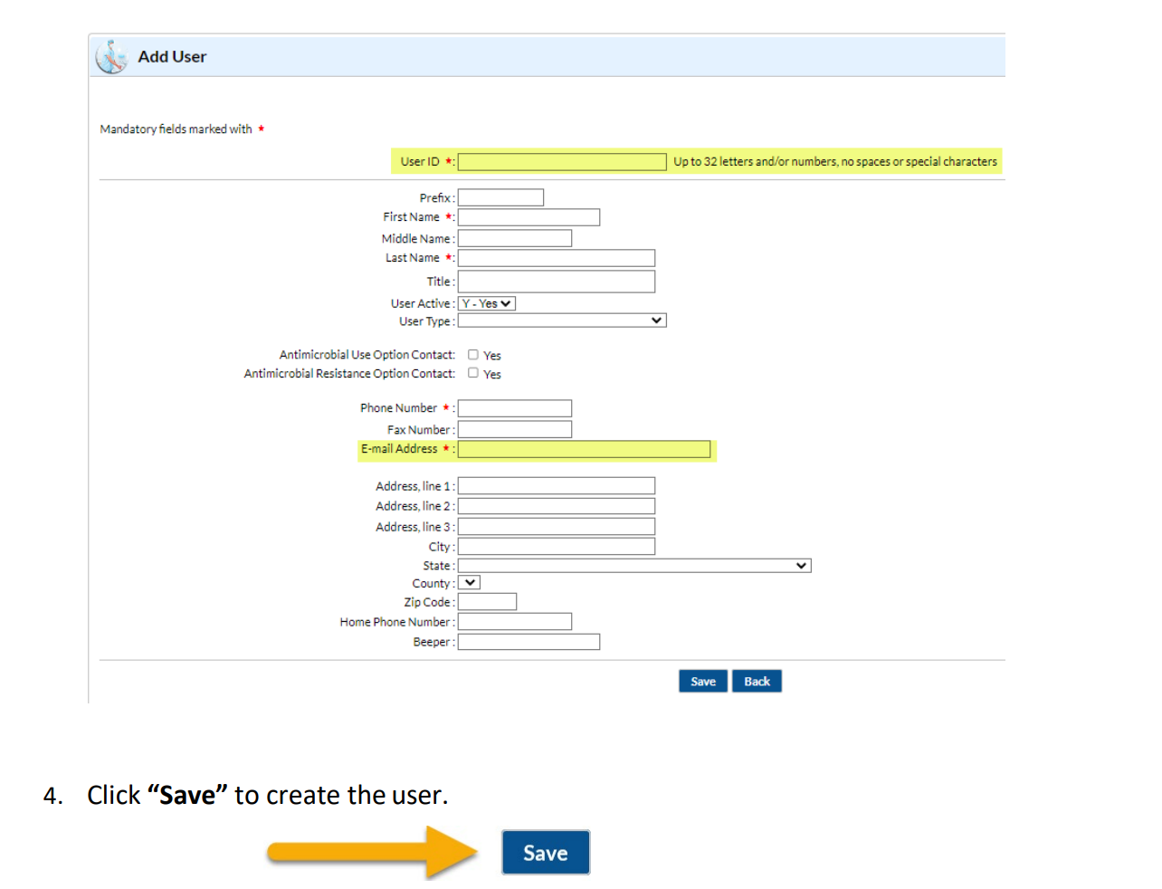
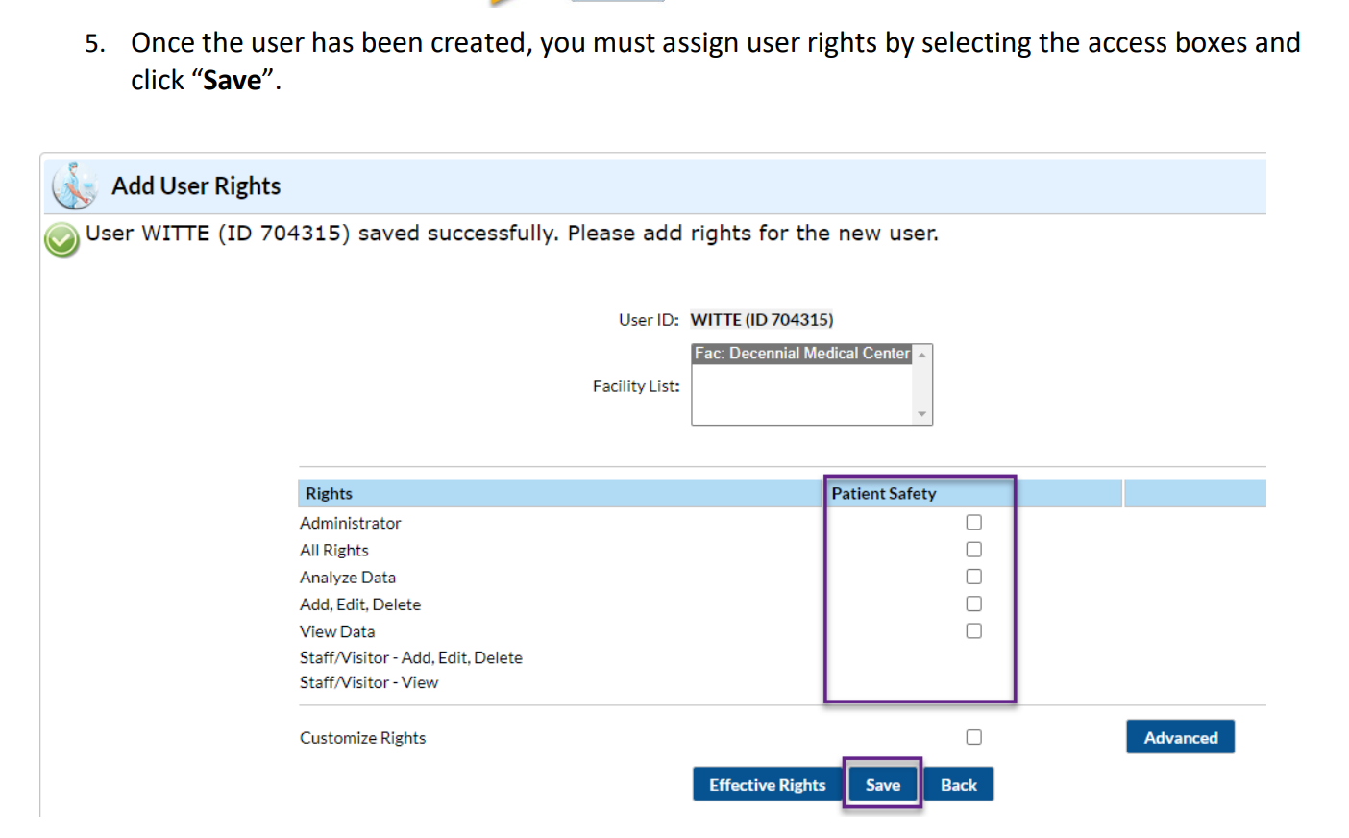
NHSN Adding New User

Slide 20
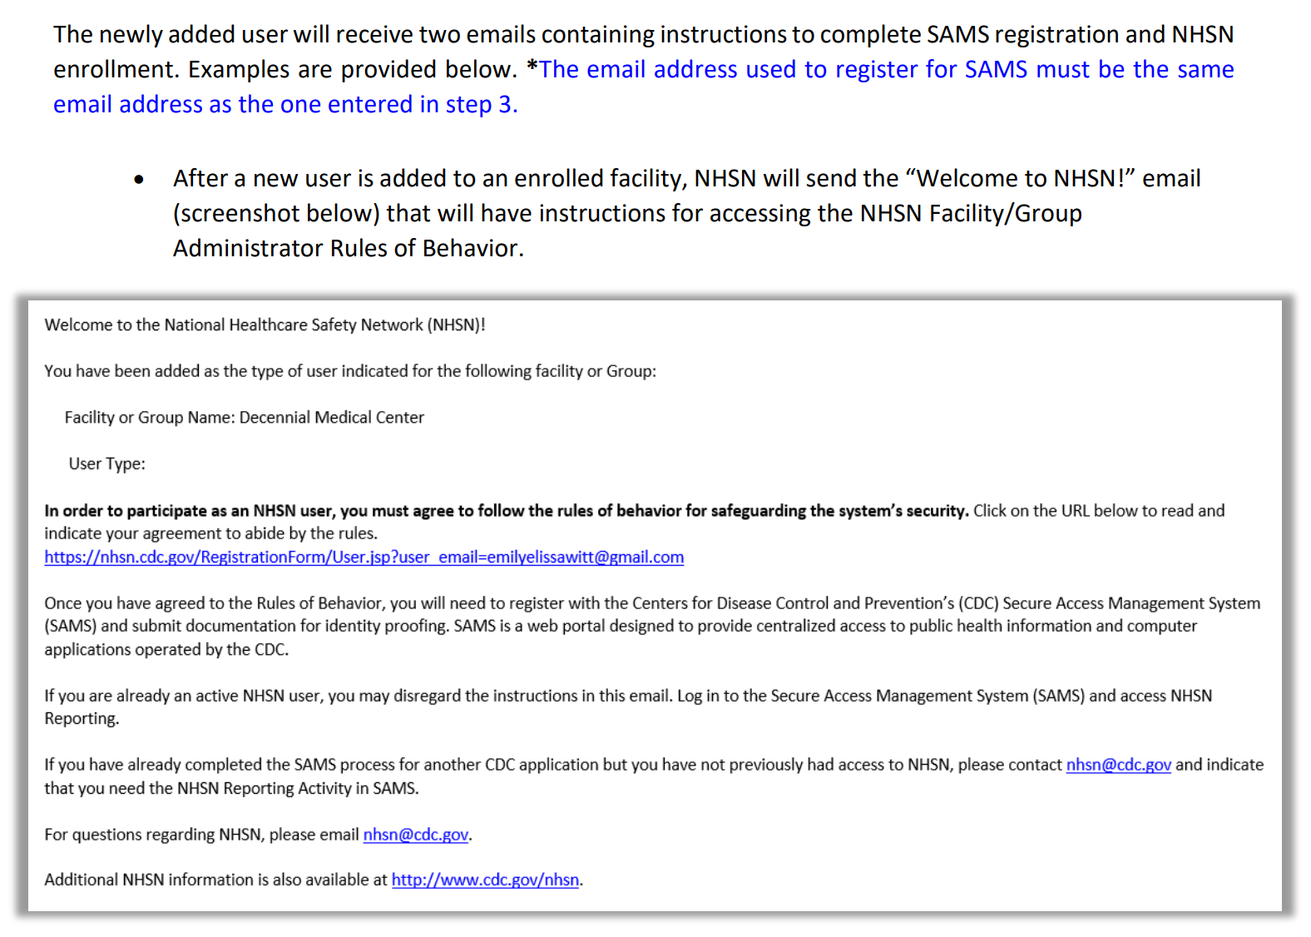
NHSN Adding New User

Slide 21
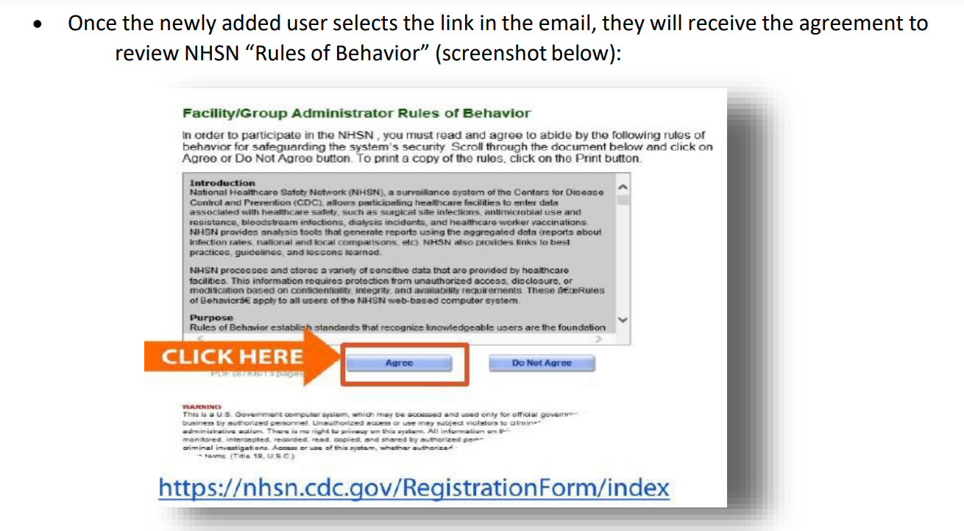
NHSN Adding New User

Slide 22
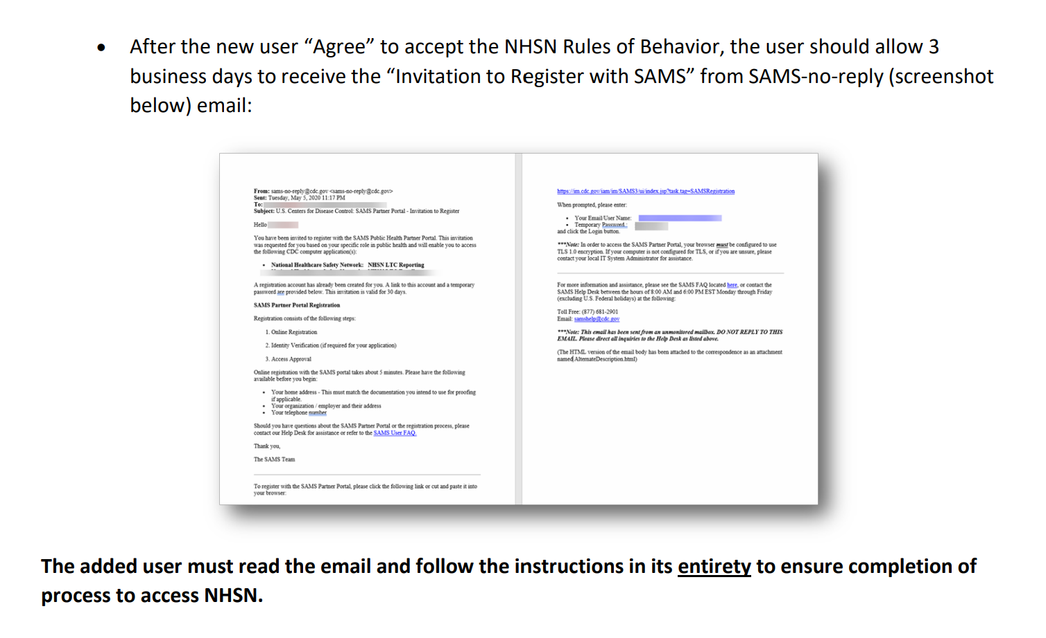
NHSN Adding New User

Slide 23
Changing NHSN Facility Administrator
If your NHSN administrator leaves, you will need to reassign this role to another person.
To reassign and administrator use the link below and complete the required information on the page.
Change NHSN Facility Administrator | NHSN | CDC

Slide 24
NHSN New Facility Enrollment
If the facility is new and has never had access to NHSN, use the instructions linked here about enrolling in NHSN.

Slide 25
NHSN Adding Locations

Slide 26
NHSN Adding Locations
Locations must be added before an event can be reported.
Location names are created based on the type of care patients/residents receive on the units.
When an event is reported the form will ask for the “Resident Care Location” the names in the dropdown box will reflect the locations created.
Log into your account and click NHSN reporting.
Select the LTC module/component and your facility name on the landing page then click submit.
Select Facility > Locations > Add.
Carefully review the resident population for the unit because once you have selected a CDC location description to go with “Your Code” it cannot be changed.

Slide 27
NHSN Adding Locations
Click on the CDC location first and select the type of care that matches 80% of the type of care residents/patients receive on the unit.
Your Code: a name you create for the units that describe the care patients receive for the unit in your facility.
Your Label: a name you create for the units in your facility that describes the care patients receive for the unit.
CDC Location Description: select the name that most closely describes the care patients receive from the unit.
Status: Active.
Bed size: should include the number of beds on the unit that are set up and staffed.
When all fields are completed, click “Add.”
Repeat the process until you have added all the locations in your facility.

Slide 28
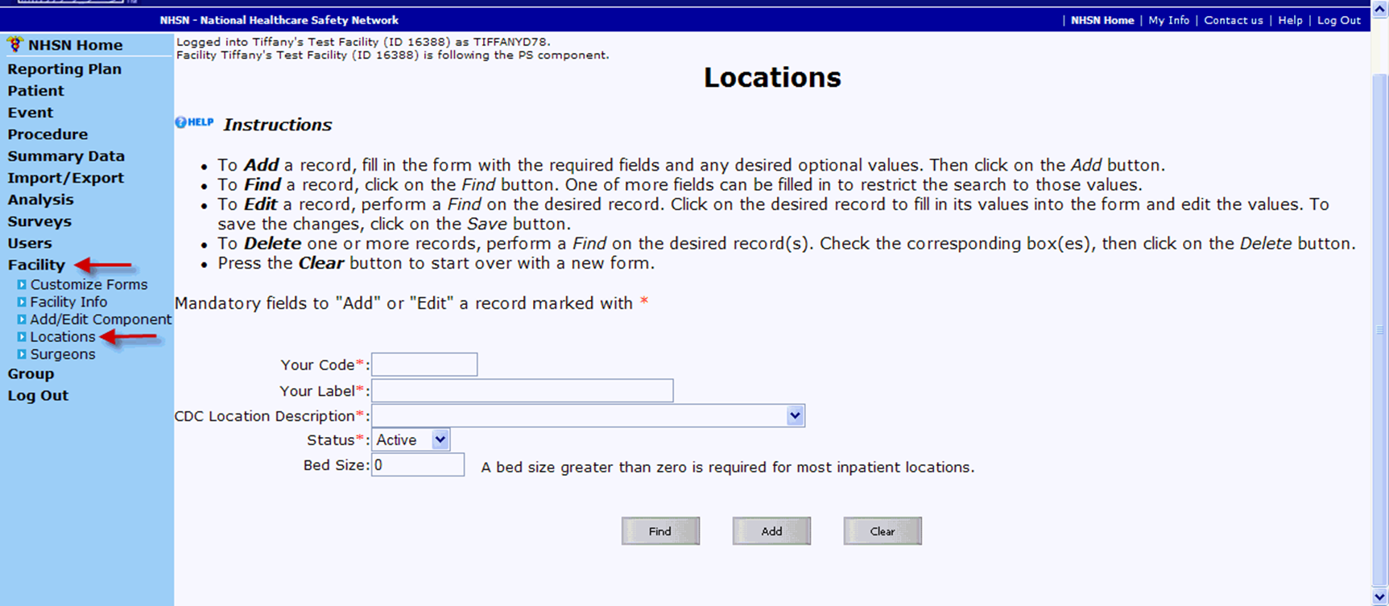
NHSN Adding Locations

Slide 29
COVID-19 Reporting Module

Slide 30
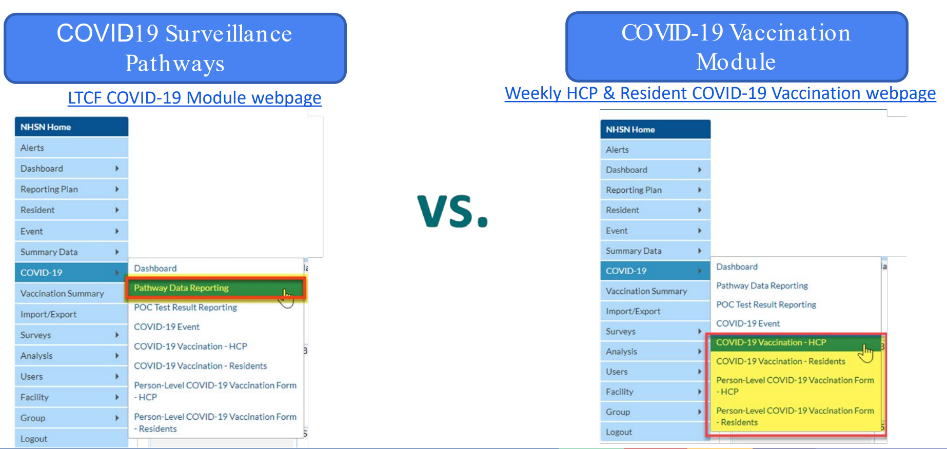
COVID-19 Surveillance Pathways vs COVID-19 Vaccination Module

Slide 31
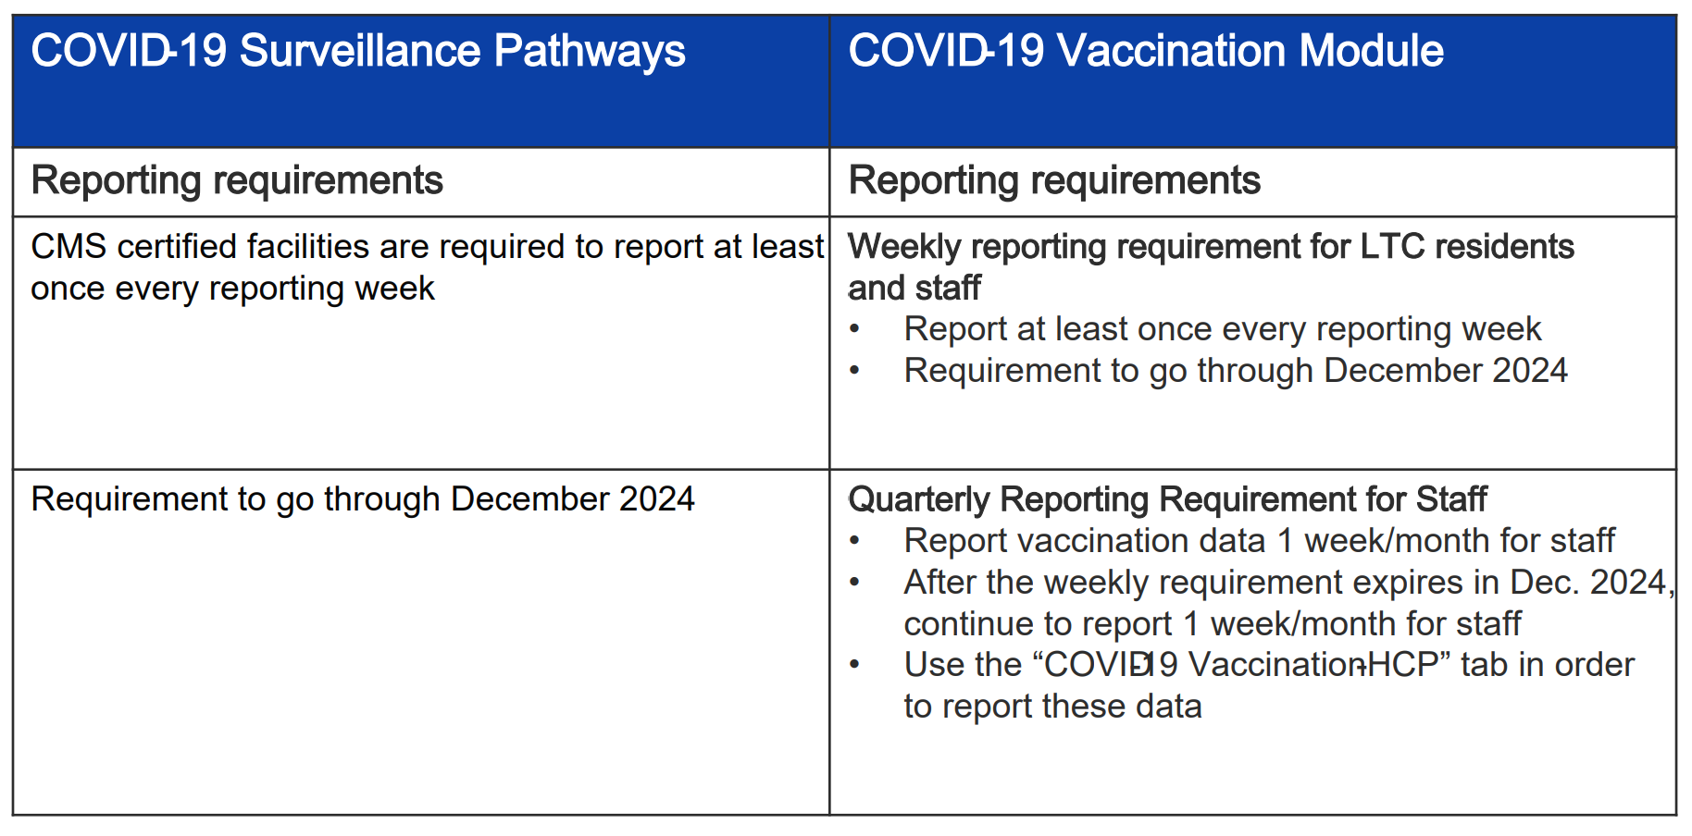
COVID-19 Surveillance Pathways vs COVID-19 Vaccination Module

Slide 32
LTCF COVID-19 Module: Surveillance Pathway Updates from June 3, 2023
https://www.cdc.gov/nhsn/pdfs/covid19/ltcf/NHSN-COVID-19-11.4-updates-for-May-30th-recording-final.pdf

Slide 33
Surveillance Pathway Data Reporting
Options for Reporting Data to NHSN: CSV Import and Manual

Slide 34
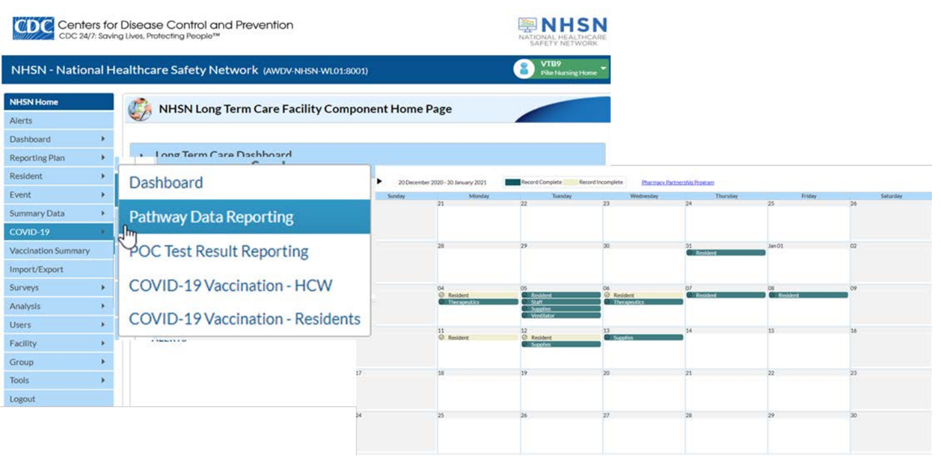
NHSN Home Page > COVID-19 > Pathway Data Reporting > Calendar View Opens

Slide 35
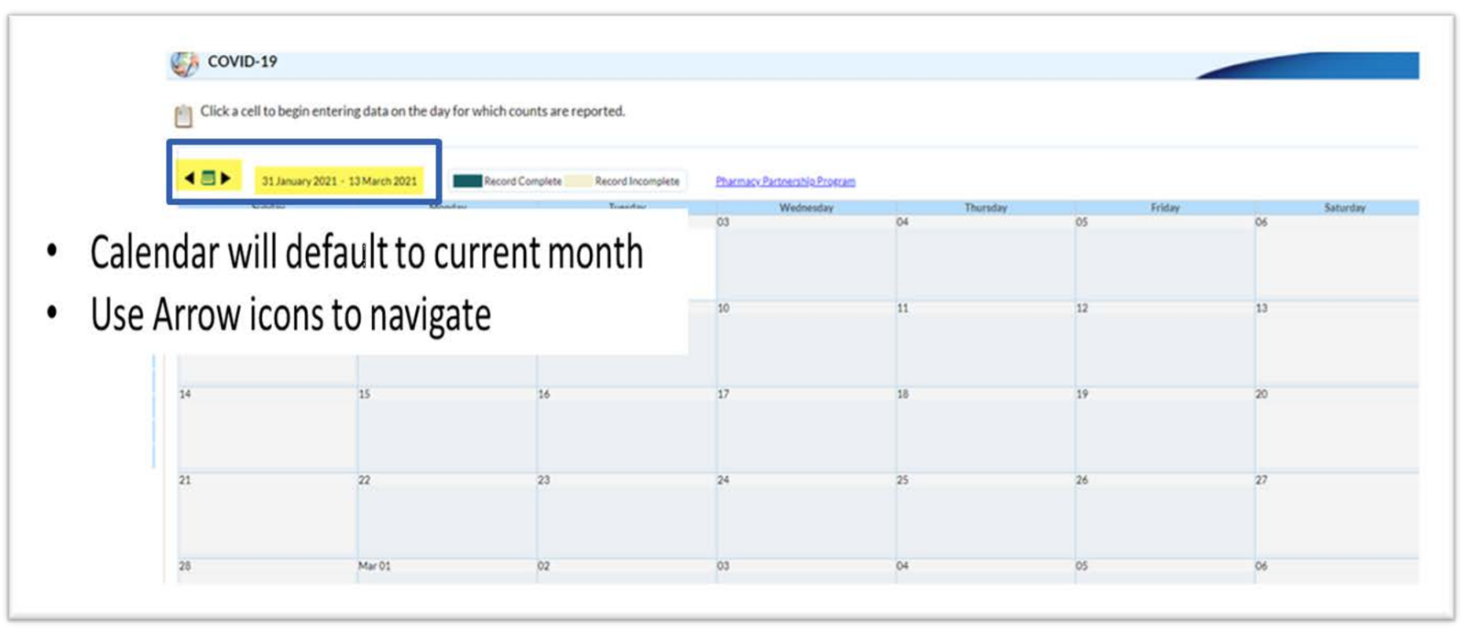

Use Arrow Icons to Navigate Dates

Slide 36
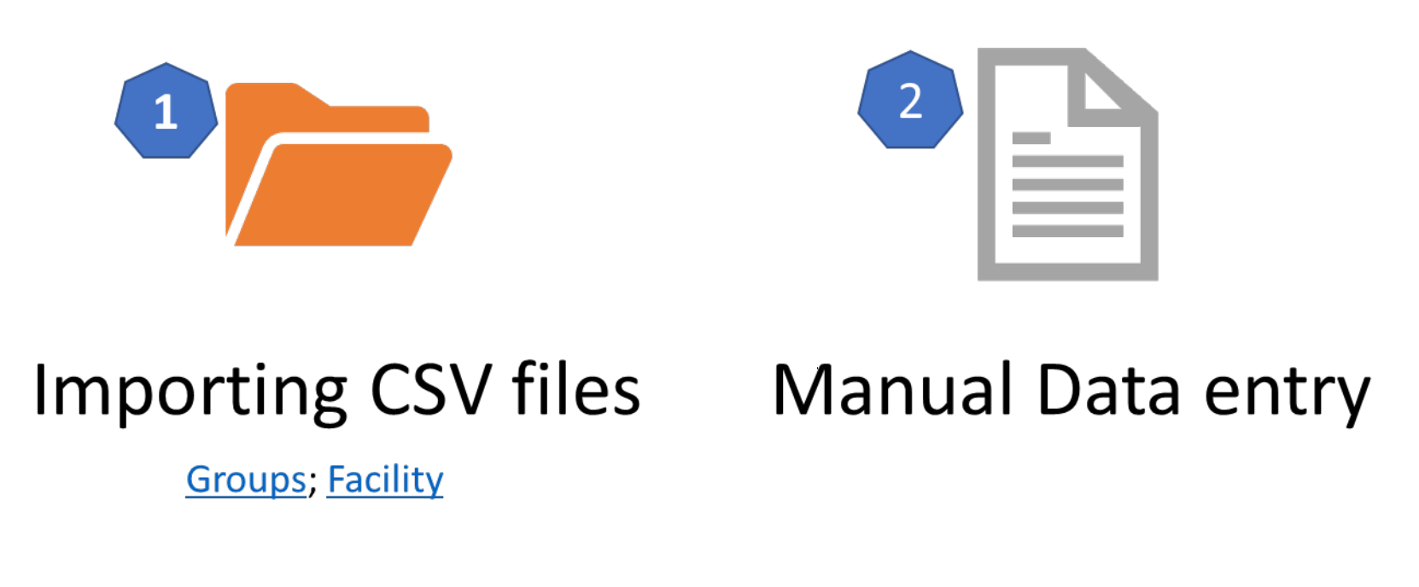
Options for Surveillance Pathway Data Reporting

Slide 37
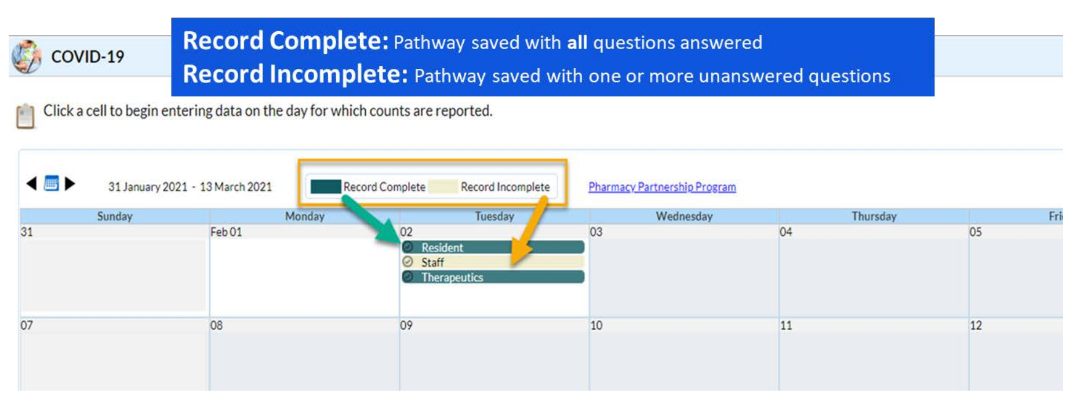
Each Saved Pathway will be Highlighted as Complete or Incomplete

Slide 38

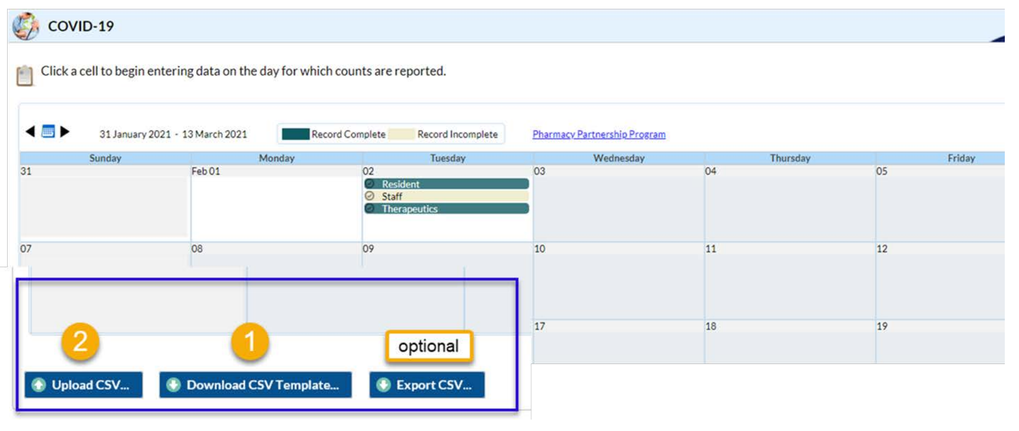

Import and Export Options

Slide 39
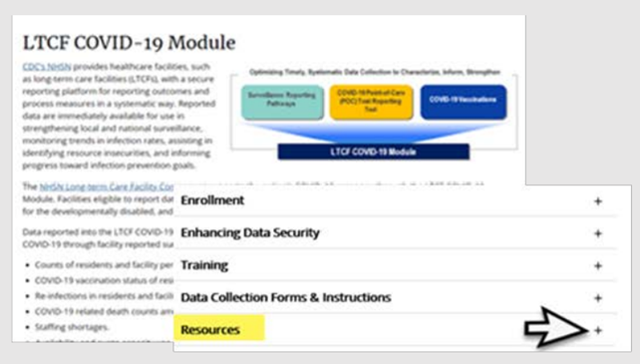
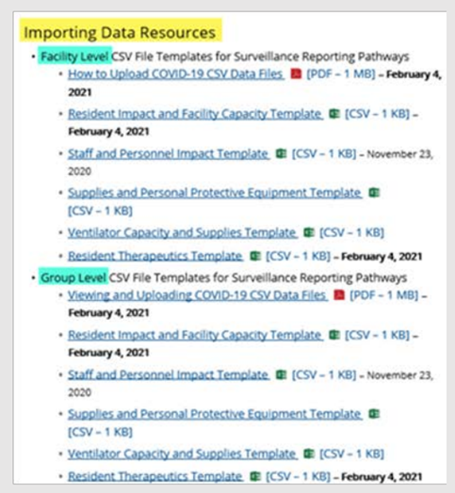
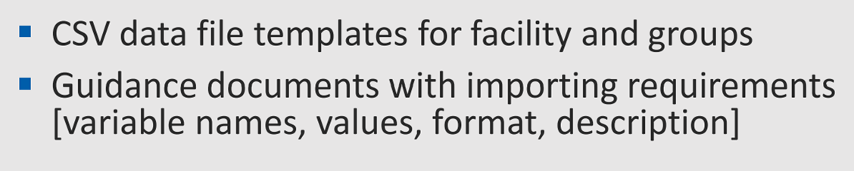
Resources for Importing Data
Visit NHSN LTCF COVID-19 Module web-page

Slide 40
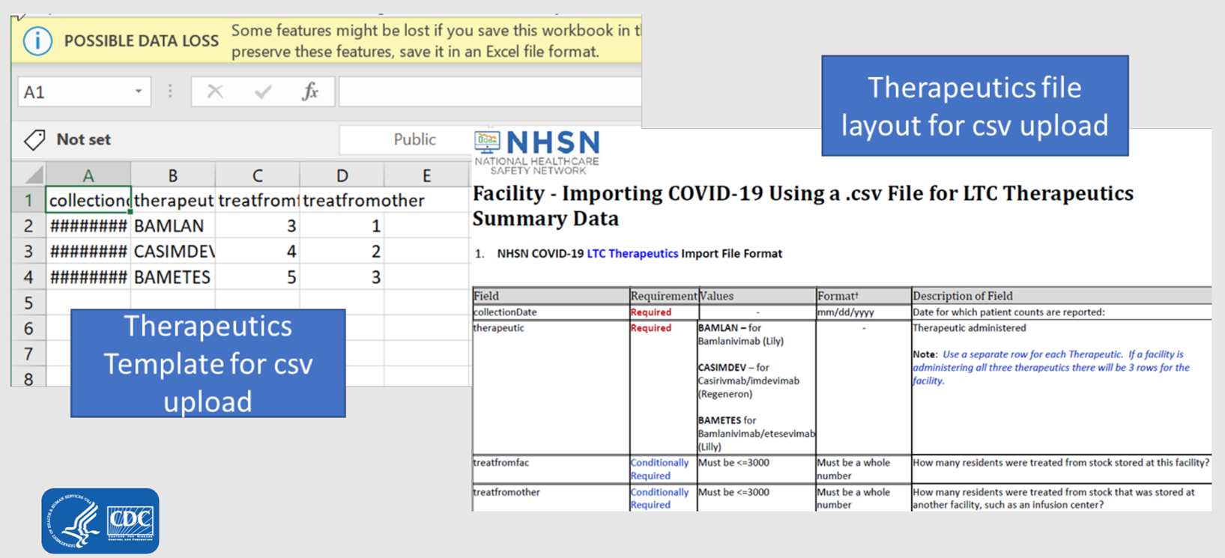
CSV Template and File Layout for CSV Upload

Slide 41
Manual Data Entry
Resident Impact and Facility Capacity Pathway
NHSN COVID-19 Module

Slide 42
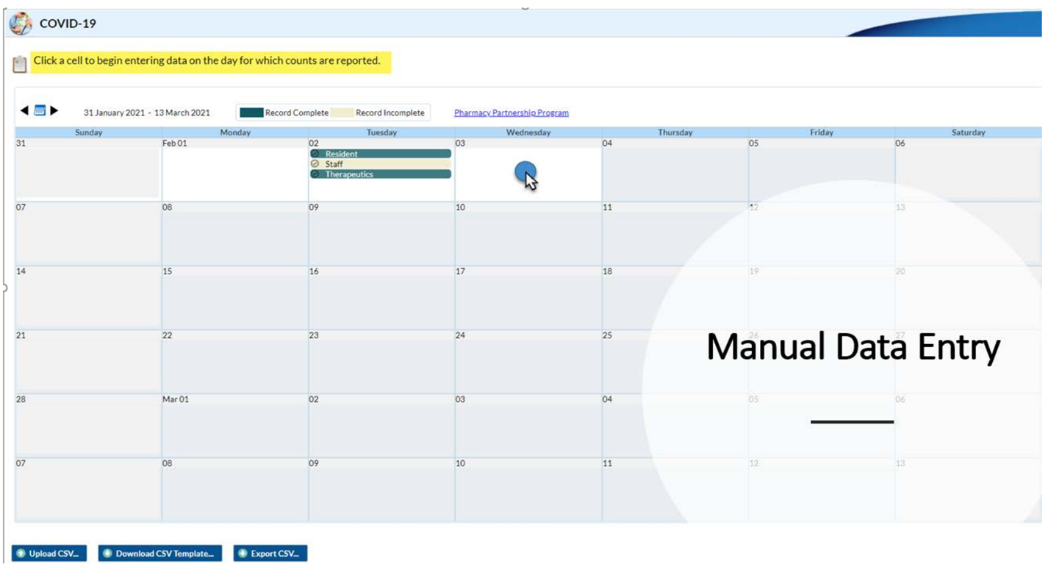
Manual Data Entry

Slide 43
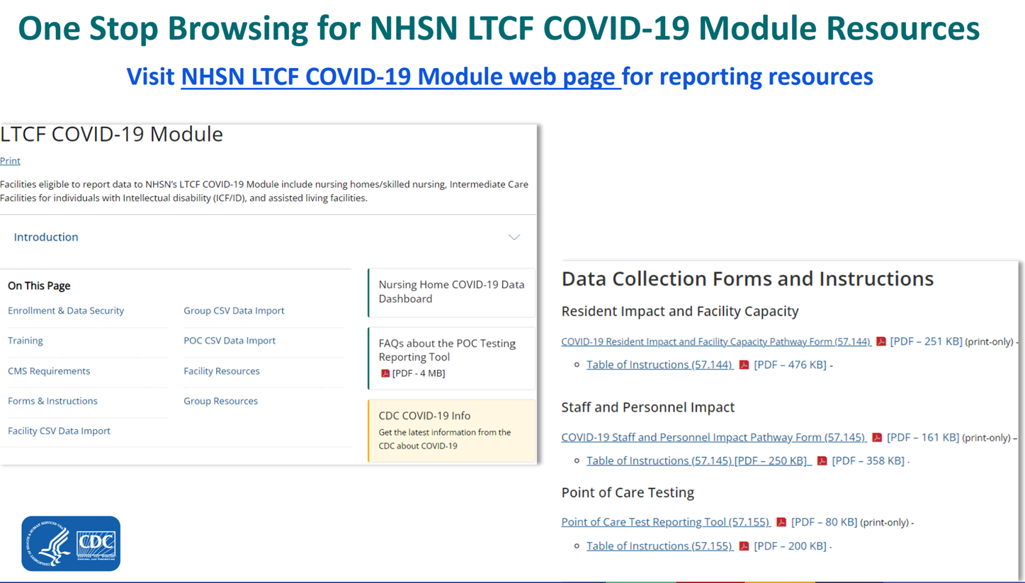
LTCF COVID-19 Module Resources

Slide 44
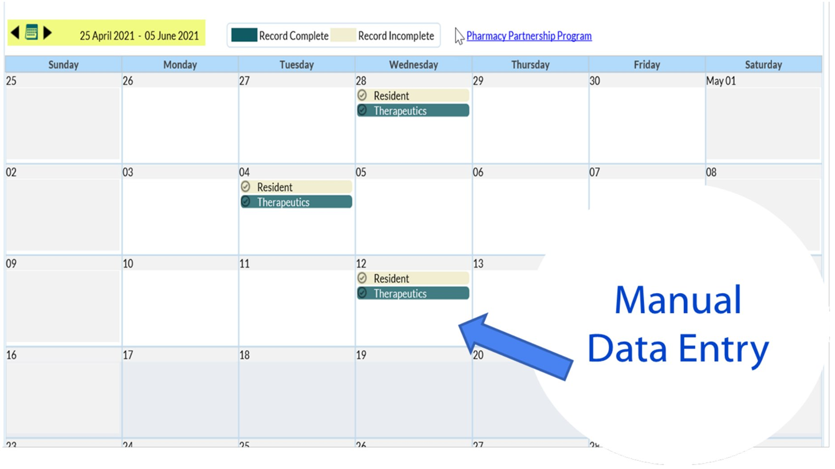
Use Arrow Icons to Navigate Dates

Slide 45
Weekly HCP and Resident COVID-19 Vaccination Reporting

Slide 46
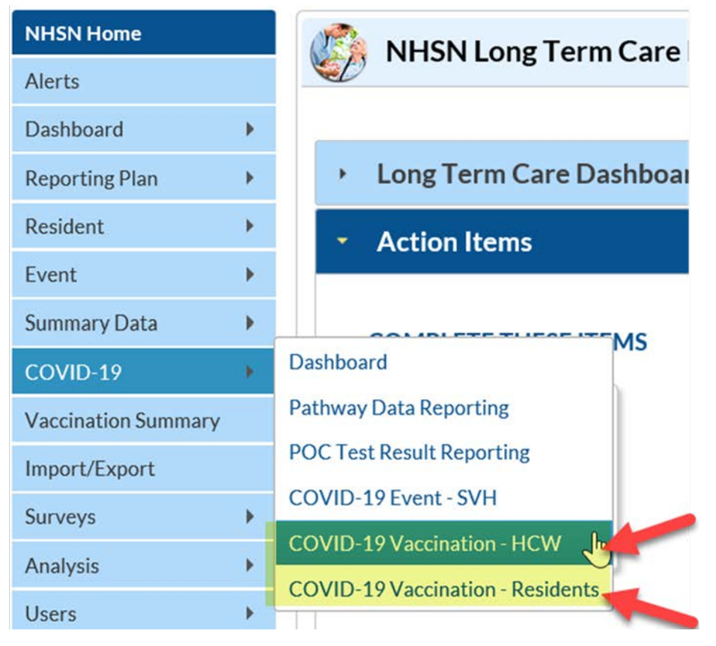

How to Access the COVID-19 Vaccination Modules in NHSN

Slide 47
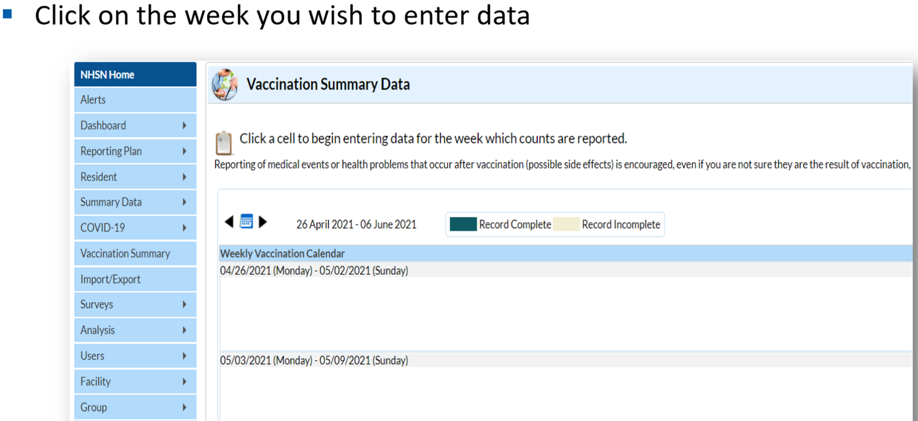
Calendar Week

Slide 48
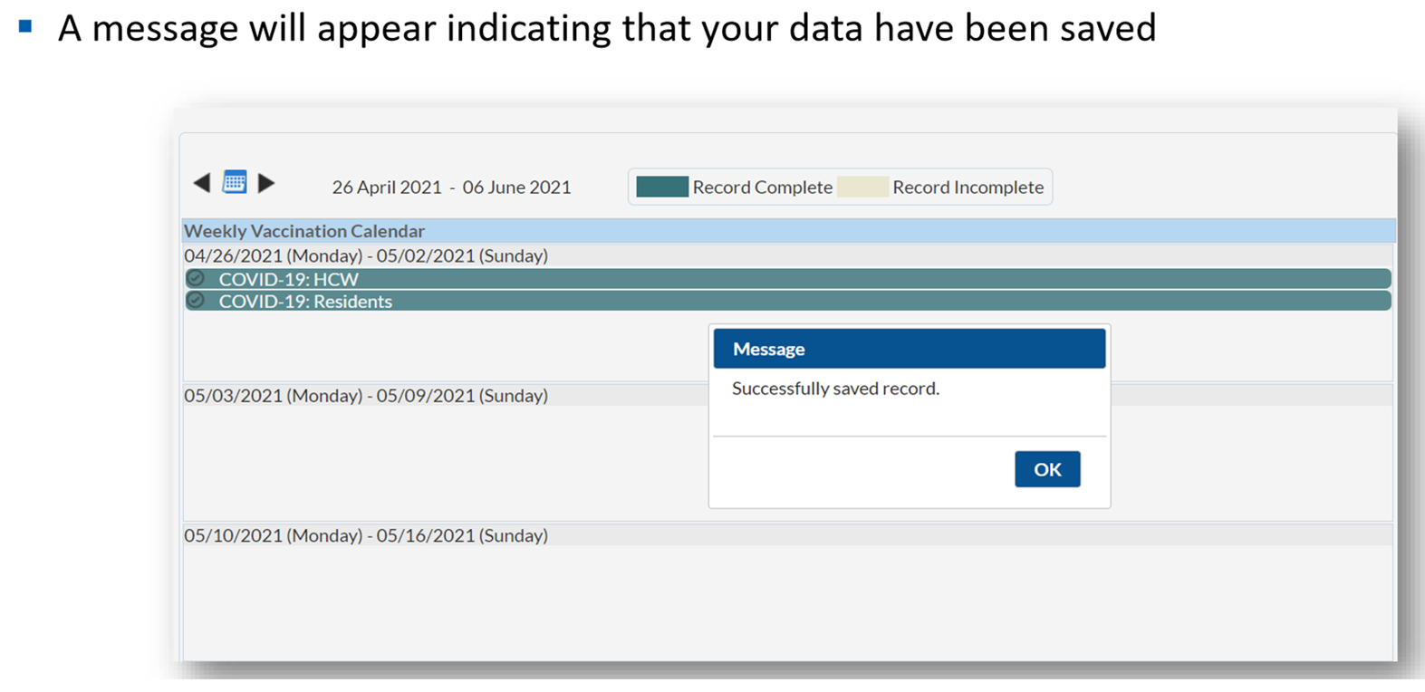
Saving COVID-19 Vaccination Data

Slide 49
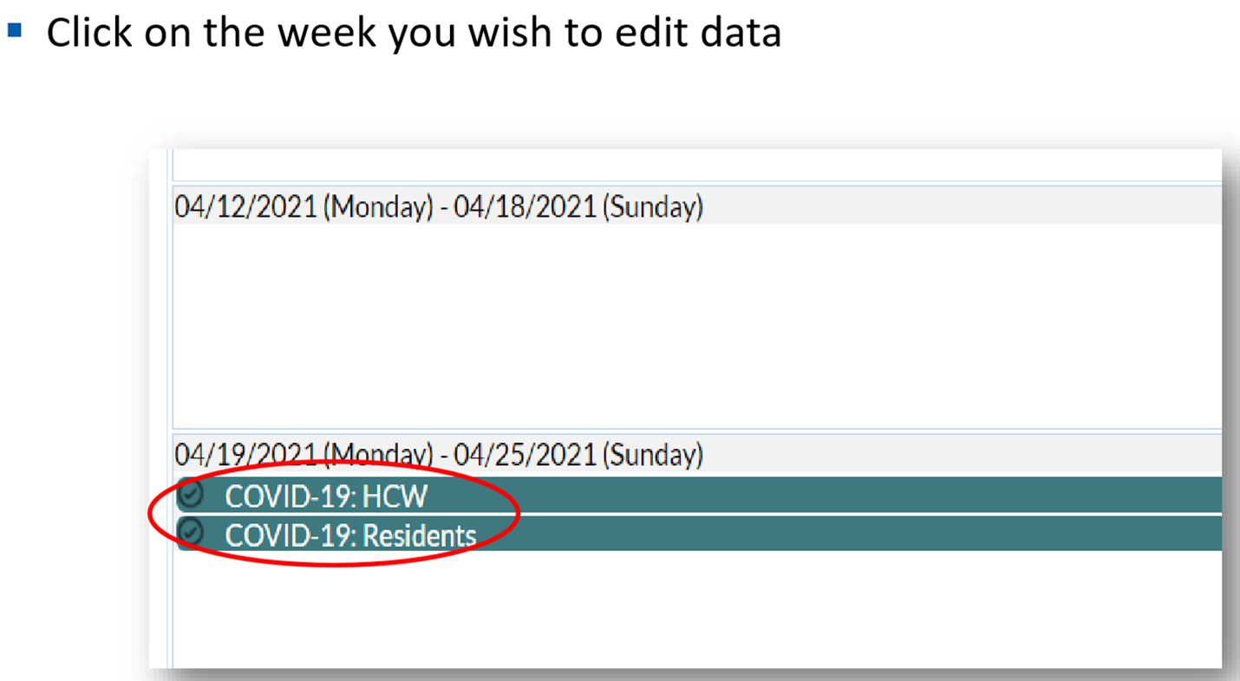
Editing Summary Data

Slide 50
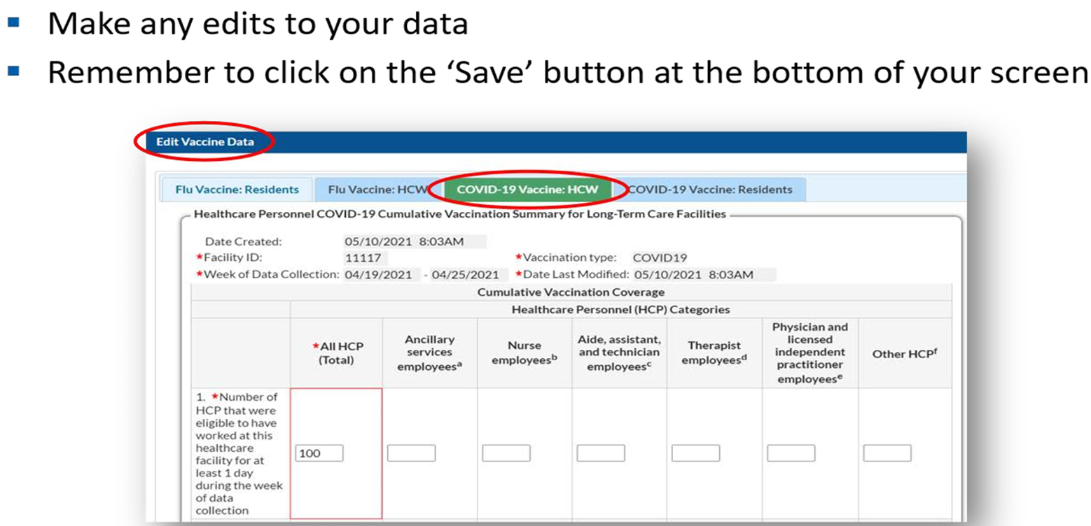
Editing Summary Data

Slide 51
Healthcare Personnel Safety Module
Staff Influenza Vaccination Reporting

Slide 52
Healthcare Personnel Safety Module (HPS)
This module is used to report your healthcare worker influenza vaccination rates from October 1- March 31 annually.
The final Flu Summary Report is due May 15 each year.

Slide 53
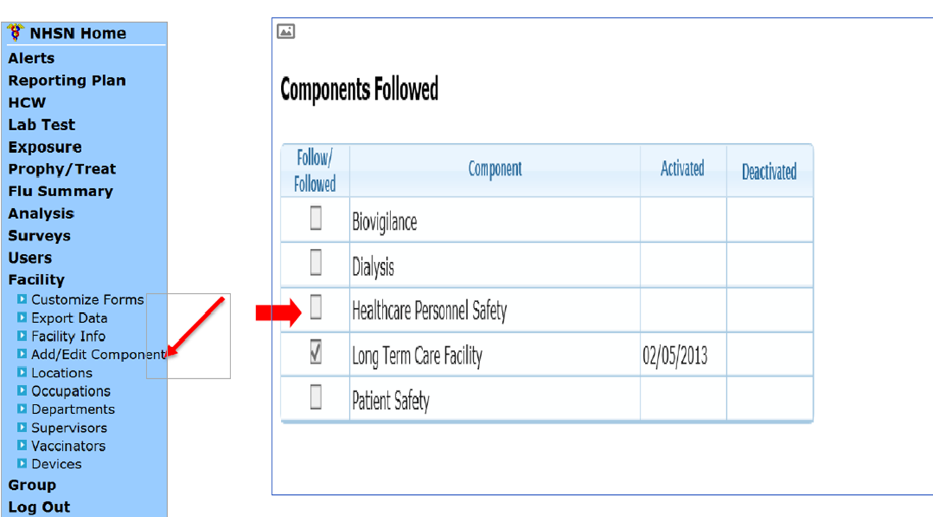
Adding HPS Module
Log into your account and click NHSN reporting.
Select the LTC module/component on the landing page then click submit.
Click Facility > Add/Edit Component > Select the box next to Healthcare Personnel Safety > Click Update at the bottom of the screen.

Slide 54
HPS Module
Once the HPS module is added, you will be able to select this module from the landing page.
To add your reporting plan and summary report you must select Healthcare Personnel Safety from your landing page and click “Submit.”

Slide 55
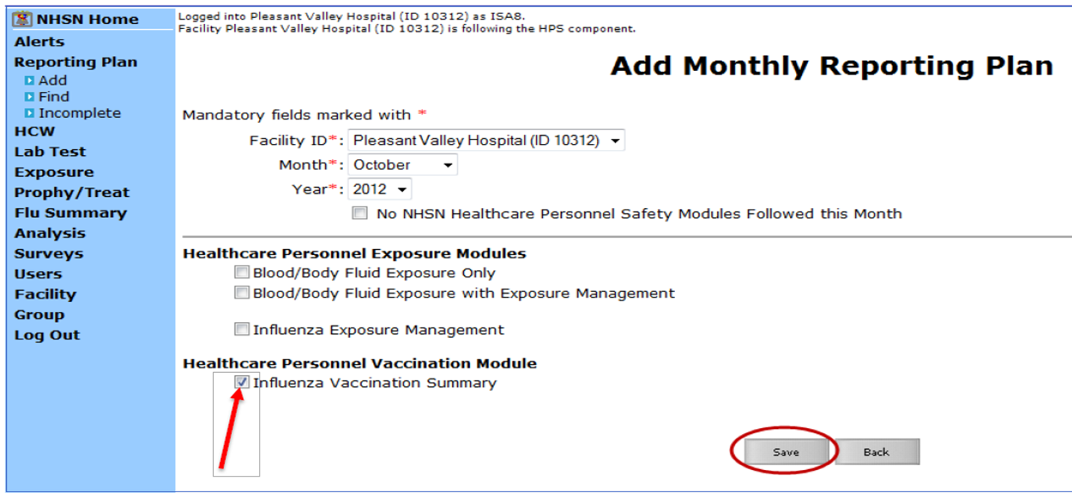
HPS Reporting Plan
From the menu on the left side, you will select the reporting plan and click add.
Select the starting month “October” and the year.
Under “Healthcare Personnel Vaccination Module” select Influenza Vaccination Summary and save the reporting plan.

Slide 56
HPS Reporting Categories
Employee HCP: staff on facility payroll.
Non-Employee HCP: licensed independent practitioners (physicians, advanced practice nurses, and physician assistants).
Non-Employee HCP: adult students/trainees and volunteers.
Number of HCP who worked at this health care facility for at least 1 day between October 1 and March 31.
Number of HCP who received an influenza vaccination at this health care facility since influenza vaccine became available this season.
Number of HCP who provided a written report or documentation of influenza vaccination outside this healthcare facility since influenza vaccine became available this season.
Number of HCP who have a medical contraindication to the influenza vaccine.
Number of HCP who declined to receive the influenza vaccine.
Number of HCP with unknown vaccination status.

Slide 57
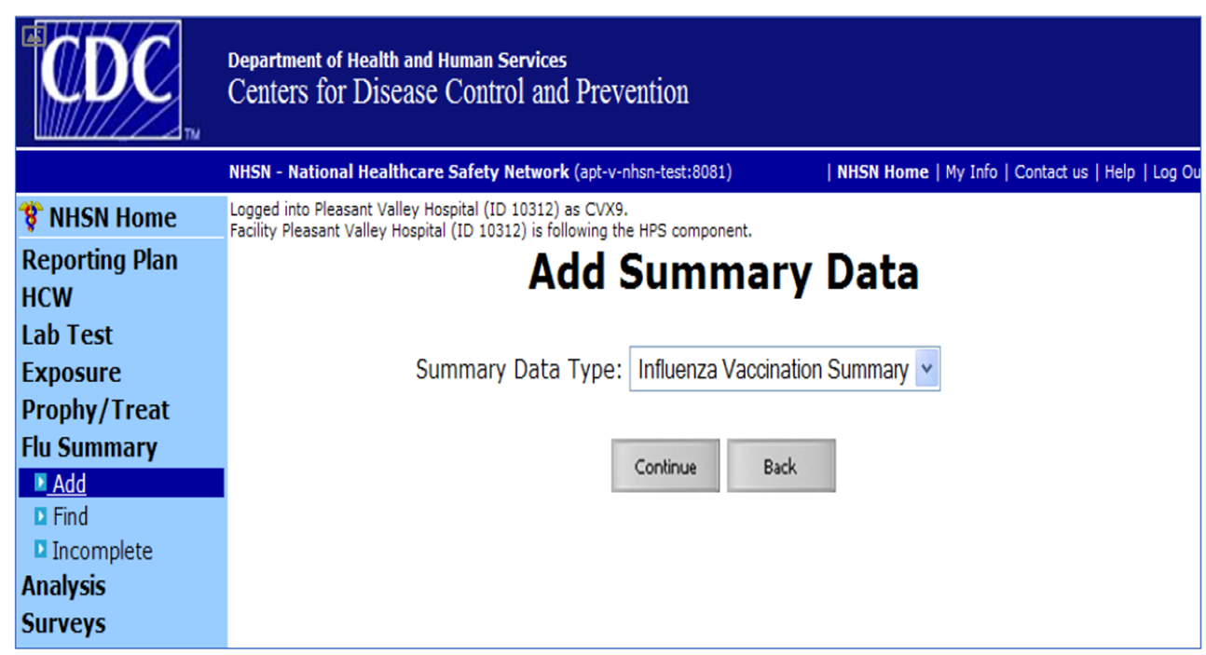
HPS Summary Report
The next slides contain screenshots of the summary reporting plan.
Data collected on reporting forms will be entered into NHSN monthly or in April after the influenza season ends.
Note if you enter data monthly, you must calculate the totals from the previous and current month and enter into the summary. Failure to do so will result in incorrect data entry.

Slide 58
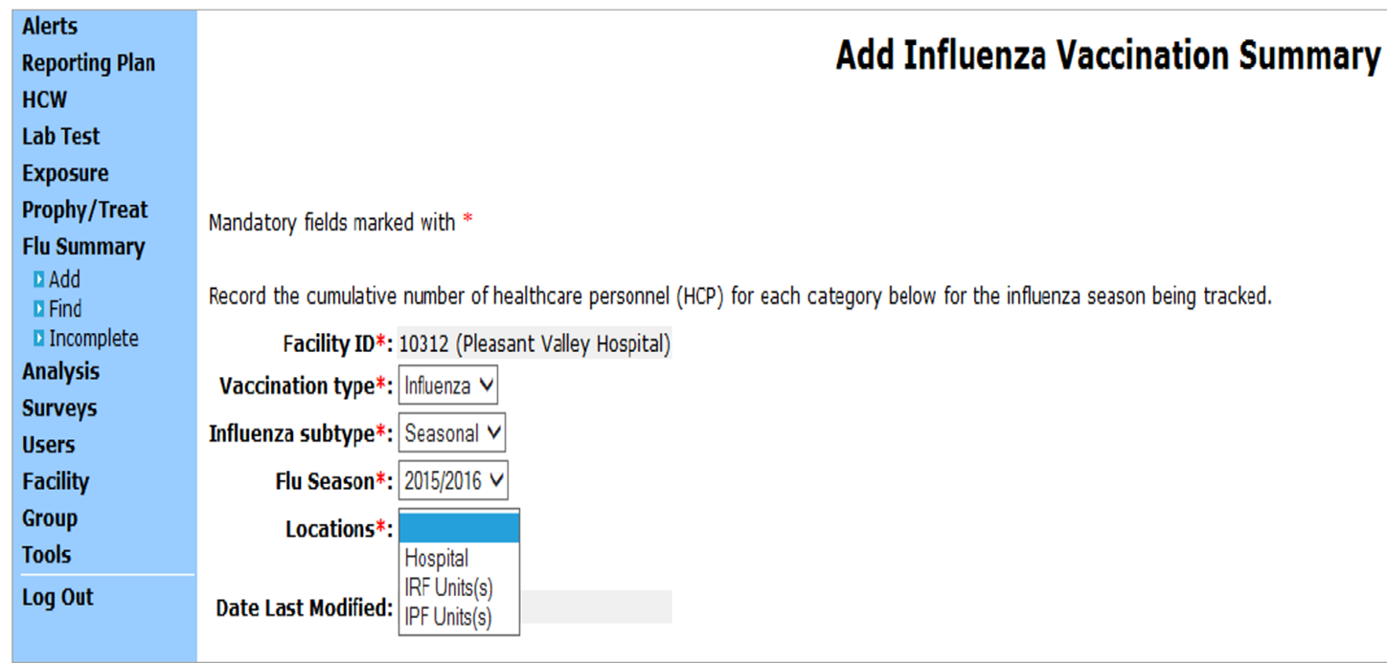
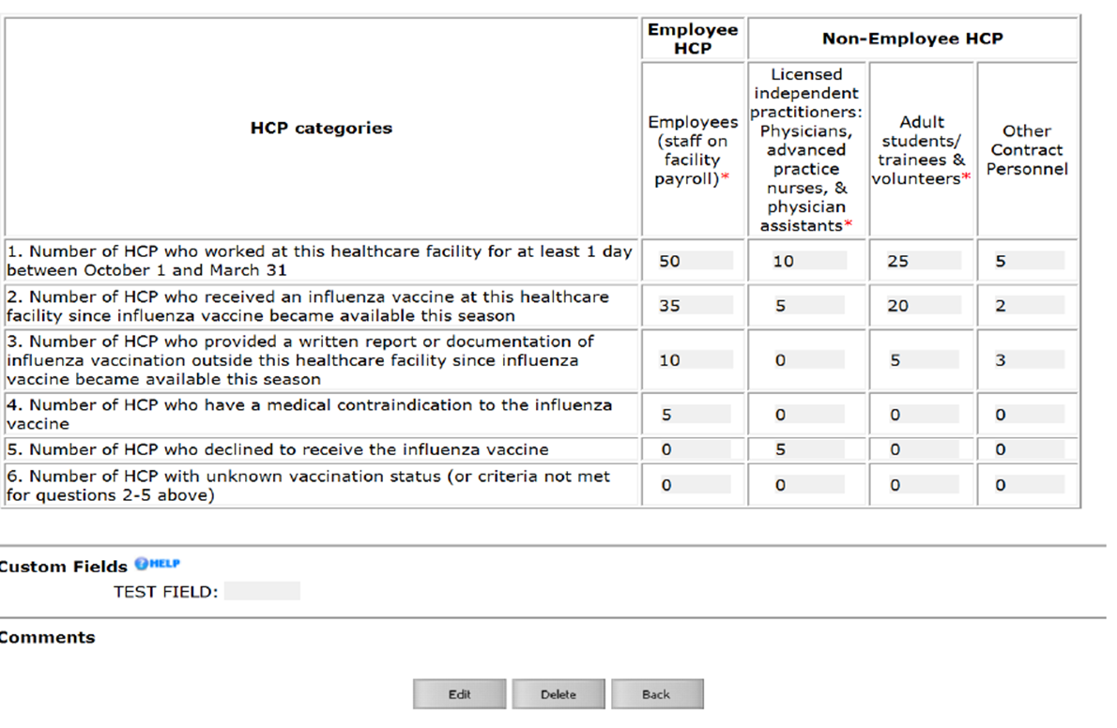
HPS Summary Report

Slide 59
Long-Term Care Module
Healthcare-Acquired Infections

Slide 60
Annual Facility Survey
An annual survey using facility data from the previous calendar year must be completed in NHSN by March 1 to enter data into the long-term care module.
If the AFS is not completed by March 1 NHSN will not allow data entry for the remaining months.
Print the survey form before submitting it. Use this link to upload the AFS.
To access the annual survey from the NHSN facility home page> survey> add.

Slide 61
Creating Monthly Reporting Plans
Reporting plans must be created for every month.
You must have a reporting plan created to report events and submit monthly summary reports.
To create a reporting plan, log into your account and click “NHSN reporting.”
Select the LTC module/component on the landing page, select your facility, and click “Submit.”

Slide 62
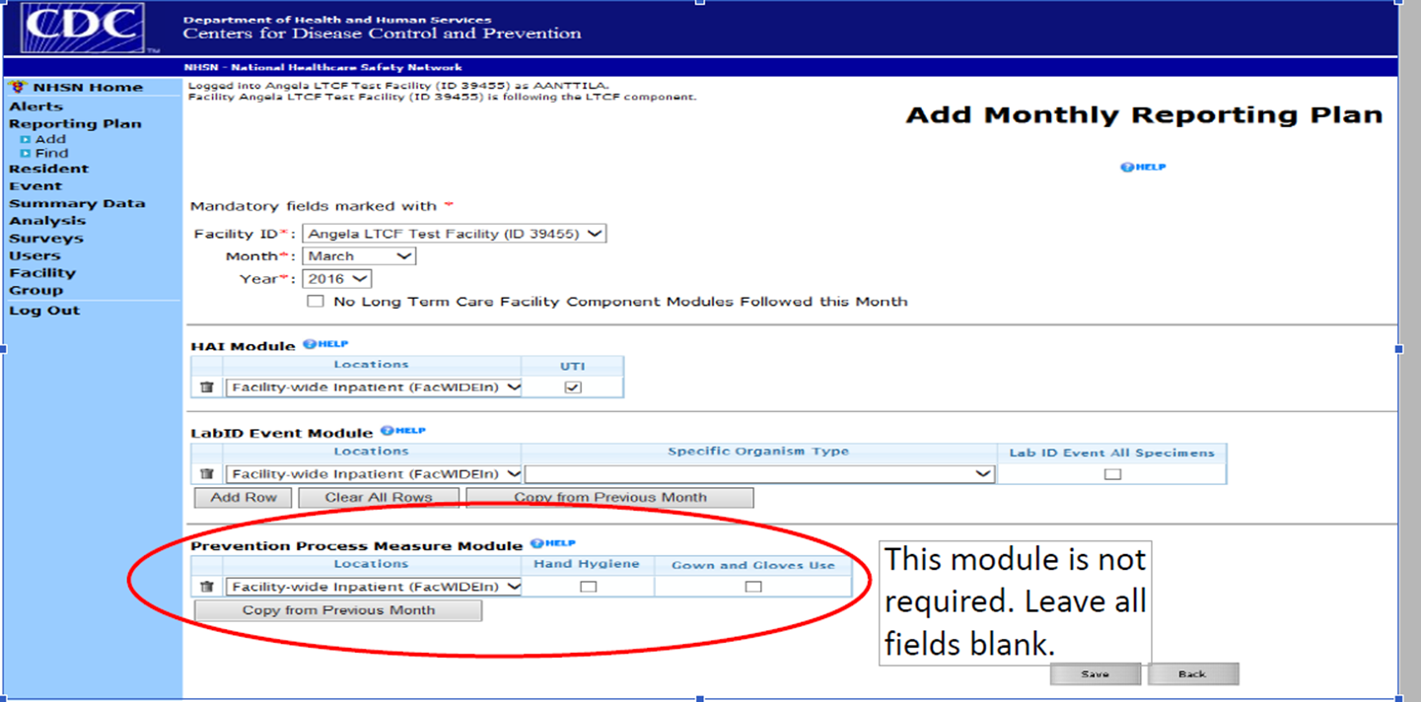
Creating Monthly Reporting Plans
Click Reporting plan > add > start with January
Under HAI Module put a check in the UTI box.
Under LabID Event Module select C. difficile as the specific organism type > check the LabID Event All Specimens box > Click save.
If you do not click save, you will erase the data you entered.
Complete the same process for every month.

Slide 63
UTI, MDRO, and CDI Event Reporting

Slide 64
UTI Event Reporting
When an event occurs at your facility that meets the NHSN definitions it must be reported according to the state mandate.
To report an event log in to your account and click NHSN reporting.
Select the LTC module/component and your name on the landing page then click submit.
Click Event> select Add.

Slide 65
UTI Event Reporting
Resident Information:
  Every field with a red asterisk (*) must be completed; all other fields are optional.
Resident Type:
  Short-stay: Resident has been in the facility for ≤ 100 days from the date of first admission to the facility.
  Long-stay: Resident has been in the facility for > 100 days from the date of first admission to the facility.

Slide 66
UTI Event Reporting
Date of First Admission to Facility:
  Date the resident first entered the facility. This date remains the same even if the resident leaves the facility (e.g., transfers to another facility) for short periods of time (<30 consecutive days).
  If the resident leaves the facility and is away for > 30 consecutive days, the date of first admission should be updated to the date of return to the facility. Enter the date using this format: MM/DD/YYYY.

Slide 67
UTI Event Reporting
Date of Current Admission to Facility: This is the most recent date the resident entered the facility. If the resident enters the facility for the first time and does not leave, then the date of current admission will be the same as the data of first admission.
If the resident leaves the facility for > 2 calendar days (the day the resident left the facility = day 1) and returns, the date of current admission should be updated to the date of return to the facility.
If the resident has not left your facility for > 2 calendar days, then the date of current admission will not change.

Slide 68
UTI Event Reporting
Event Type: UTI
Date of Event: Enter the date when the first clinical evidence (signs or symptoms) of infection were documented or the date the specimen used to meet the infection criteria was collected, whichever comes first.
Resident Care Location: Enter the location where the resident was residing on the Date of Event.

Slide 69
UTI Event Reporting
Primary resident service type: Check the single primary service that best represents the type of care the resident is receiving on the Date of Event:
  Long-term general nursing, long-term dementia, long-term psychiatric, skilled nursing/short-term rehab (subacute), ventilator, bariatric, or hospice/palliative.
Has the resident been transferred from an acute care facility in the past 3 months? Select “Yes” if the resident has been an inpatient of an acute care facility and was directly admitted to your facility in the past three months.

Slide 70
UTI Event Reporting
The guide linked here can be used to further direct completion of the UTI event reporting form.

Slide 71
MDRO and CDI Event Reporting
When reporting a C. difficile infection, the following information will be needed:
Patient information:
  Resident ID (MRN), Social Security number, gender, and date of birth.
Resident type:
  Short-stay: Resident has been in the facility for ≤ 100 days from the date of first admission to the facility.
  Long-stay: Resident has been in the facility for > 100 days from the date of first admission to the facility.
Event details:
  Date specimen collected, specific organism type, specimen body site/system, etc.
Reporting instructions can be found at this link.

Slide 72
Summary Reporting

Slide 73
Summary Reporting
Every month your facility is responsible for submitting a summary report for the previous month.
Log into your account and click NHSN reporting.
Select the LTC module/component and your facility name on the landing page and click submit.
Every field with a red asterisk (*) must be completed before you can Save your data.
Click Summary Data > select Add.
Enter the month and year you are entering summary data for in the Month and Year field.

Slide 74
UTI Summary Reporting
Denominators for Long Term Care Locations:
  Total resident days: The monthly sum of the total number of residents present in the facility each day of that month.
  Catheter days: Defined as the number of residents with an indwelling urinary (Foley) catheter.
  Indwelling urinary catheter days: The number of patients with an indwelling urinary catheter device, are collected daily, at the same time each day, according to the chosen location. These daily counts are summed and only the total for the month is entered into NHSN.
  Indwelling urinary catheter days and resident days are collected separately for each of the locations monitored.

Slide 75
UTI Summary Reporting
None of the following urinary management devices should be included when counting indwelling catheter days:
suprapubic catheters
straight in-and-out catheters
condom catheters.
Note: If a resident is transferred to an acute care facility for a suspected UTI, no additional indwelling catheter days are reported after the day of transfer.

Slide 76
UTI Summary Reporting
New Antibiotic Start: refers to a new prescription for an antibiotic ordered for a resident who is suspected or diagnosed with having a urinary tract infection (both catheter-associated and non-catheter-associated) regardless of whether that UTI meets the NHSN event definition.
  Count all new orders. Include only antibiotics that are started while the resident is receiving care in your facility.
  Do not include antibiotic courses started by another health care facility prior to the resident’s admission or re-admission back to your facility.
If you do not have no UTIs for the month, put a check in the box marked “Report No UTI.” If you do have UTI(s) for the month leave this box empty.

Slide 77
MDRO and CDI LabID Summary Reporting
Every field with a red asterisk (*) must be completed before you can save your data.
  Resident admissions: Monthly total of residents admitted for the month.
  Resident days: This number will auto-populate from the total entered in the denominators for LTC locations.

Slide 78
MDRO and CDI LabID Summary Reporting
Number of Admissions on C.diff Treatment: For each day of the month, count and record the number of residents who are receiving antibiotic therapy for C. difficile infection at the time of admission. Include both new admissions and re-admissions.
  LabID Events (all specimens): Place a check in this box under C. difficile.
  Report No Events: Place a check in the box under C. difficile if you did not have any events for the month. Leave this box blank if you had event(s) for the month.

Slide 79
MDRO and CDI LabID Summary Reporting
Once all the data is entered, click “Save” at the bottom of the page to save your summary data.
If you go to a new screen without clicking “Save” all your data will be erased.

Slide 80
Internal Data Validation

Slide 81
Internal Data Validation
Analysis Matters:
Provide a narrative about your facility’s current standing and progress over time.
Highlights areas of strength and weakness.
Informs users of the success of preventive measures.
Allow users to detect inconsistencies and perform internal validation to promote accuracy.
Empower facilities to make data-driven decisions.

Slide 82
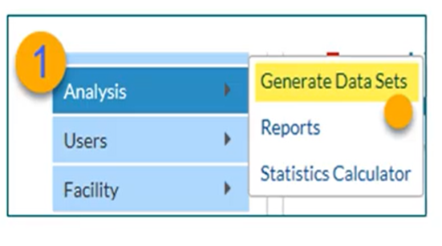
Generate Data Set from NHSN
Step 1:
The first step in data analysis is to generate a data set.
Once you log in, select “Analysis” on the left-hand side and click “Generate Data Sets.”
  Time frame selection: Keep in mind the default time frame is the most recent three full calendar years; you can do your adjustment as needed.

Slide 83
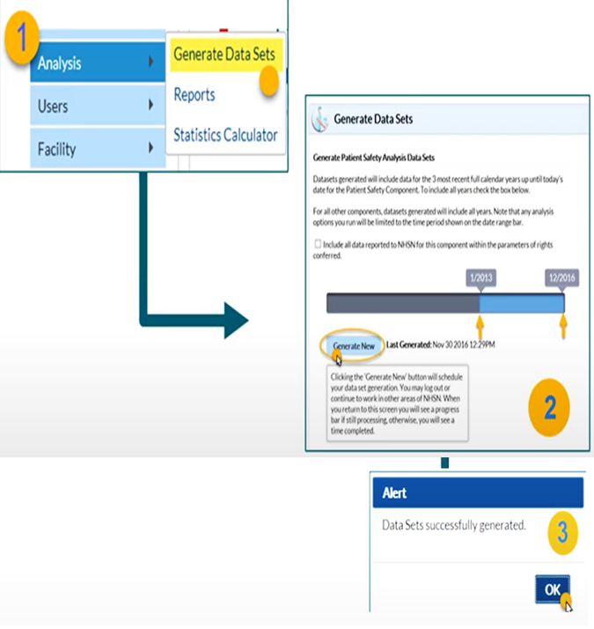
Generate Data Set from NHSN
Step 2:
Click “Generate New.”
  Generated data sets copies and freezes data will be specific to your account.
  You can access other areas of NHSN or log off while it is completed.
  Any changes after the generated data set will not be reflected in the analysis report.
Step 3:
Click “OK” on the alert box as shown in the picture guide.

Slide 84
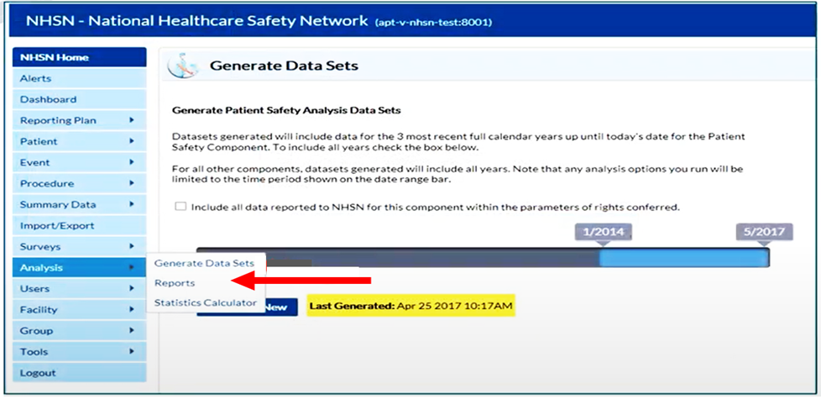
Accessing Analysis Reports
From the “Analysis” tab choose “Reports” from the drop-down list.

Slide 85
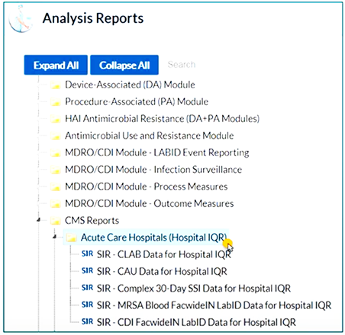
Accessing Analysis Reports
Analysis reports are organized into separate folders.
These folders expand to showcase sub-folders and reports.
Navigate to the “CMS reports folder.”
Select the appropriate facility type.
Select the desired HAI / COVID module report.

Slide 86
NHSN CMS Report Guide
At this link you can access step-by-step guidance on how to run the NHSN CMS report.

Slide 87
Helpful Links
NHSN home page: https://www.cdc.gov/nhsn/index.html
Changing administrator: https://www.cdc.gov/nhsn/facadmin/index.html
LTCF COVID-19 Module: https://www.cdc.goc/nhsn/ltc/covid19/index.html
Annual Facility Survey: http://www.cdc.gov/nhsn/forms/57.137_ltcfsurv_blank.pdf
Long-term Care Facilities (LTCF) Component: https://www.cdc.gov/nhsn/ltc/index.html
UTI Event Reporting Form: http://www.cdc.gov/nhsn/forms/57.140_uti_ltcf_blank.pdf
Laboratory-identified MDRO or CDI Event for LTCF: http://www.cdc.gov/nhsn/forms/57.138_labidevent_ltcf_blank.pdf
Denominators for LTCF: http://www.cdc.gov/nhsn/forms/57.142_denominatorltcf_blank.pdf

Slide 88
Contact Information for presenters
Kimisha Causey
Health Program Manager II
Kcausey@health.nv.gov
702-468-5516
Fathia Osman
Health Program Specialist II
Fosman@health.nv.gov
702-326-3449
Jennifer Connolly
Health Program Specialist I
Jconnolly@health.nv.gov
775-351-4269

Slide 89
Acronym definitions
UTI: Urinary Tract Infection
CAUTI: Catheter Associated Urinary Tract Infection
CDI: Clostridium Difficile
MDRO: Multidrug-Resistant Organisms
COVID-19: CoronaVirus Disease 2019
HAI: Healthcare Associated Infection
HCP: Healthcare Personnel
LTC: Long Term Care
NAC: Nevada Administrative Code
NHSN: National Healthcare Safety Network
SNF: Skilled Nursing Facility
CMS: Centers for Medicare and Medicaid Services

Slide 90
End slide – decorative only

