Slide 1



Slide 2


Slide 3

The Island of Reno,
Sparks and Carson City

Slide 4

The Island of Las Vegas
& Henderson

Slide 5

The Island of Las Vegas
& Henderson

Slide 6


Nevada is a Small
Part of Our World

Slide 7
Think Globally - Act Locally
Presented by:
Norman Wright, RN, BSN, MS
Kindred Hospital, Sahara
and
Lisa Schaffer, RN, CIC
Mountainview Hospital
“Bridge the Gap” Between Health Care Providers

Slide 8



http://dpbh.nv.gov/Programs/Office_of_Public_Healh_Informatics_and_Epidemiology_(OPHIE)/
https://twitter.com/nv_ophie
With the support of:
Kimisha Causey & Adrian Forero

Slide 9
Learning Objectives
Develop a collaborative between
Nevada APIC chapters, Health Care Providers and OPHIE to reduce transfer of pathogens.
Develop goals to improve communication between all Nevada Health Care Providers.
Promote safe transfer of patients between the varied Health Care levels from Acute Care Hospitals, LTAC, LTC to Home Health Care.
Promote the use of Inter-facility transfer form between varied systems and levels of health care.

Slide 10

Las Vegas, Reno and Nevada
is a very small part of our World
The Island of Las Vegas

Slide 11


Slide 12
Think Globally
Act Locally
First we must
define the problem.

Slide 13
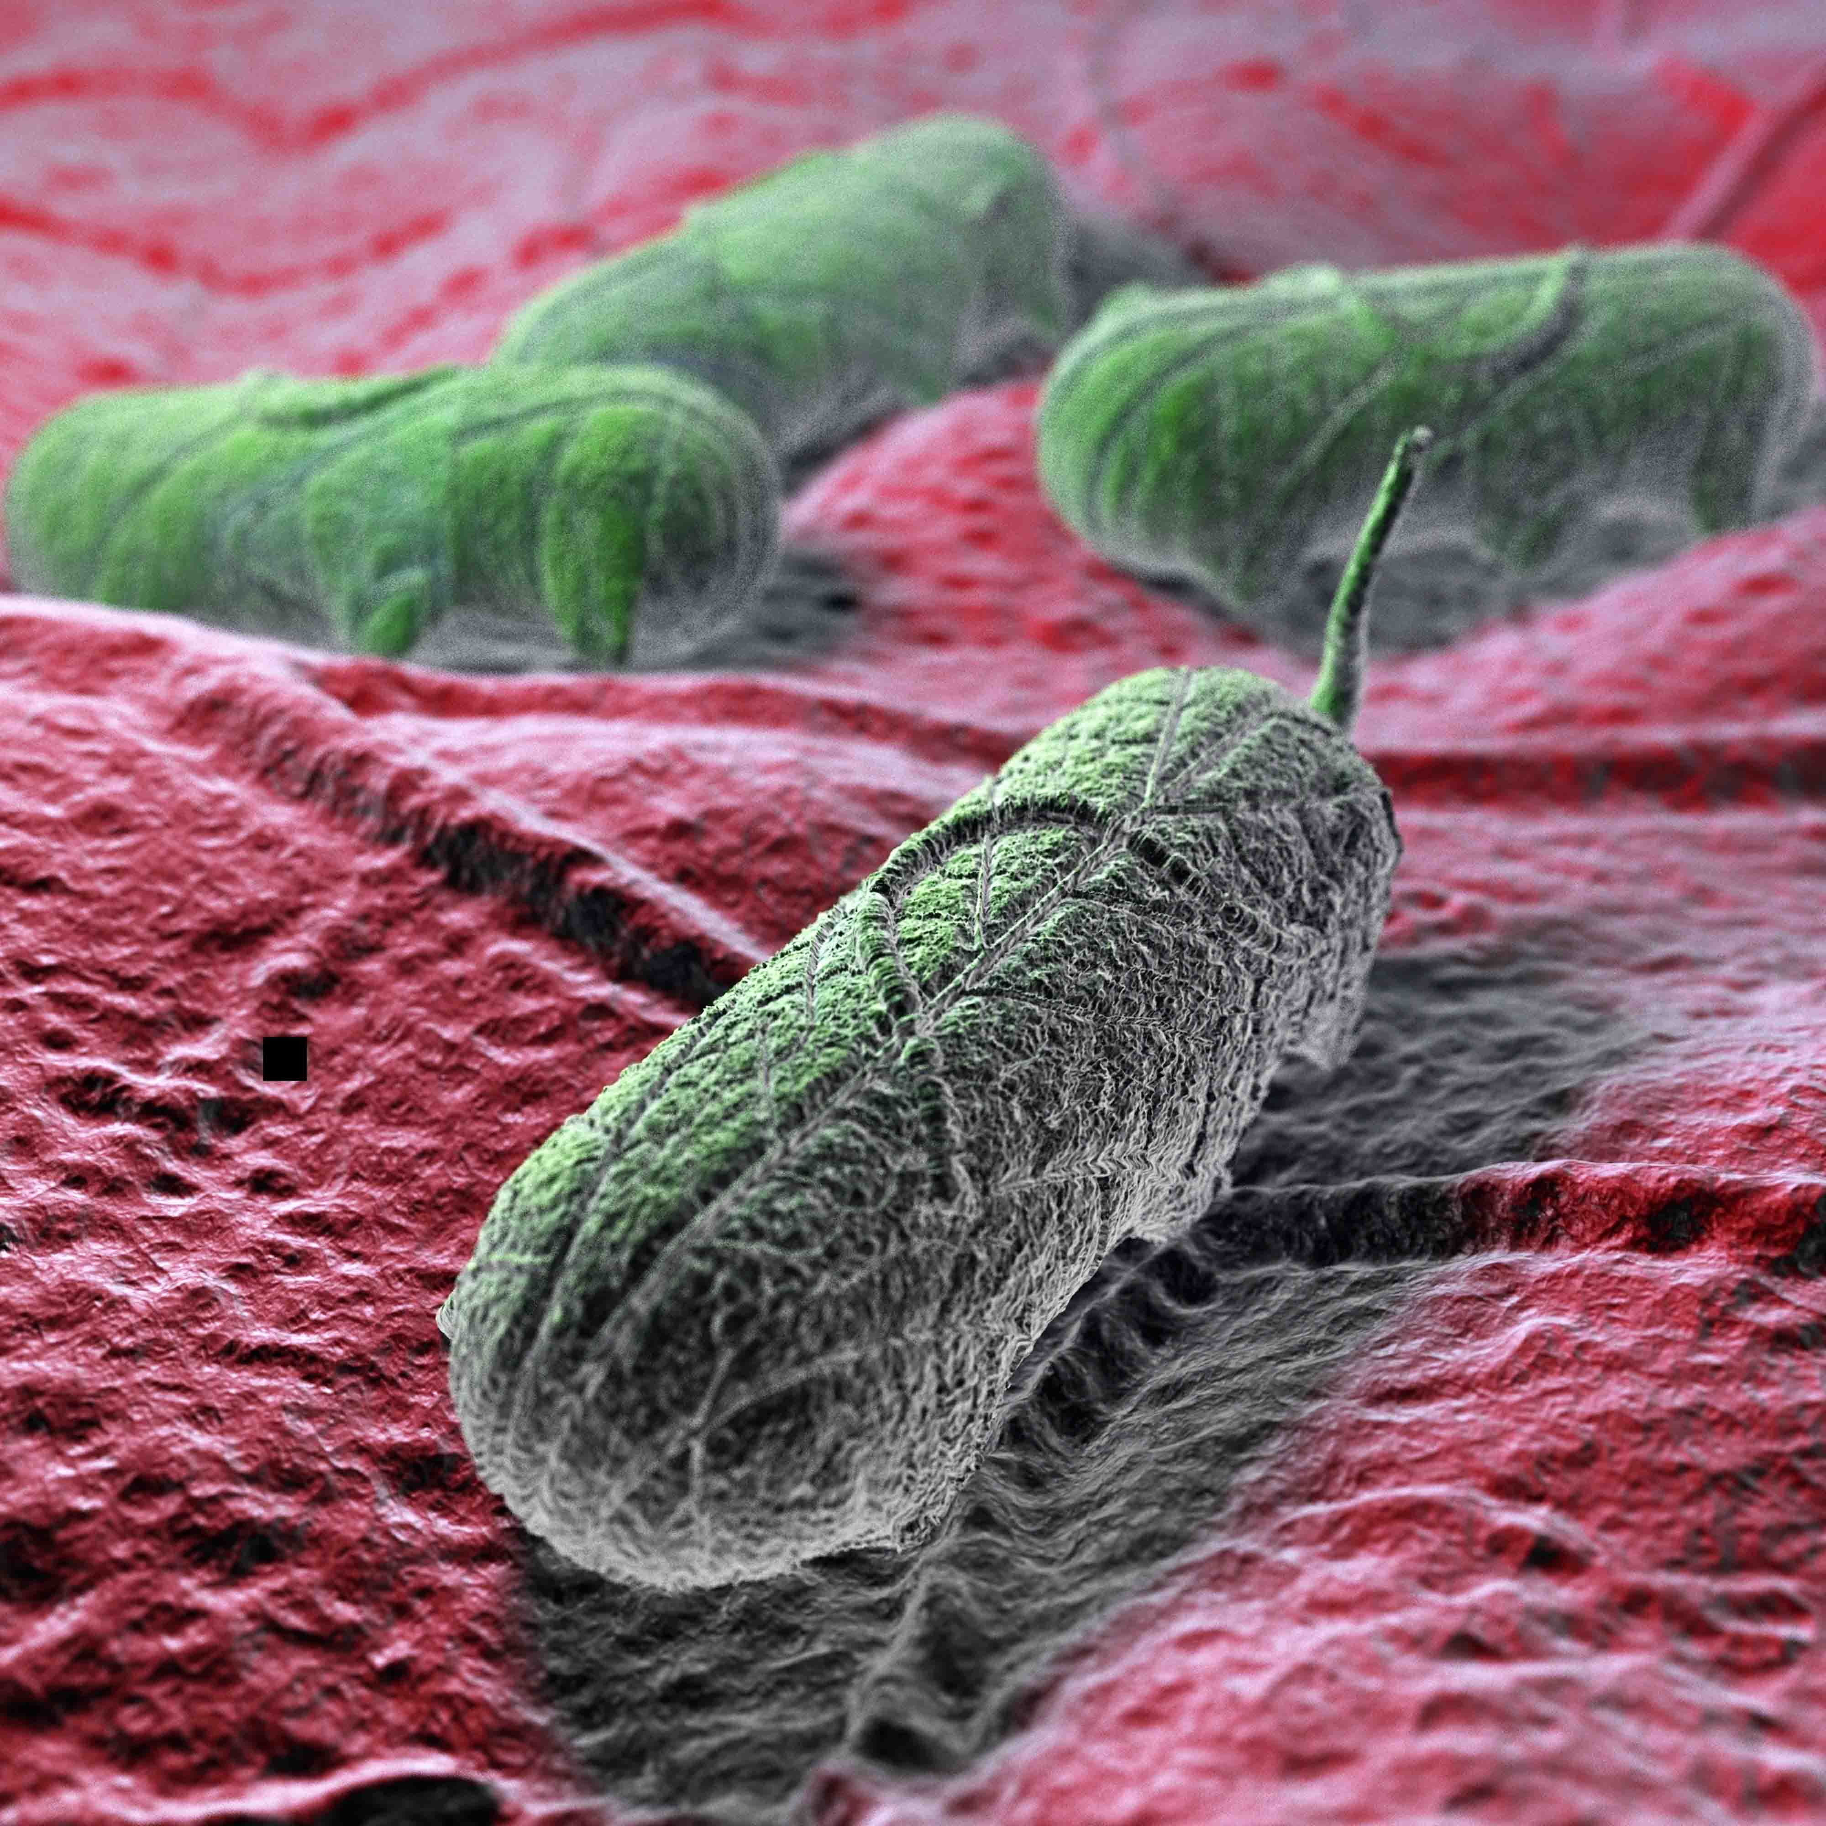
Defining the problem
Bacteria have become
resistant to antibiotics

Slide 14
According to the CDC
Antibiotic-resistant germs cause more than 2 million illnesses and at least 23,000 deaths each year in the US.
Up to 70% fewer patients will get CRE over 5 years if facilities coordinate to protect patients.
Preventing infections and improving antibiotic prescribing could save 37,000 lives from drug-resistant infections over 5 years.
https://www.cdc.gov/vitalsigns/stop-spread/index.html
Notes:
In order to do “no harm” to our patients all facilities MUST coordinate our efforts in order to protect our patients and decrease the chance of our patients getting infections.

Slide 15
According to CDC the Problems are:
Germs spread between patients and across facilities.
Antibiotic resistance is a threat.
Nightmare germs called CRE (carbapenem-resistant Enterobacteriaceae) can cause deadly infections and have become resistant to all or nearly all antibiotics we have.
CRE spread between health care facilities like hospitals and nursing homes when appropriate actions are not taken.
MRSA infections commonly cause deadly pneumonia & sepsis.
Pseudomonas aeruginosa can cause HAIs, including bloodstream infections. Strains resistant to almost all antibiotics are in hospitalized patients.
These nightmare germs are some of the most deadly resistant germs identified as “urgent” and “serious” threats.
https://www.cdc.gov/vitalsigns/stop-spread/index.html

Slide 16
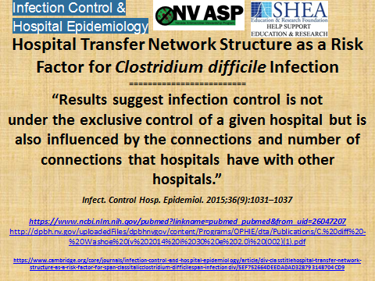
Notes:
We, as a healthcare community are only as good as the weakest link in the healthcare community chain. If there are 10 facilities and 9 of those facilities do a stellar job at infection prevention and one facility doesn’t, it’s that one facility that puts every other facility at risk. We share patients and healthcare providers.

Slide 17
“This elderly appearing man, with repeated
multiple admissions across multiple facilities
throughout the Las Vegas Valley, presented
to the hospital on a transfer from a local
post-acute facility.”
“This epidemic strain of Clostridium Difficile
(NAP 027-NAPI-BI) is known to produce a
significantly higher number of C-diff spores”
The epidemic BI/NAP1/027 strain of C. difficile
is more lethal, causes more extensive brain hemorrhage, and is antigenically variable from previously studied strains.
https://www.ncbi.nlm.nih.gov/pmc/articles/PMC3731247/
Notes:
Are there any facilities or labs that are specifically testing for NAP 027-NAPI BI? If so, are they testing all Cdiffs or is there certain criteria that leads them to perform the specialized testing?

Slide 18

CDC reports Nevada's first 'nightmare bacteria'
Marcella Corona, mcorona@rgj.com Published 6:04 a.m. PT Jan. 13, 2017 |
“Public health officials reported a Reno woman who died last year
from an incurable superbug – a problem that is spreading in the U.S.
The bug was resistant to 26 different antibiotics, according to the
Morbidity and Mortality Weekly Report.
So the CDC basically reported that there was nothing
in our medicine cabinet to treat this lady,”
said Dr. Randall Todd, division director of epidemiology &
public health preparedness for Washoe County Health Dist.
Notes:
Take the time to Google search this article. Communication is of extreme importance!

Slide 19
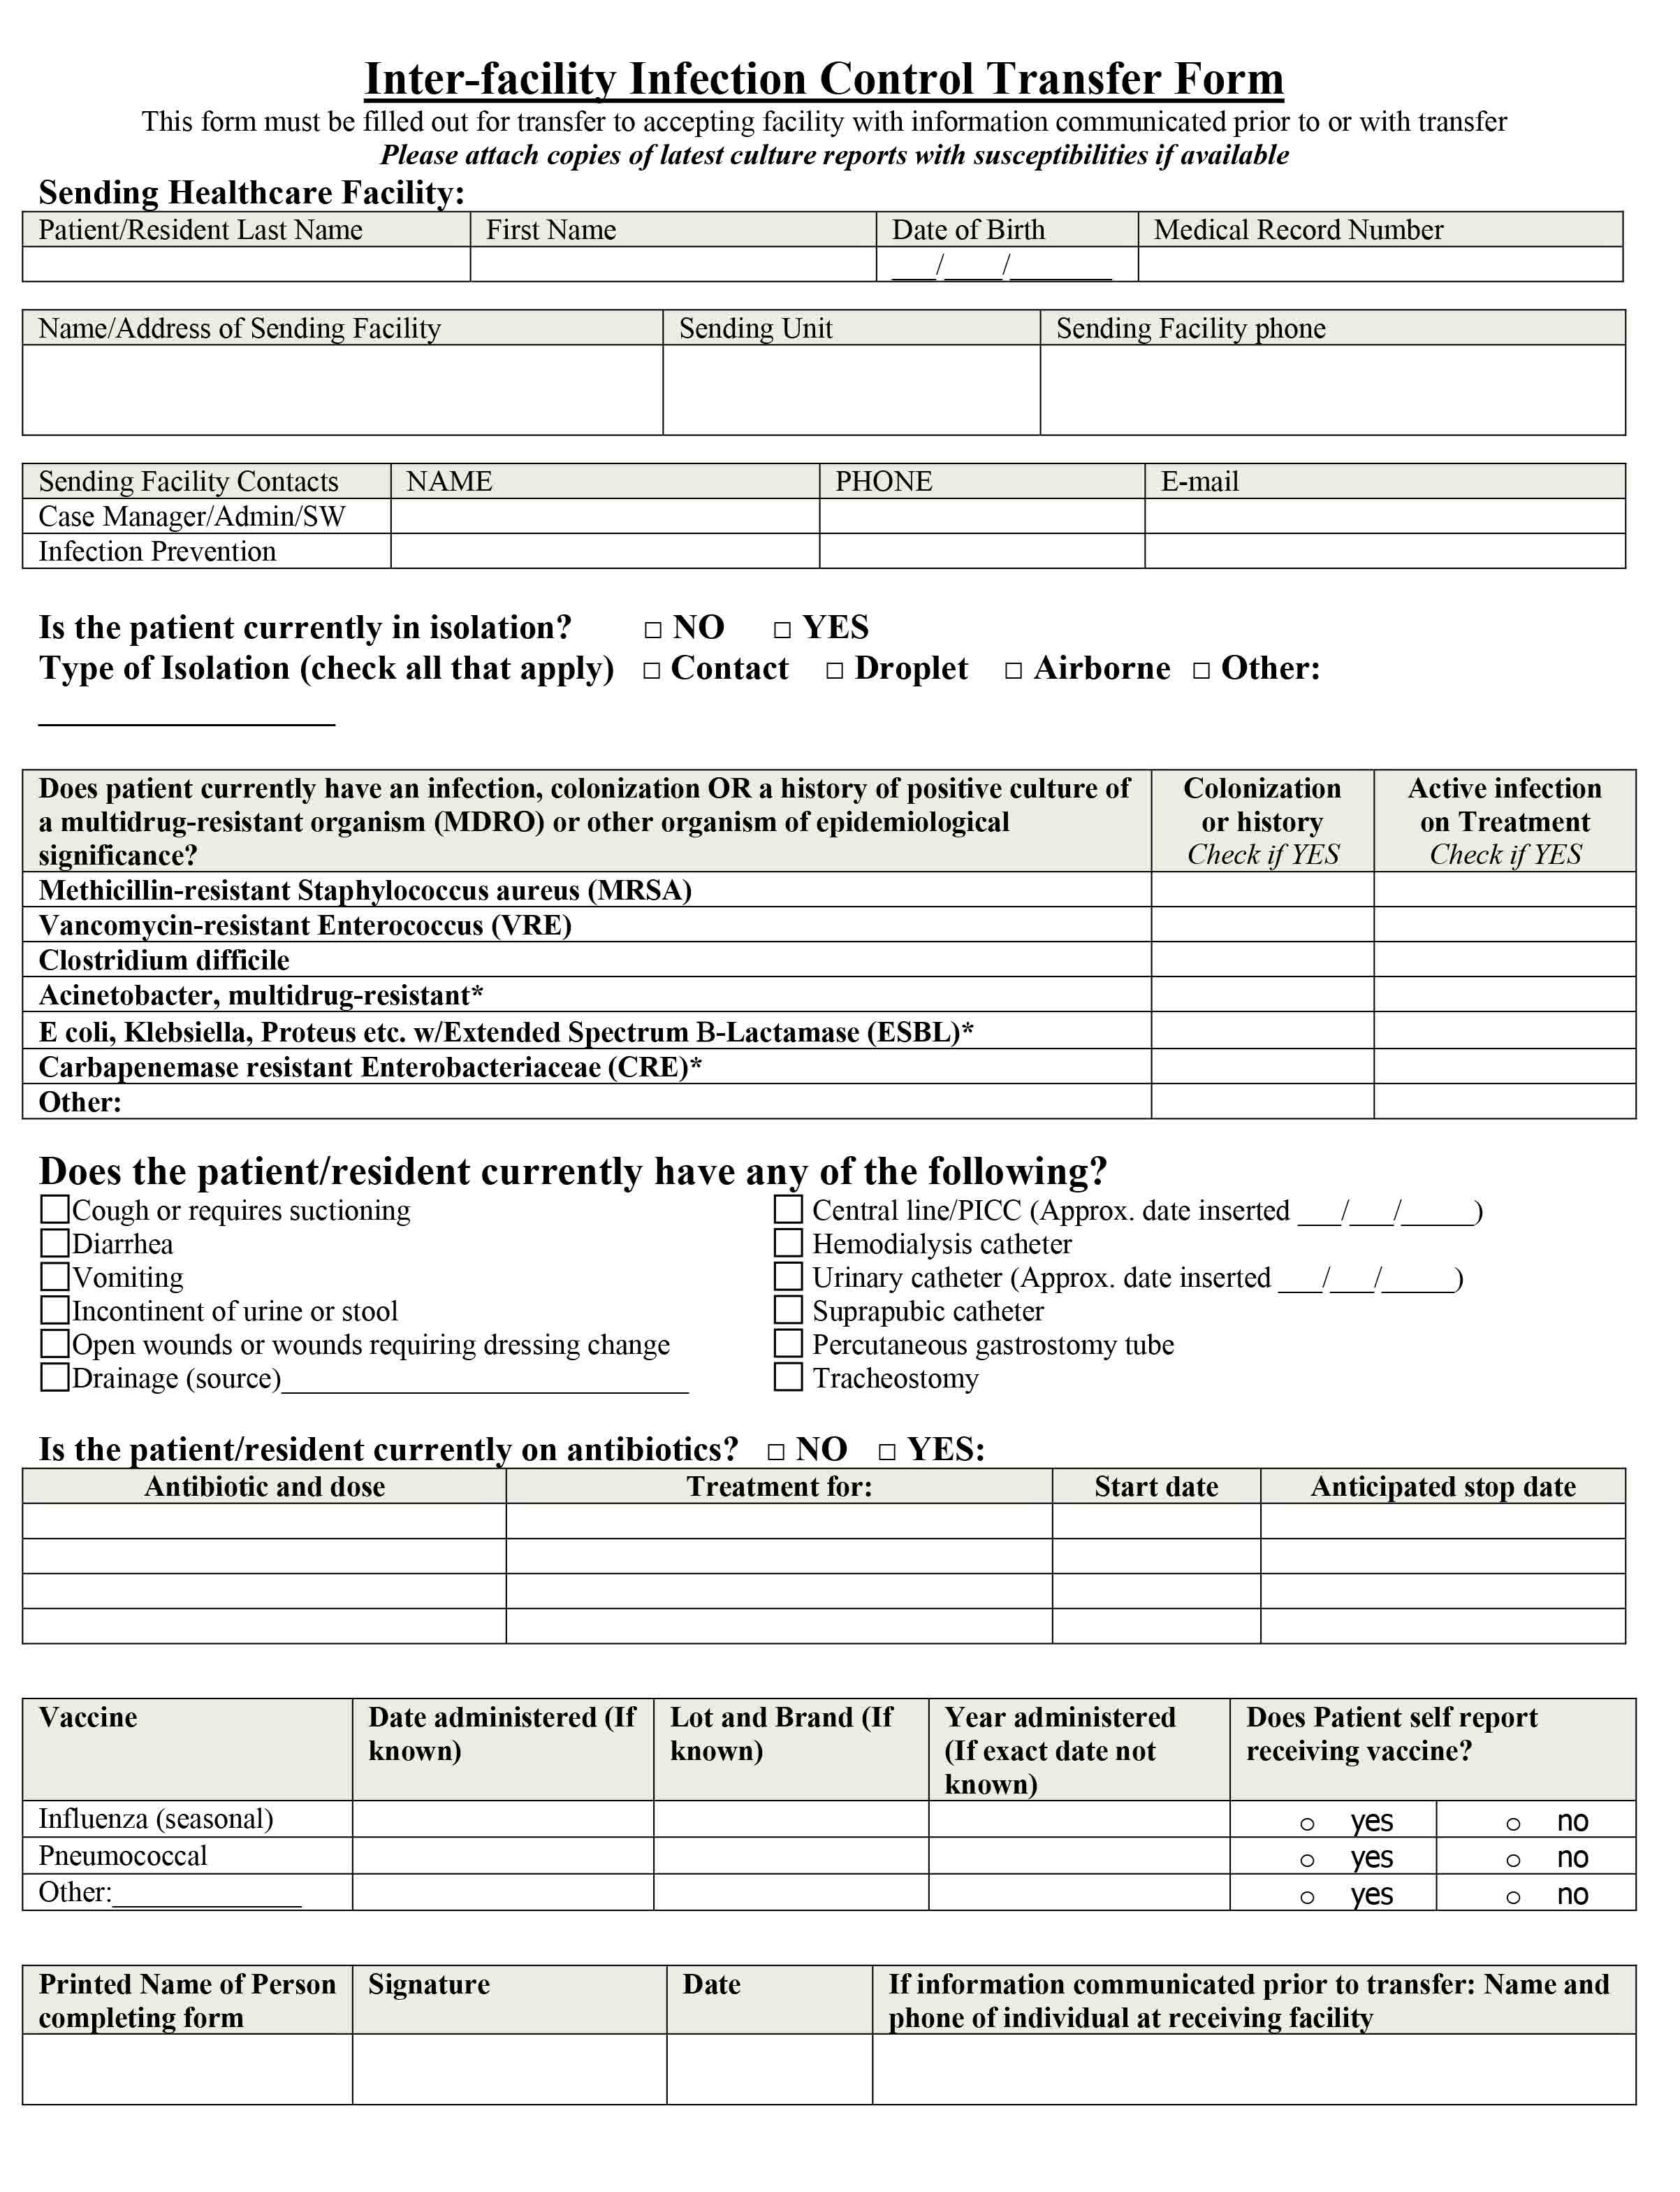
Transition slide needed
Notes:
CDC Form

Slide 20
The Journey of the IFICTF
September 2015- The need for a better communication tool was identified
Give our community partners the same information that we want them to give us
October 2015- Brought the idea to each of our committee meetings for “buy in”
Identified the “Top 10” places our patients go to and come from
November 2015- Invited the “Top 10” to Mountainview Hospital to review our communication tool
December 2015- Updated the transfer papers to eliminate “double documentation”
January 2016- Shared and received approval with various medical committees at Mountainview.
Shared with NV ASP, local APIC chapter
February /March 2016- Housewide Education Campaign
April 2016- Official kick off
May-September 2016- Feedback, reinforcement, shared communication from other facilities
October 2016- Back to Basics
November 2016- Present- Continue to educate (Nursing Orientation, GME, Staff Meetings)

Slide 21
Feedback…teaching moments
Incomplete forms are sent to me from receiving facilities
Copies are reviewed with involved staff
Sharing the POSITIVES has been very important, it’s really helped get the staff on board
Received this email on May 3, 2016 …..our process kick off was April 19, 2016. This email was shared on our hospital intranet
We transferred in a patient a couple of nights ago. When I came in the following morning to look over the admission I saw the patient was coming from an acute hospital stay r/t SIRS and was here to finish out the antibiotics. They had been pan cultured while in the hospital which showed multiple systems affected with multiple MDROs. EVERY culture including date, origin of specimen and result with organism was there. I was able to review the meds and clinical status, get out onto the floor and work with the nurses and CNAs on things to be watching for and what to report right way. I then called our ID provider and by the time I was done, felt like we had a great handle on the patient and his care.

Slide 22
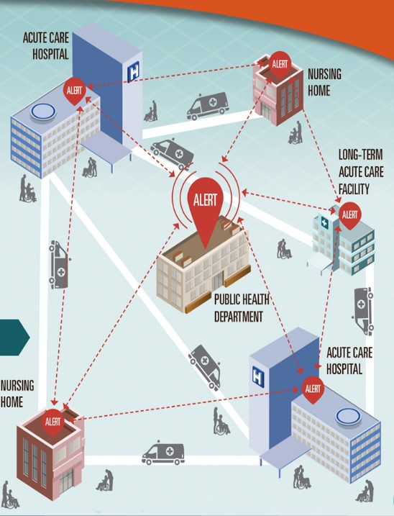
Facilities need to work together
As members of the healthcare community all of us are responsible for preventing the transmission of organisms
Communication between facilities is just as important as communication within each of our individual facilities
When we don’t work together, we have the potential to cause harm to our patients
Let’s not forget about involving transport companies and EMS so that they can take proper precautions

Slide 23
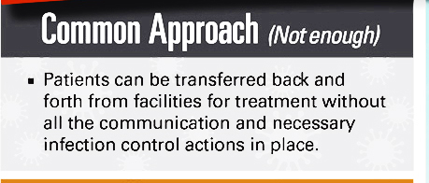

Slide 24
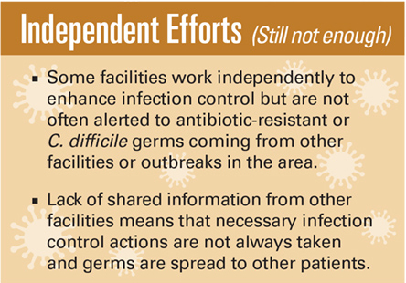

Slide 25
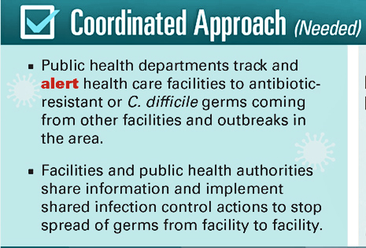

Slide 26
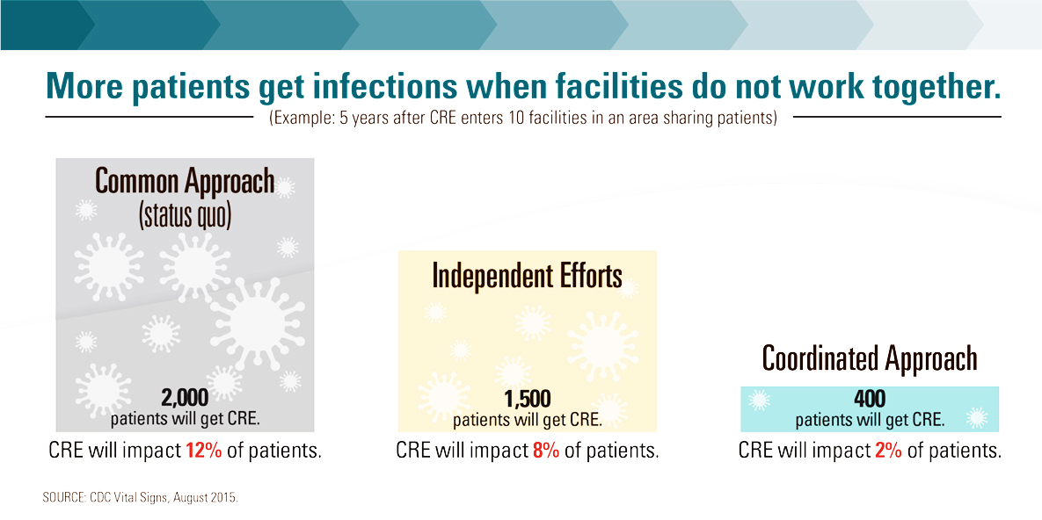

Slide 27
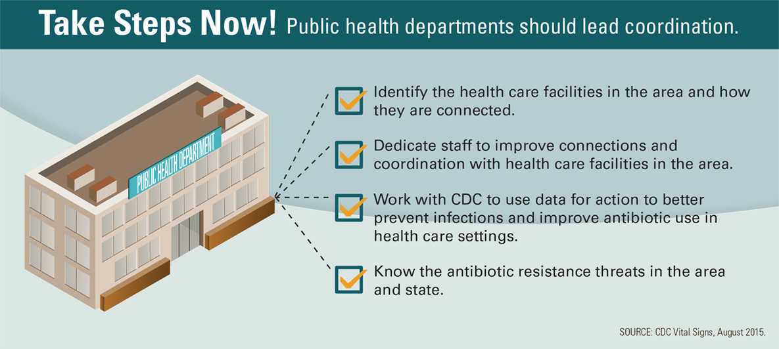

Slide 28
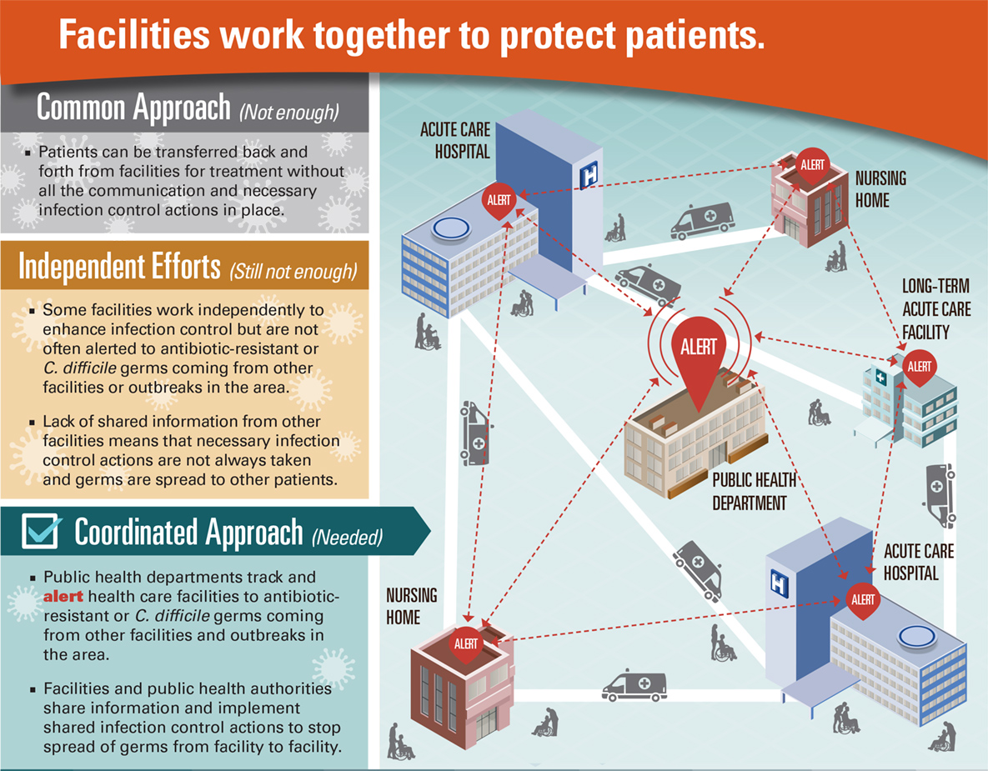
Build Bridges

Slide 29
www.nvasp.net

Slide 30


Slide 32



Slide 33


Slide 34


Slide 35


Slide 36
“Superbug”

Slide 37
Infection
Preventionists
Raise Your
Hand

Slide 38
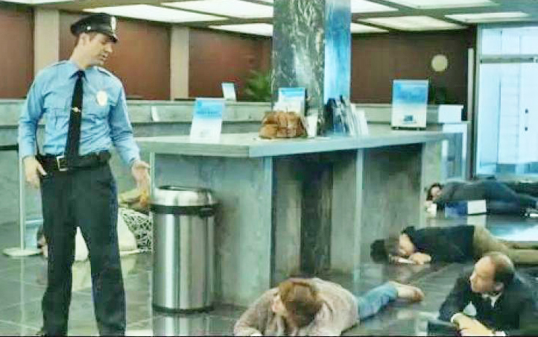
I’m an Infection Monitor
Notes:
IP’s are really monitors. Everyone must be educated about infection prevention and empowered to say something. They need to be supported.

Slide 39
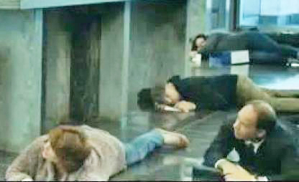
Duck and Cover

Slide 40
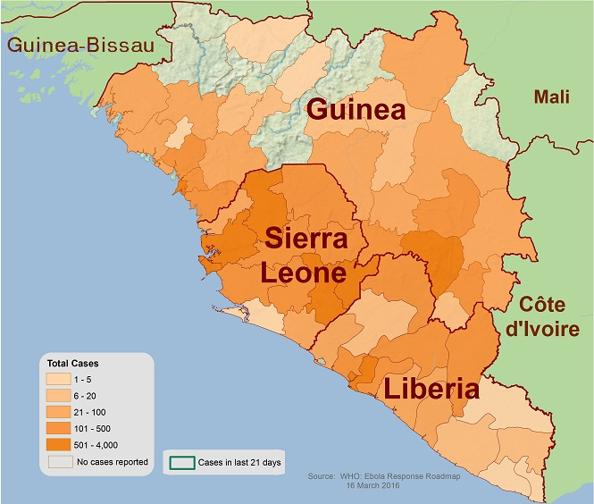
Countries with Former Widespread Transmission
and Current, Established Control Measures¹
EBOLA
Country | Total Cases (Suspected, Probable, and Confirmed) | Laboratory-Confirmed Cases | Total Deaths
Guinea ² | 3814 | 3358 | 2544
Sierra Leone ³ | 14124 | 8706 | 3956
Liberia⁴ | 10678 | 3163 | 4810
Total | 28616 | 15227 | 11310
http://www.cdc.gov/vhf/ebola/outbreaks/2014-west-africa/case-counts.html

Slide 41
Ebola deaths outside of Africa
Country | Total Cases (Suspected, Probable, and Confirmed) | Laboratory-Confirmed Cases | Total Deaths
Nigeria | 20 | 19 | 8
Senegal | 1 | 1 | 0
Spain | 1 | 1 | 0
United States | 4 | 4 | 1
Mali | 8 | 7 | 6
United Kingdom | 1 | 1 | 0
Italy | 1 | 1 | 0
Total | 36 | 34 | 15
http://www.cdc.gov/vhf/ebola/outbreaks/2014-west-africa/case-counts.html

Slide 42
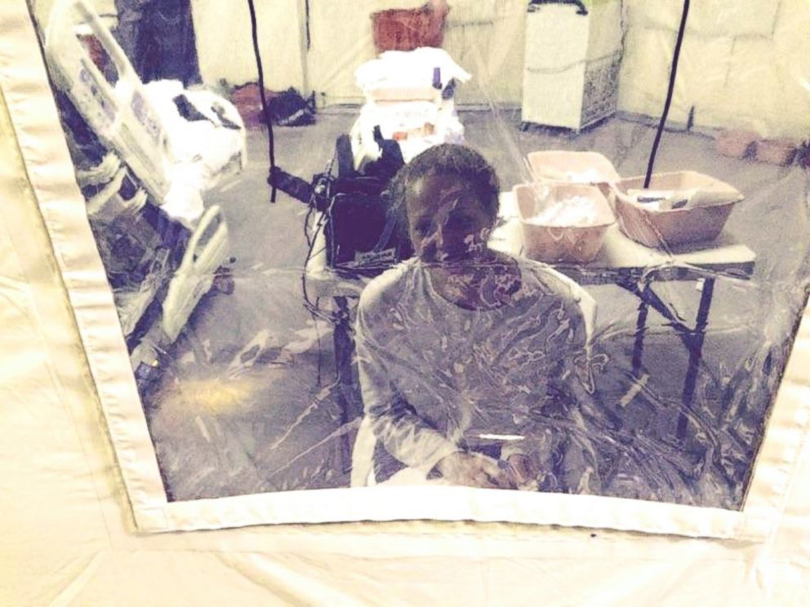
A “Nevada nurse” in “isolation” in New Jersey
after working with Ebola patients.

Slide 43
Defining the problem
Bacteria Are
Resistant to Antibiotics
We Must All Be
Infection
Preventionists

Slide 44

Nursing Homes and Assisted Living
(Long-term Care Facilities [LTCFs])
In “Nursing homes, skilled nursing facilities, and assisted living facilities, LTCFs) . . . Infections are a major cause of hospitalization and death; as many as 380,000 people die of infections in LTCFs every year.”
https://www.cdc.gov/longtermcare/prevention/
https://www.cdc.gov/hai/pdfs/toolkits/InfectionControlTransferFormExample1.pdf

Slide 45
“The LTCF is functionally the home for the resident, who is usually elderly and in declining health and will often stay for years, hence comfort, dignity, and rights are paramount. It is a low-technology setting. Residents are often transferred between the acute care and the LTC setting, adding an additional dynamic to transmission and acquisition of HAIs.”
https://www.cdc.gov/longtermcare/prevention/
========================================================================
“An atmosphere of community is fostered (in the LTCF), and residents share common eating and living areas and participate in various activities. Thus, the psychosocial consequences of isolation measures must be carefully balanced against the infection control benefits.”
https://www.ncbi.nlm.nih.gov/pmc/articles/PMC3319407/

Slide 46
“The presence of MDROs in the LTCF has implications beyond the individual facility. Because residents of LTCFs are hospitalized frequently, they can transfer pathogens between LTCFs and receiving hospitals; transfer of patients colonized with MDROs between hospitals and LTCFs has been well documented.^{192,193} On the other hand, LTCF residents remain in the facility for extended periods of time, and the LTCF is functionally their home. An atmosphere of community is fostered, and residents share common eating and living areas and participate in various activities. Thus, the psychosocial consequences of isolation measures must be carefully balanced against the infection control benefits. “
===========================================================================
https://www.ncbi.nlm.nih.gov/pmc/articles/PMC3319407/
Implementation of isolation procedures identical to those found in a hospital may result in undesirable social and psychological consequences & functional decline for residents.²⁰⁷

Slide 47

“Transmission-based precautions” (a.k.a. “Isolation”) refers to the actions (precautions) implemented, in addition to standard precautions, that are based upon the means of transmission (airborne, contact, and droplet) in order to prevent or control infections.”
https://www.cms.gov/Regulations
Guidance/Guidance/Transmittals/downloads/r55soma.pdf
Transmission-based precautions
are maintained for as long as necessary to prevent the transmission of infection. It is appropriate to use the least restrictive approach possible that adequately protects the resident and others. Maintaining isolation longer than necessary may adversely affect psychosocial well-being. The facility should document in the medical record the rationale for the selected transmission-
based precautions.

Slide 48

“The use of appropriate
transmission-based precautions
when an LTCF resident develops symptoms or signs of a transmissible infection ..reduces transmission opportunities.”
https://www.cms.gov/Regulations-and-Guidance/Guidance/Transmittals/downloads/r55soma.pdf
However, once it is confirmed that
the resident is no longer a risk for transmitting the infection, removing transmission-based precautions avoids unnecessary social isolation.

Slide 49
Journal of the American Geriatrics SocietyVolume 61, Issue 7, Version of Record online: 3 JUN 2013
The Consequences of Poor Communication During Transitions from Hospital to Skilled Nursing Facility: A Qualitative Study
SNF Nurses described feeling overwhelmed by the constant need to gather and reconcile information received from hospitals. (because of) inadequate discharge communication.
Missing or incomplete, conflicting, and inaccurate information produced significant care delays because of the time-consuming process of gathering and reconciling the information required to implement a safe plan of care.
Conclusion: Nurses noted multiple deficiencies in hospital-to-SNF transitions, with poor-quality discharge communication being identified as the major barrier to safe and effective transitions. This information should be used to refine and support the dissemination of evidence-based interventions that support transitions of care
http://onlinelibrary.wiley.com/doi/10.1111/jgs.12328/pdf

Slide 50
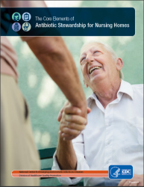
https://www.cdc.gov/longtermcare/prevention/antibiotic-stewardship.html

Slide 51

Defining the Problem
According to the CDC, "Each year in the United States, at least 2 million people become infected with bacteria that are resistant to antibiotics and
at least 23,000 people die each year as
a direct result of these infections."

Slide 52

“The damaging effects of antimicrobial resistance (AMR) are already manifesting themselves across the world. Antimicrobial-resistant infections currently claim at least 50,000 lives each year across Europe and the US alone, with many hundreds of thousands more dying in other areas of the world. But reliable estimates of the true burden are scarce.”
http://amr-review.org/

Slide 53
“Based on scenarios of rising drug resistance for six pathogens to 2050, we estimated that unless action is taken, the burden of deaths from AMR could balloon to 10 million lives each year by 2050, at a cumulative cost to global economic output of 100 trillion USD. On this basis, by 2050, the death toll could be a staggering one person every three seconds and each person in the world today will be more than 10,000 USD worse off.”
Based on United Nations report World Population Prospects: The 2015 Revision, 2015, which cites current world population of 7.3 billion and projected world population in 2050 of 9.7 billion.
http://amr-review.org/sites/default/files/160525_Final%20paper_with%20cover.pdf

Slide 54


Slide 55

Think Globally
Act Locally

Slide 56

We must be partners and communicate
with each other if we are to solve the
problem of antibiotic resistance

Slide 57
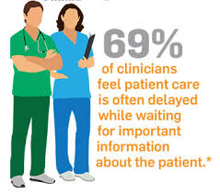
Inter-Facility Infection Control Transfer Form
Communication tool
Clear, concise information
Facility to facility, as well as within a facility
Improves patient care
Decreased potential for patient harm
Three main viewpoints:
  Sepsis
  Antimicrobial Stewardship
  Infection Prevention
https://www.cdc.gov/hai/pdfs/toolkits/InfectionControlTransferFormExample1.pdf

Slide 58
Inter-facility
Transfer
Form
This is available on the NVASP.net webpage under
FORMS
Notes:
Our form

Slide 59
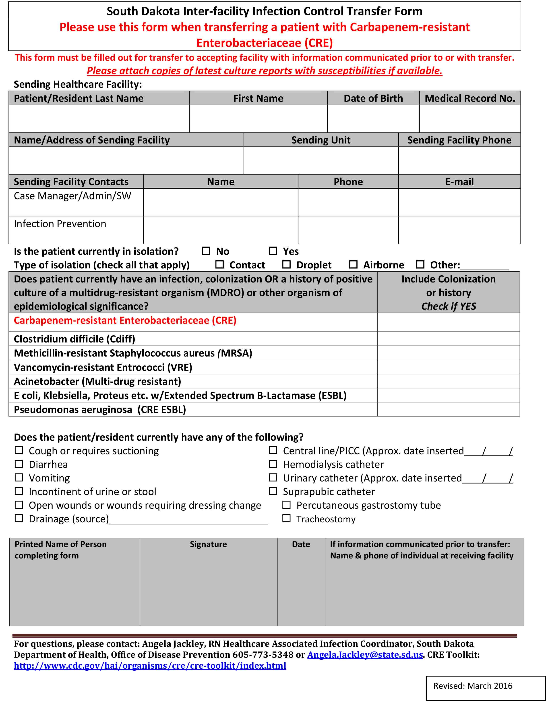
Notes:
South Dakota Form

Slide 60
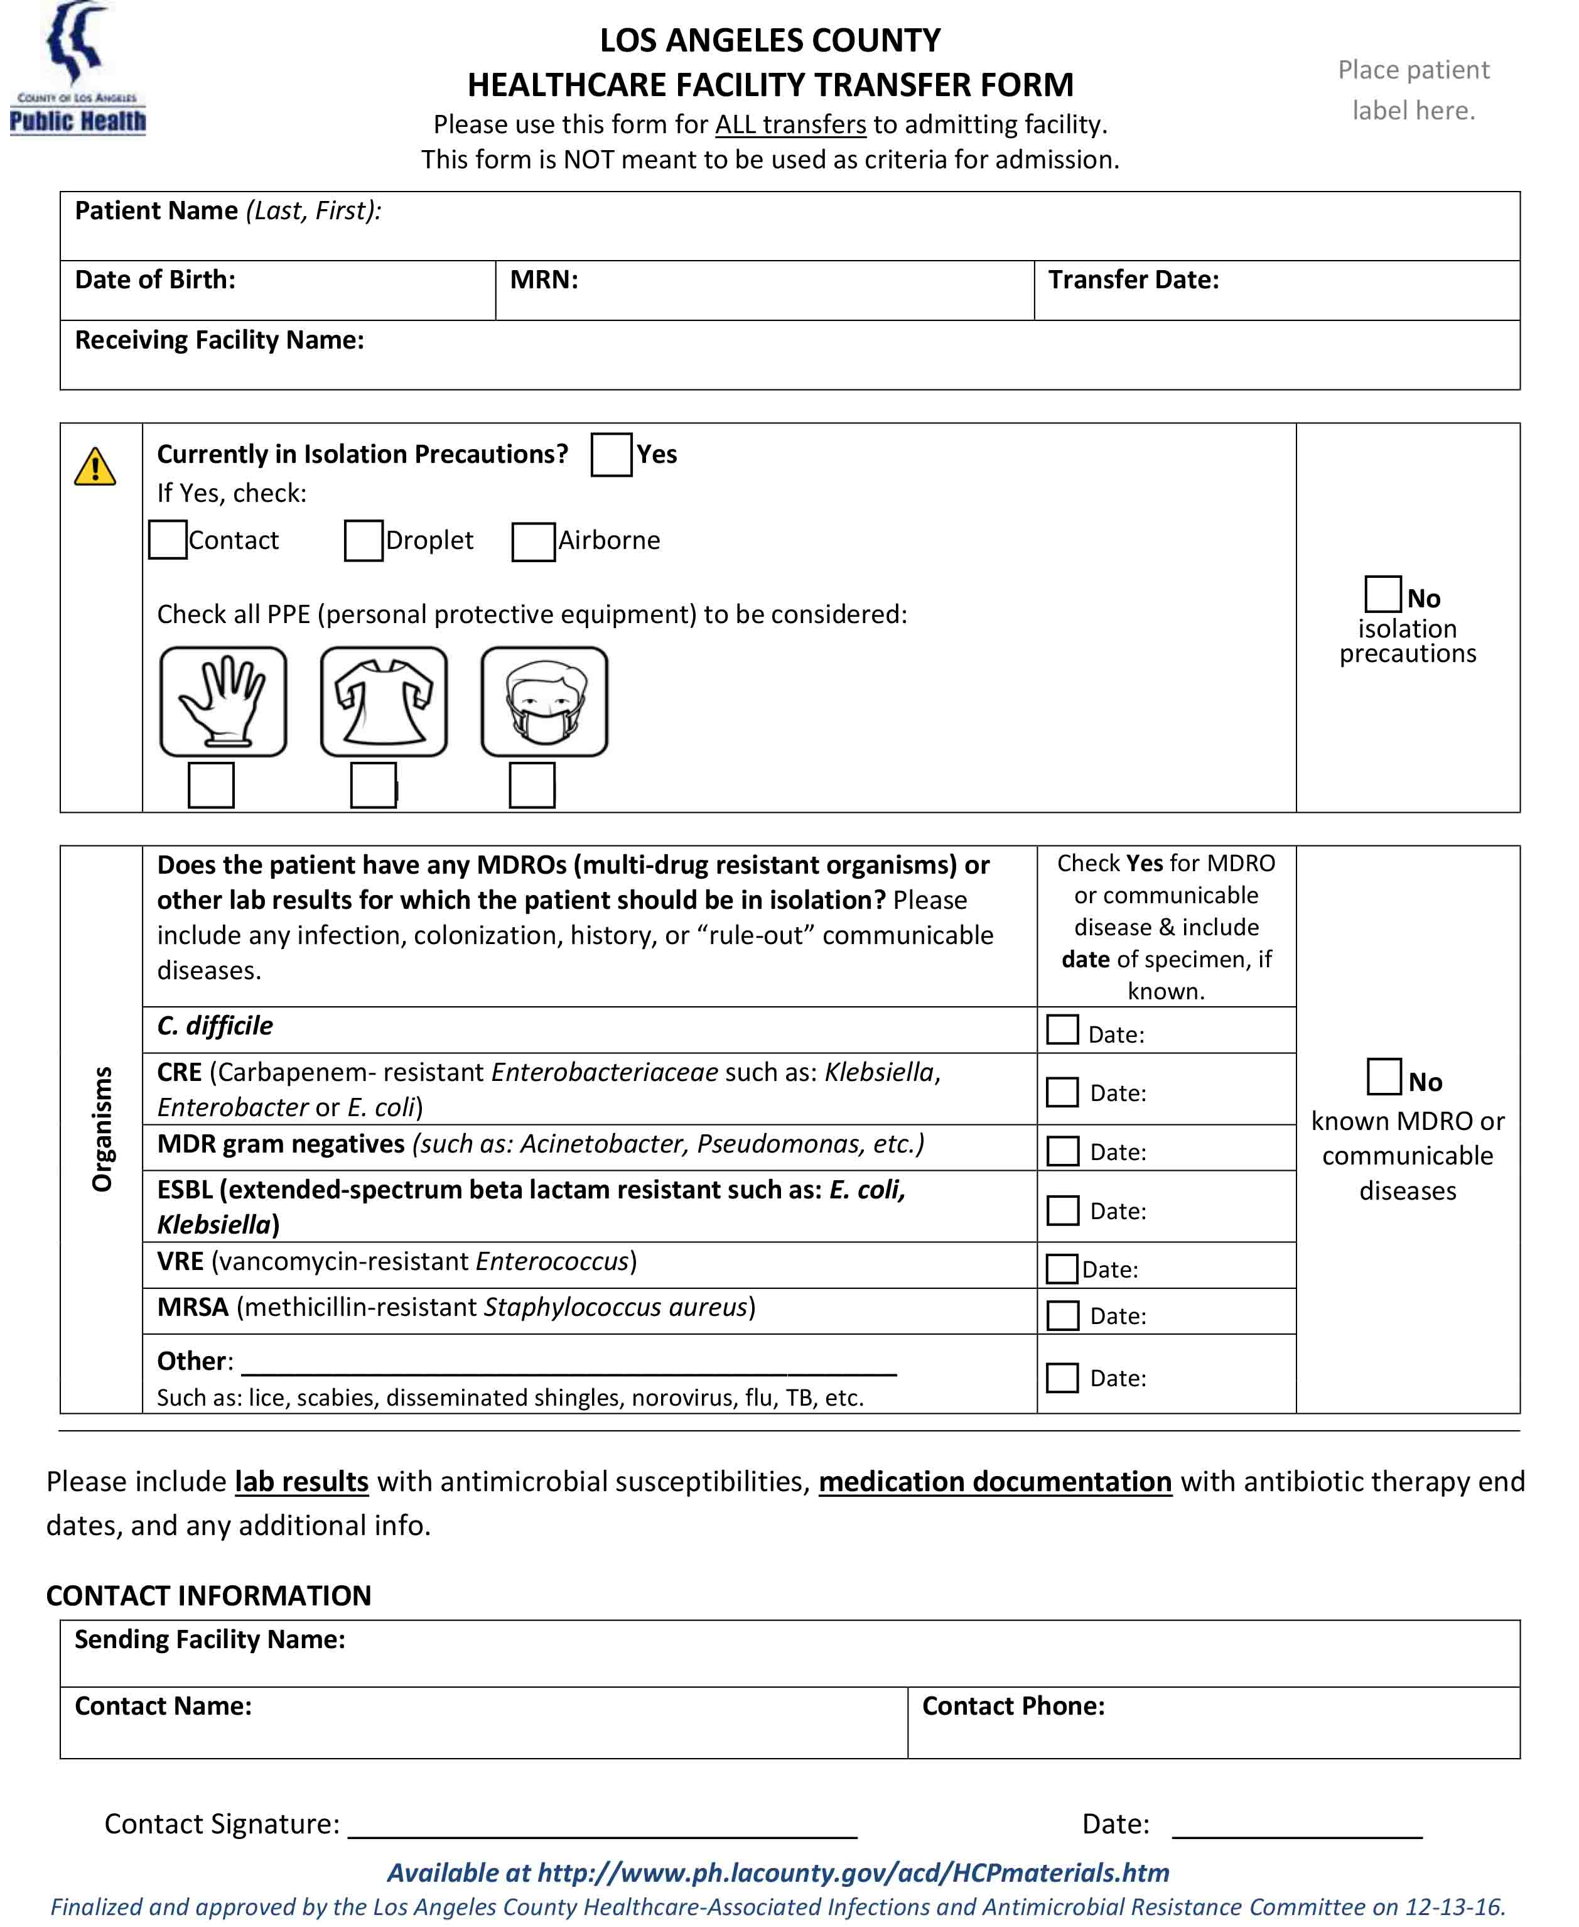
Notes:
Los Angeles County Form

Slide 61
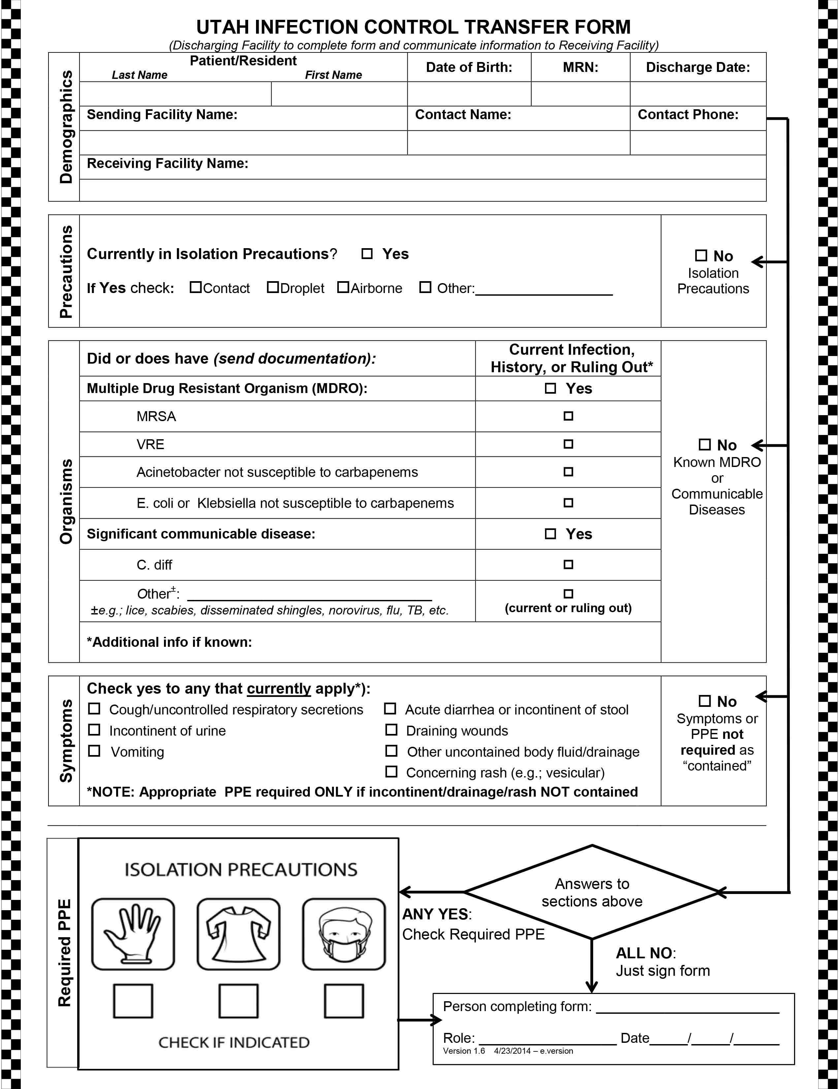
Notes:
Utah Form

Slide 62
Los Angeles and
South Dakota

Slide 63


Slide 64
J Am Med Dir Assoc. 2010 May;11(4):239-45. doi: 10.1016/j.jamda.2009.08.006. Epub 2010 Mar 12.
What are your Organizational Barriers to Communication?
hospital-nursing home affiliations, pharmacy or laboratory agreements, cross-site staff visits, and cross-site physician care;
hospital size, teaching status, and frequency of geriatrics specialty care;
nursing home size, location, type, staffing, and Medicare quality indicators; and
(4) hospital-to-nursing home communication,
consistency of hospital care with health care goals,
and communication quality improvement efforts.

Slide 65

J Am Med Dir Assoc. 2010 May;11(4):239-45. doi: 10.1016/j.jamda.2009.08.006. Epub 2010 Mar 12.
The most frequently reported perceived barriers to communication were
sudden or unplanned transfers (44.4%),
transfers that occur at night or on the weekend (41.4%),
hospital providers' lack of effort (51.0%), lack of familiarity with patients (45.0%), and lack of time (43.5%). Increased hospital size, teaching hospitals, and urban nursing home location were associated with greater perceived importance of these barriers, and
cross-site staff visits and hospital provision of laboratory and pharmacy services to the nursing home were associated with lower perceived importance of these barriers.

Slide 66

Format: Abstract J Gerontol Nurs. 2004 Jun;30(6):10-5; quiz 52-3.
The transition of elderly patients between hospitals and nursing homes. Improving nurse-to-nurse communication. Cortes TA¹, Wexler S, Fitzpatrick JJ.
Lack of patient information is a particular problem when a patient is transferred from one health care facility to another. The lack of information needed to develop a timely and effective plan of care for an older adult transferred to the nursing home facility may exacerbate disruptions in the older adult's care. Also, adjustment or readjustment to the nursing home or hospital environment may be prolonged. Persistence of problems or difficulty in adjustment may then lead to exacerbation of the disease processes and, ultimately, hospital readmissions. Evidence suggests that elderly patients discharged from the hospital have high readmission rates. Although the patient is most affected by a breakdown in communication, everyone in the nursing home involved in the resident's care is also affected. All staff who provide care to the resident, including nursing, medicine, nutrition, pharmacy, social work, and physical therapy staff members, must be cognizant of issues related to communication for patients being transferred. In this article, the authors discuss the development, implementation, and results of a model designed to increase the communication surrounding the transition of elderly patients from an inpatient unit to and from nursing homes.
https://www.ncbi.nlm.nih.gov/pubmed/15227932

Slide 67
J Am Geriatr Soc. 2010 May;58(5):901-7. doi: 10.1111/j.1532-5415.2010.02804.x. Epub 2010 Apr 6.
Factors associated with potentially preventable hospitalization in nursing home residents in New York State: a survey of directors of nursing.
CONCLUSION:
Efficient and effective care depends on continuity of communication between nurses and physicians and adequate access to patients' medical history, laboratory results, and ECGs.
https://www.ncbi.nlm.nih.gov/pubmed/20406315

Slide 68
The Three Legged Stool
Healthcare Workers
Healthcare Facilities
Patients and their families

Slide 69
J Aging Res. 2014;2014:873043. doi: 10.1155/2014/873043. Epub 2014 Feb 9. Following up on clinical recommendations in transitions from hospital to nursing home. Caruso LB1, Thwin SS2, Brandeis GH1. Abstract
Following up on recommendations made at the time of a hospital discharge is important to patient safety. While data is lacking, specifically around the transition of patient to nursing home, it has been postulated that missed items such as laboratory tests may result in adverse patient outcomes. To determine the extent of this problem, a retrospective cohort study of subjects discharged from an academic medical center and admitted to nursing homes (NH) was followed to determine the type of discharge recommendations and the rate of completion. In addition, for the purpose of generalizability, the 30-day hospital readmission rate was calculated. Recommendations were made on 51 subjects. Almost a quarter of the recommendations made by the hospital discharging team were not acted upon. Furthermore, for the majority of those recommendations that were not acted upon, a reason could not be determined. In concert with national data, 20% of the subjects returned to the hospital within 30 days. Further investigation is warranted to determine if an association exists between missed recommendations and hospital readmission
from the nursing home setting.
https://www.ncbi.nlm.nih.gov/pubmed/24678422
R.T.A. _ Return to Acute

Slide 70


In addition, the 30-day hospital readmission rate was calculated. Recommendations were made on 51 subjects. Almost a quarter of the recommendations made by the hospital discharging team were not acted upon.
https://www.ncbi.nlm.nih.gov/pubmed/24678422
In concert with national data, 20% returned to the hospital within 30 days.

Slide 71
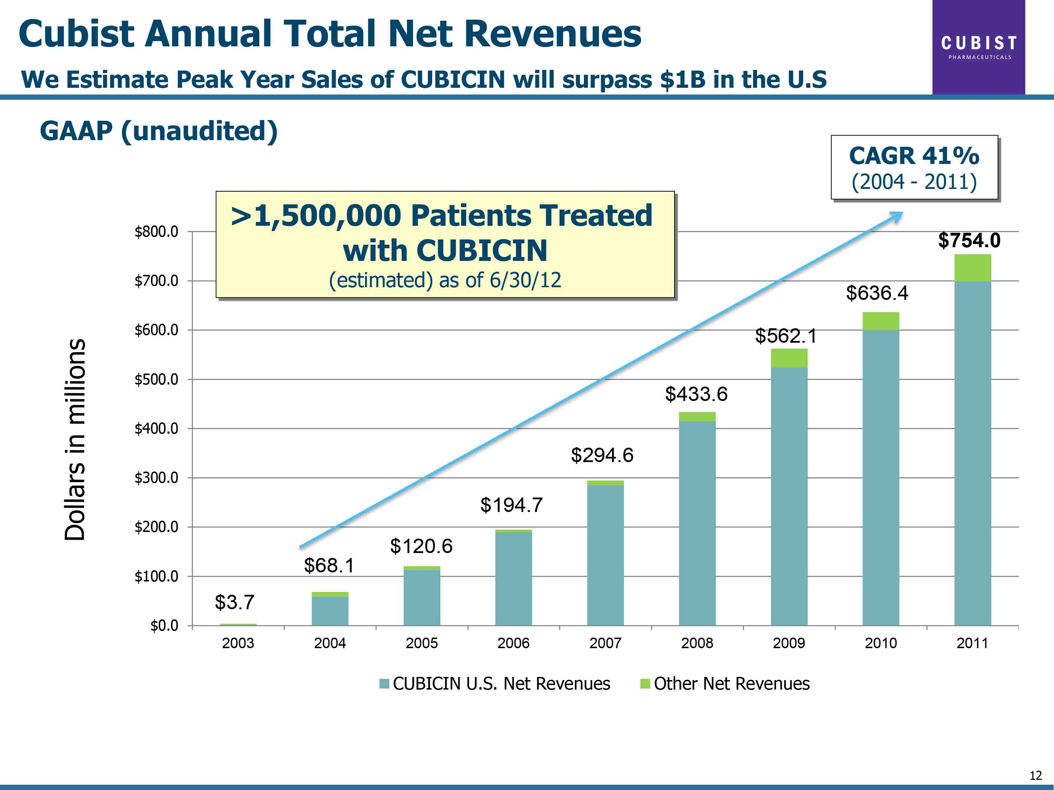

Slide 72
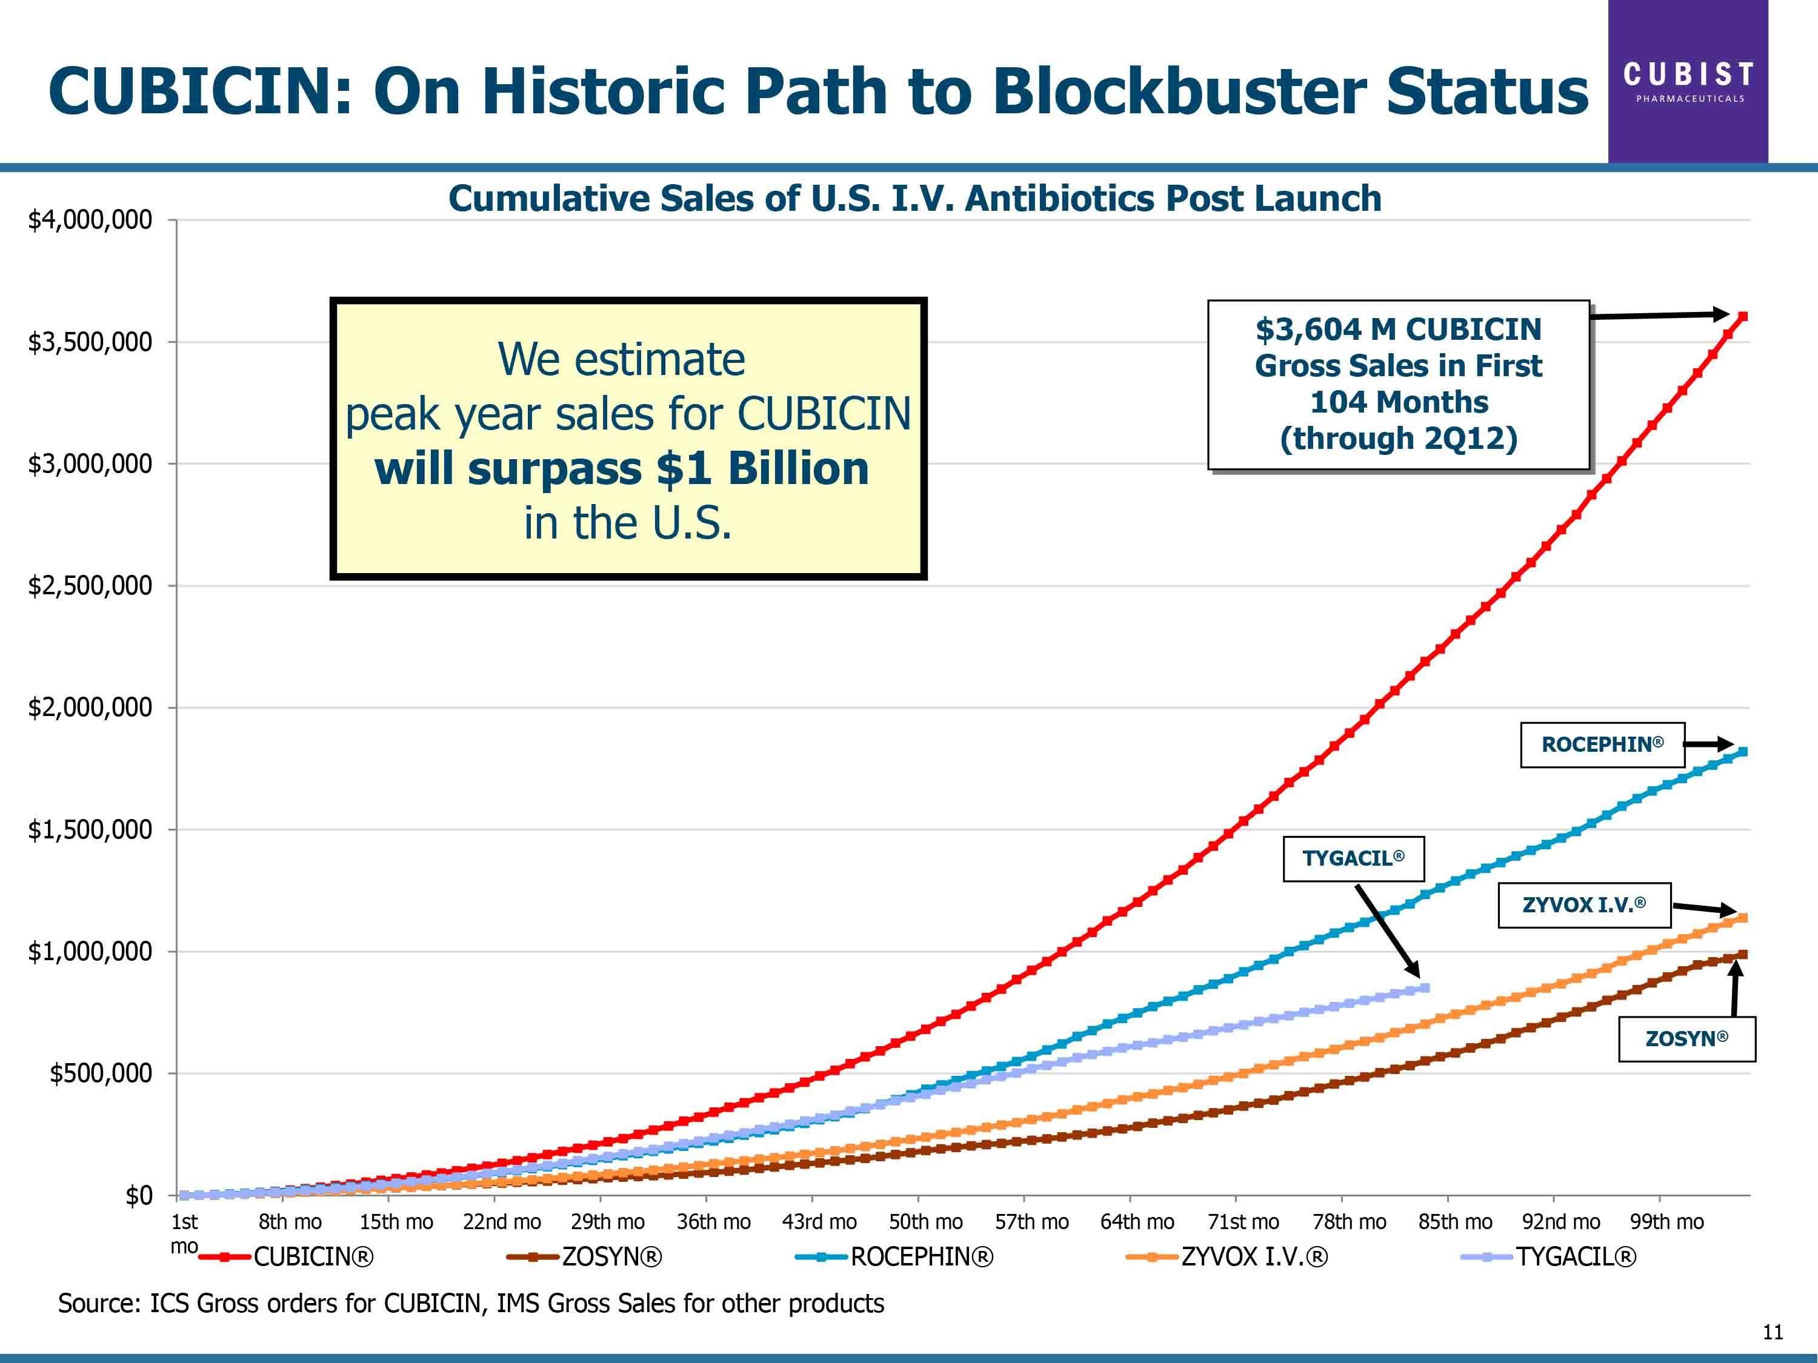

Slide 73


Slide 76


Slide 77


Slide 78


Slide 79


Slide 80

NV ASP Nevada Antimicrobial Stewardship EVOLUTION OF ANTIBIOTICS
Misuse Yesterday + Resistance Today
= No Choices Tomorrow

Slide 81
“This program is designed to cover a variety of topics related to the evolution of antibiotics and how we can change the future with responsible distribution.”

Slide 82
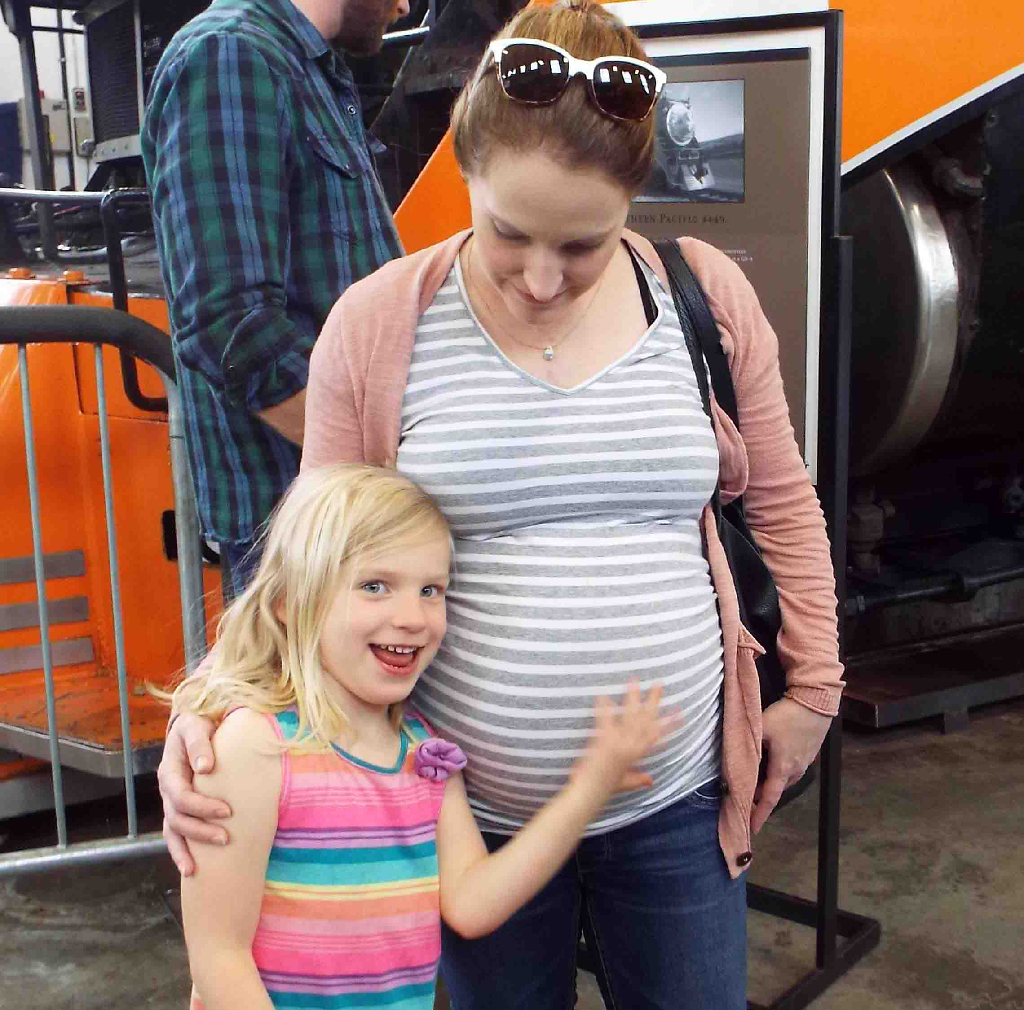

Slide 83


Slide 84
“The damaging effects of antimicrobial resistance (AMR) are already manifesting themselves across the world. Antimicrobial-resistant infections currently claim at least 50,000 lives each year across Europe and the US alone, with many hundreds of thousands more dying in other areas of the world. But reliable estimates of the true burden are scarce.”
http://amr-review.org/

Slide 85
“Based on scenarios of rising drug resistance for six pathogens to 2050, we estimated that unless action is taken, the burden of deaths from AMR could balloon to 10 million lives each year by 2050, at a cumulative cost to global economic output of 100 trillion USD. On this basis, by 2050, the death toll could be a staggering one person every three seconds and each person in
the world today will be more than 10,000 USD worse off.”
Based on United Nations report World Population Prospects: The 2015 Revision, 2015, which cites current world population of 7.3 billion and projected world population in 2050 of 9.7 billion.
http://amr-review.org/sites/default/files/160525_Final%20paper_with%20cover.pdf

Slide 86
Inter-facility
Transfer
Form
Notes:
It’s time for action. We need a commitment from every type of facility that they will speak with their powers to be about adopting this form, or creating a form with similar information. It’s in the best interest of all of our patients.

Slide 88





