Slide 1
Duration of Antimicrobial Therapy
Kimberly D. Leuthner, PharmD, FIDSA
University Medical Center of Southern Nevada
August 15, 2017

Slide 2
It depends…..
Thank you

Slide 3
Objectives
Overview
Generalized treatment concepts
Disease specific
  Pneumonia
  Pyelonephritis
  Intra-abdominal infection
Summary

Slide 4
2008 Hospital Drug expenses
Drug Expenses | 2008 Expenditures ($ Thousands) | % change from 2007
Antineoplastics | 3,344,742 | 5.0
Hemostatic modifiers | 3,459,980 | 6.6
Anti-infectives, systemic | 3,188,596 | 7.3
Blood growth factors | 2,196,040 | -9.6
Hospital solutions | 1,697, 024 | 17.5
Hoffman, JM, et al. Am J Health-Syst Pharm 2010;67:919-28

Slide 5
Unnecessary Use in Hospitals
Prospective observational study conducted in adult inpatients over 2 weeks in August 2001
576 (30%) of 1941 total antimicrobial days of therapy (DOT) were deemed unnecessary
33.3%
Hecker MT, et al. Arch Intern Med 2003;163:972-78

Slide 6

Duration of Antimicrobial Therapy
“Among available strategies to reduce use, reductions in length of antimicrobial regimens are the safest and are likely to be the most palatable to practicing clinicians.”
Rice LB: Clin Infect Dis 2008; 46:491

Slide 7
General treatment duration Issues
Duration depends on individual patient response
  Quicker the response shorter the duration
Source control extremely important
  Drain abscesses
  Remove lines or urinary catheters
Empirical treatment important
  Need to get it correct up front so knowing local susceptibility patterns vital

Slide 8
Pneumonia

Slide 9
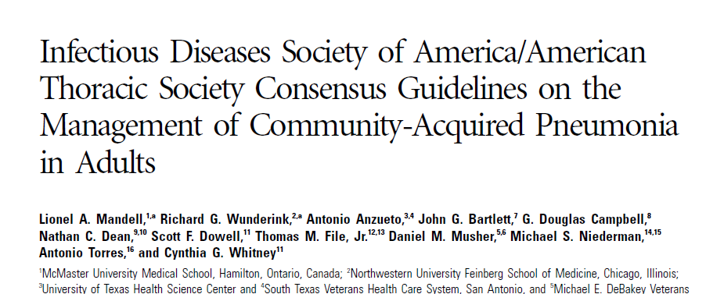
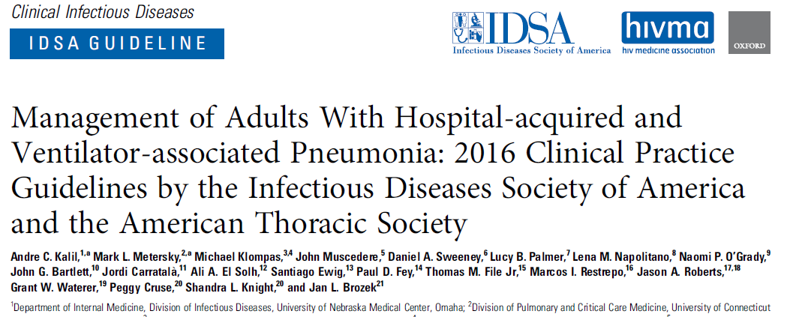

Slide 10
CAP: Length of Therapy
Minimum of 5 days
Before discontinuation of therapy:
  Afebrile for 48 – 72 hrs
  ≤ 1 CAP-associated sign of clinical instability
Longer duration usually indicated with Legionella, Chlamydophila, MRSA
Mandell LA et al. CID 2007;44:S27-72
File TM and Niederman MS. Infect Dis Clin North Am. 2004;18(4):993-1016

Slide 11
CAP: Criteria for Clinical Stability
Temperature < 37.8°C
Heart rate < 100 beats/min
Respiratory rate < 24 breaths/min
Systolic blood pressure > 90 mmHg
Arterial O₂ sat > 90% or pO2 > 60 mmHg RA
Ability to maintain oral intake
Normal mental status
Mandell LA et al. CID 2007;44:S27-72

Slide 12
Duration for CAP Clinical Trial
Randomized, multicenter clinical trial to confirm IDSA duration recommendations
  Intervention group
    5 days minimum
    Stopped when temperature ≤ 37.8° for 48h, and ≤ 1 CAP stability sign
  Control group
    Duration determined by physician
Uranga A et al. JAMA Int Med 2016;176(9)1257:1265

Slide 13
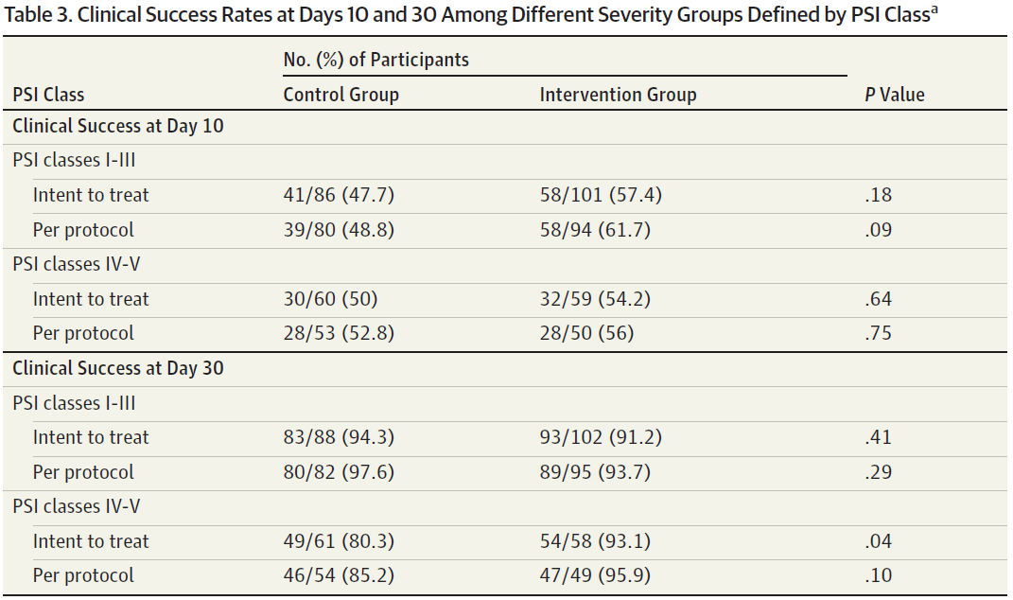
Results
Uranga A et al. JAMA Int Med 2016;176(9)1257:1265

Slide 14
HAP/VAP guidelines
7 day course of antibiotics
  Depending upon response of the patient

Slide 15
8 vs. 15d for VAP
Randomized, double blind trial for VAP
51 ICUs
  VAP confirmed by quantitative, BAL culture
Randomized to either 8 days vs. 15 days of antibiotics
Primary outcomes (at day 28 post BAL)
  Death (any cause)
  Microbiological reoccurrence
Chastre et al. JAMA 2003;290(19):2588-2598

Slide 16
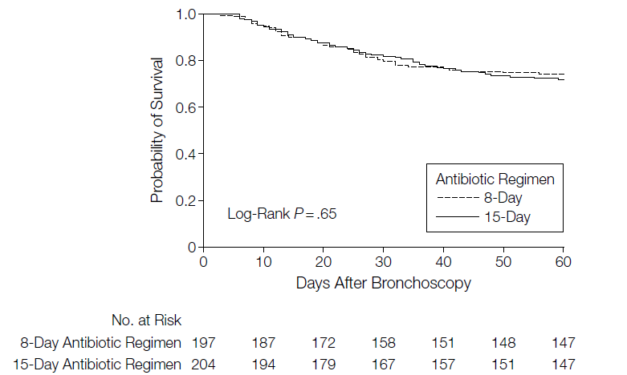
Probability of survival
Chastre et al. JAMA 2003;290(19):2588-2598
Notes:
Figure 2. Kaplan-Meier Estimates of the Probability of Survival Probability of survival is for the 60 days after ventilator-assisted pneumonia onset as a function of the duration of antibiotic administration.

Slide 17
Results
 | 8 days (n=197) | 15 days (n=204)
Mortality | 18.8% | 17.2%
Recurrent infection | 28.9% | 26.0%
Antibiotic free days | 13.1 days | 8.7 days
Antimicrobial resistance | 42.1% | 62.0%
Recurrence rate: Non-fermenting GNB | 40.6% | 25.4%
No difference in outcomes with short course (8-day) treatment
Chastre et al. JAMA 2003;290(19):2588-2598

Slide 18
Aspiration Pneumonia
Aspiration syndrome vs. chemical pneumonitis
  Defined for patients intubated for > 48h
    Temperature ≥ 38.5°C or ≤ 35.5°C
    WBC ≥ 10,000/mm or ≤ 4,000/mm
Randomized, prospective observational
No differences in mortality, LOS or
Empirical antibiotics – even with witnessed aspirations – not warranted unless clinical syndrome
  Antibiotics stopped if appropriately obtained cultures negative
New infiltrate
Purulent aspirate
Lascarrou JB et al. Crit care Med 2017;45:1268-1275

Slide 19
Recommendations
CAP
  5 days
  Hospitalized patients may need to extend duration until ≤ 1 CAP clinical stability marker
HAP/VAP
  Short course (7 days) appropriate for most
  May need longer duration for non-fermenting gram negatives
Aspiration pneumonia
  Unless clinical signs/symptoms antibiotics not warranted
  Antibiotics discontinued if cultures negative

Slide 20
Intra-abdominal infections

Slide 21
Uncomplicated Intra-abdominal
Generally involve transmural inflammation of a portion of the GI tract or its appendages
  No extension of the infection beyond the hollow viscus
  Microorganisms cannot be cultured from peritoneal or other surrounding fluid
If untreated, there is a substantial probability of these infections progressing to a complicated intra-abdominal infection
Solomkin JS, et al: Surg Infect 2010; 11:79; Clin Infect Dis 2010; 50:133

Slide 22
Complicated Intra-abdominal
Growth of pathogenic microorganisms in a normally sterile region of the abdominal cavity
Usually refers to secondary or tertiary peritonitis or an intra-abdominal abscess arising from a perforated viscus:
  Appendix
  Colon or small bowel
  Stomach or duodenum
  Gallbladder
  Postoperative
Solomkin JS, et al: Surg Infect 2010; 11:79; Clin Infect Dis 2010; 50:133

Slide 23

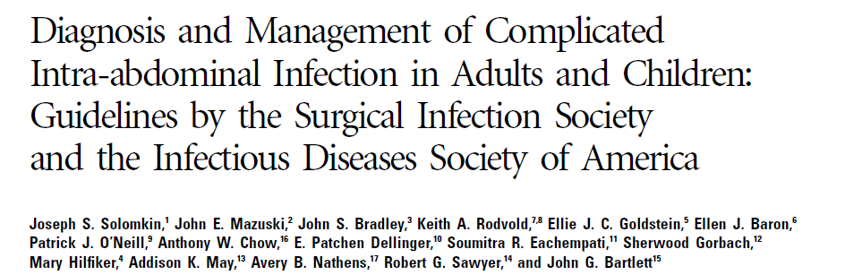


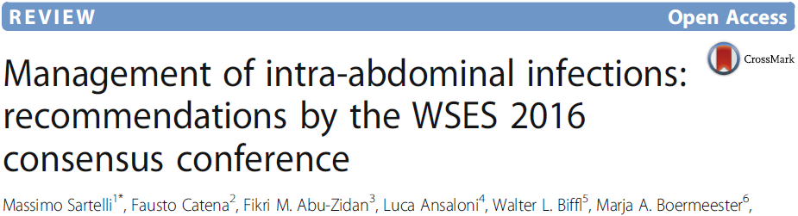

Slide 24
Guideline recommendations
Uncomplicated intra-abdominal infections
  Surgical interventions and antibiotics ≤ 24 h
Complicated Intra-abdominal infection
  4 to 7 days UNLESS UNABLE to achieve adequate source control
Bowel injuries due to penetrating, blunt or iatrogentic trauma
  ≤ 24 hours if repaired within 12h
Acute appendicitis without evidence of perforation, abscess or local peritonitis
  ≤ 24 hours
Solomkin JS, et al: Clin Infect Dis 2010; 50:133
Sartelli M et al. World Journal of Emergency Surgery 2017;12:22

Slide 25
Why Source Control?
Risk factors for mortality in 108 bacteremic patients with intra-abdominal infections.
Overall mortality was 27.8%
Source control ≤ 24h: 74/101 patients (73.3%)
  Mortality 9.5% adequate source control
  Mortality 33.3% inadequate source control
In the multivariate logistic regression analysis, inadequate source control was highly associated with mortality (P = 0.011)
Tellor B, et al: Crit Care Med 2012; 40[Suppl]:680

Slide 26
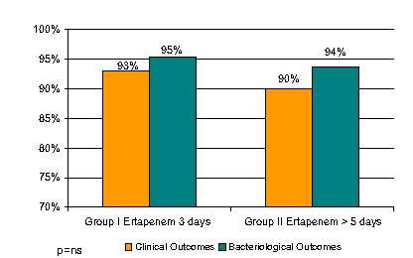
Duration of Antimicrobial Therapy
Prospective trial of 3 vs. > 5 days of antimicrobial therapy in 90 patients with low severity intra-abdominal infections
  50% with perforated appendicitis
Basoli A, et al: J Gastrointest Surg 2008; 12:592

Slide 27
SIS STOP-IT trial
Randomized, open-label trial
  Control: antibiotics until 2d post SIRS resolution (max 10d)
  Experimental: antibiotics for 4 days
Primary outcome: composite endpoint
  Surgical site infection
  Recurrent intra-abdominal infection
  Death
Sawyer R, et al: NEJM 2015;372;21:1999-2005

Slide 28
Results
260 patients control vs. 257 experimental
Similar baseline characteristics
  Similar surgical interventions/source control
  APACHE II score = 10
 | Standard (N=260) | 4 day (N=257) | P value
Surgical site infection; n(%) | 23 (8.8) | 17 (6.6) | 0.43
Recurrent intra-abd infection; n(%) | 36 (13.8) | 40 (15.6) | 0.67
Death; n(%) | 2 (0.8) | 3 (1.2) | 0.99
Composite ; n(%) | 58 (22.3) | 56 (21.8) | 0.92
Sawyer R, et al: NEJM 2015;372;21:1999-2005

Slide 29
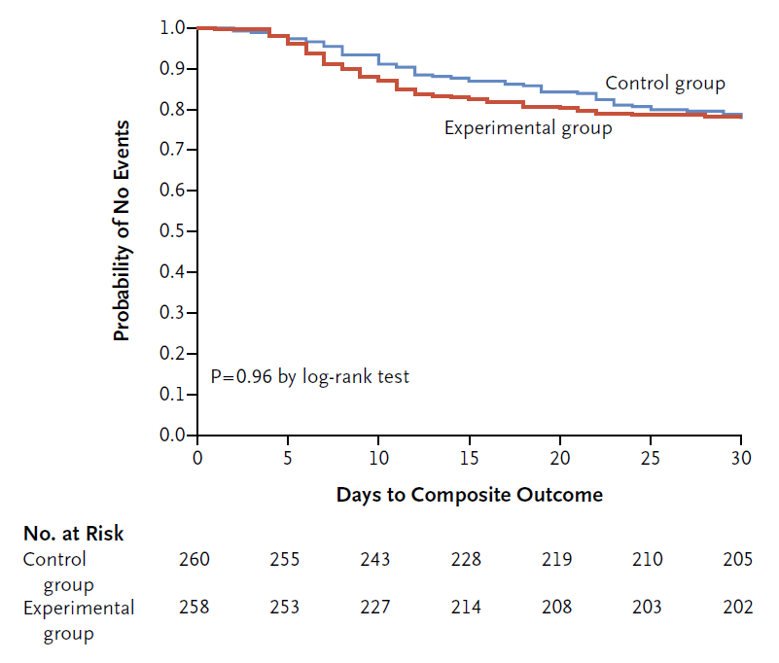
Time to Primary Outcome
Sawyer R, et al: NEJM 2015;372;21:1999-2005
Notes:
Primary endpoint was composite surgical site infection, recurrent intra-abd infection or death

Slide 30
Recommendations
Studies support guideline recommendations of shorter durations
  Certain patients as few as 3 days
  Most patients between 4 to 7 days
Source control is still integral to the treatment of most patients with intra-abdominal infections
  Duration of treatment without adequate source control not well defined

Slide 31
Pyelonephritis

Slide 32
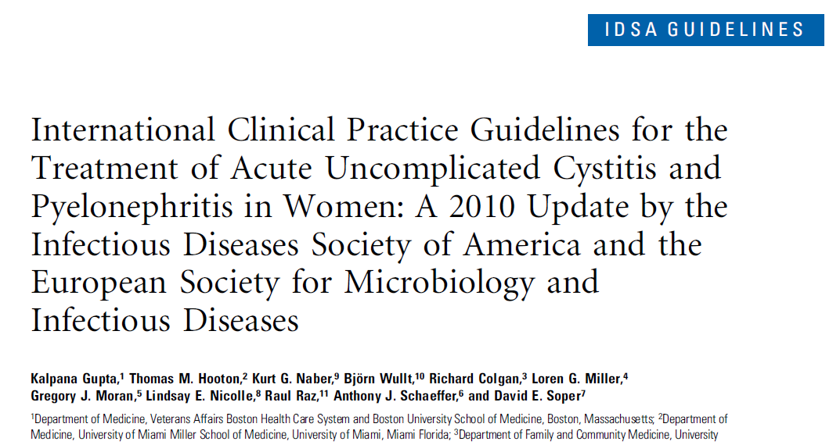
Notes:
In this case, there was no UTI to treat, but what if there is a UTI to treat?
Unfortunately, no specific guidelines for post-menopausal, NH population.

Slide 33
Guideline recommendations
Pyelonephritis
  7 days with fluoroquinolone
    Only if resistance rates < 10%
  14 days with TMP/SMX
  10-14 days with B-lactam
Guidelines published in 2011 – anything new?
UMCSN outpatient resistance > 25%
Gupta K et al. Clinical Infectious Diseases 2011;52(5):e103-120

Slide 34
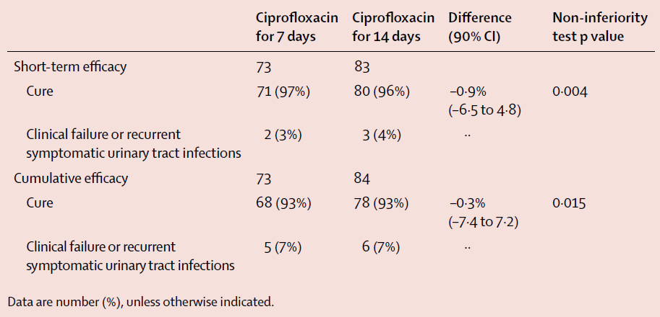
Ciprofloxacin 7 vs. 14 days
Randomized, prospective non-inferiority
Sandberg T et al. Lancet 2012;380:484-90

Slide 35
Duration Re-evaluation
Meta-analysis of RCT comparing ≤ 7 days to longer therapy
  Not specific for which antibiotics included
Primary outcome
  Clinical failure at EOT longer treatment arm
Secondary outcomes
  Clinical failure at end of follow-up
  Microbiological failure
  All cause mortality
  Resistance development
Eliakim-Raz N et al. Antimicrob Chemother 2013;68:2183-2191

Slide 36
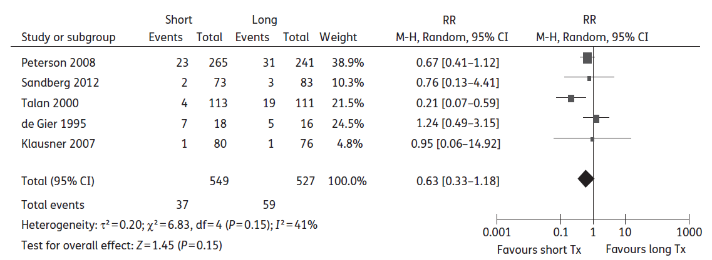
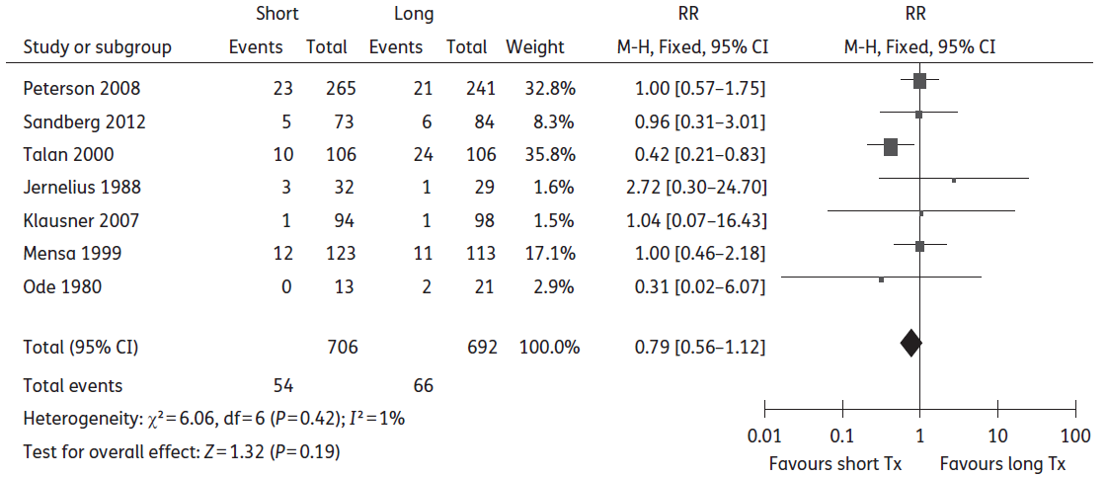
End of therapy
End of Follow-up

Slide 37
Summary
No differences in any outcomes
  Clinical failure at EOT or EOF
  Microbiological
  Adverse events
Conclusion
Shorter courses for the treatment of acute pyelonephritis appropriate
If patient has urogenital abnormalities, longer durations may be warranted
Eliakim-Raz N et al. Antimicrob Chemother 2013;68:2183-2191

Slide 38
B-lactams for pyelonephritis
Retrospective, non-inferiority, multi-center cohort for cefazolin vs. ceftriaxone
  Included for clinical signs/symptoms of pyelonephritis
  Microbiological susceptibilities not required
Primary outcome
  If cefazolin non-inferior to ceftriaxone
Hobbs ALV et al. J Antimicrob Chemother 2016;71:1665-1671

Slide 39
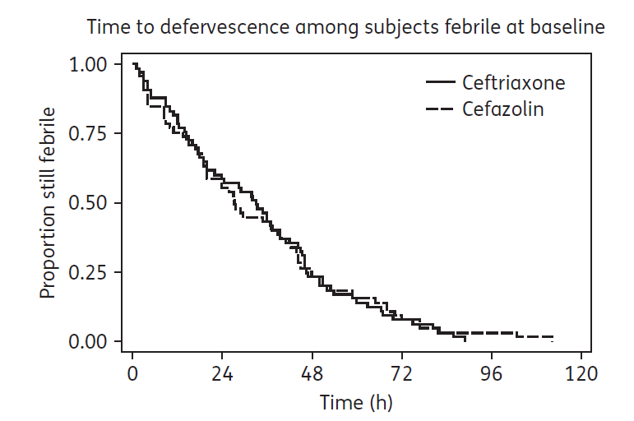
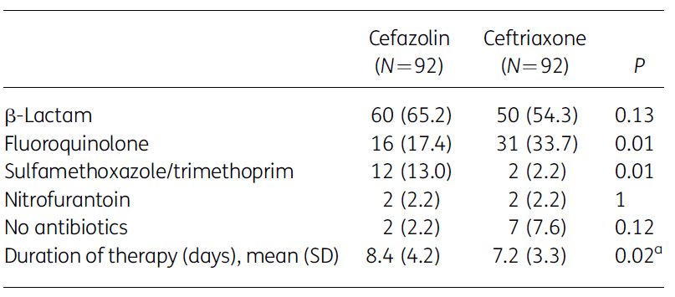
No different between groups
Hobbs ALV et al. J Antimicrob Chemother 2016;71:1665-1671
Notes:
P-value not significant if the patient who got 28d for prophylaxis is removed.

Slide 40
Summary
Retrospective study
No differences clinical response
  87.0% cefazolin vs. 85.9% ceftriaxone
Cefazolin was non-inferior to ceftriaxone
Demonstrates
Shorter courses even for B-lactam antibiotics may be appropriate
Treatment outcomes were independent of susceptibilities
Hobbs ALV et al. J Antimicrob Chemother 2016;71:1665-1671

Slide 41
Recommendations
Guidelines suggest 10-14 days
Newer studies show shorter duration appropriate
  ≤ 7 days
  Does not appear to matter which antimicrobial
Important to know local susceptibilities to ensure appropriate empirical therapy
  Duration may have to be extended due to non-response if initial therapy not susceptible
Hobbs ALV et al. J Antimicrob Chemother 2016;71:1665-1671

Slide 42
Overall Summary
Studies supporting shorter courses regardless of diagnosis
Duration should be individualized to patient response
Disease | Treatment days
 | Short | Long
Community acquired pneumonia | 3 – 5 | 7 – 10
VAP/HAP pneumonia | ≤ 8 | 10 – 15
Aspiration pneumonia | 3 – 7 | 7 – 10
Intra-abdominal infection | 4 | 10
Pyelonephritis | 5 – 7 | 10 – 14
Spellberg, B. JAMA Int Med 2016;176(9)1254:1255

Slide 43

Questions?

