Slide 1
Antibiotic Stewardship in the Nursing Home
Donna S. Thorson, MS, CPHQ, CPPS | Senior Project Manager, HealthInsight

Slide 2
Objectives
Describe the core elements of an antibiotic stewardship program in long-term care
Identify two strategies for supporting appropriate prescribing patterns for antibiotic therapy
Explain how the antibiotic stewardship program in long-term care supports continuity of care

Slide 3
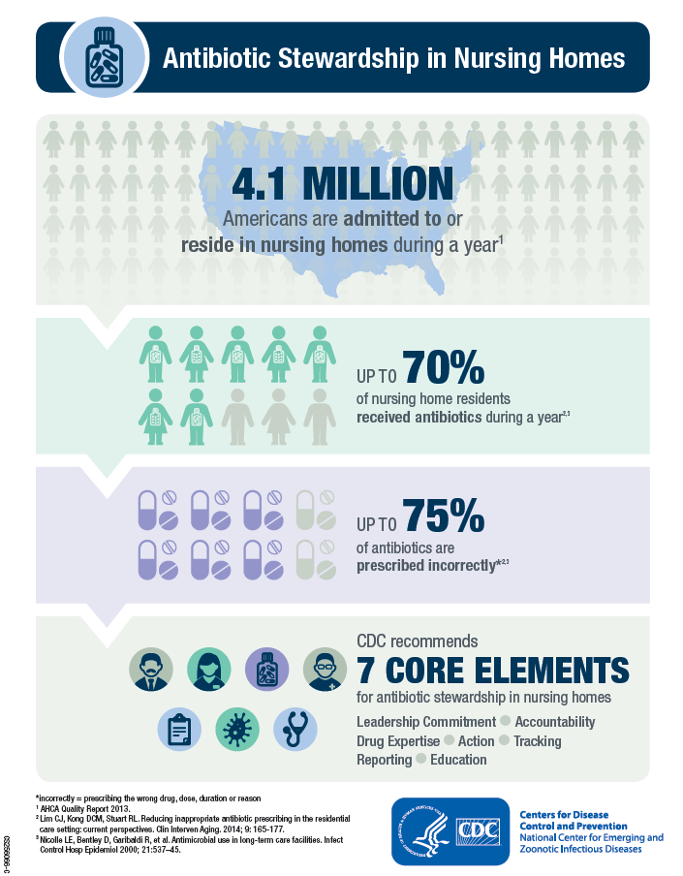
Nursing Home Requirements of Participation – Phase 2
§483.80(a) Infection prevention and control program.
The facility must establish an infection prevention and control program (IPCP) that must include, at a minimum, the following elements:
§483.80(a)(3) An antibiotic stewardship program that includes antibiotic use protocols and a system to monitor antibiotic use.
Federal Register / Vol. 81, No. 192, p 68868

Slide 4
F881
INTENT
The intent of this regulation is to ensure that the facility:
Develops and implements protocols to optimize the treatment of infections by ensuring that residents who require an antibiotic are prescribed the appropriate antibiotic
Reduces the risk of adverse events, including the development of antibiotic-resistant organisms, from unnecessary or inappropriate antibiotic use
Develops, promotes and implements a facility-wide system to monitor the use of antibiotics
Advanced Copy – Appendix PP with Final IGs, SOM

Slide 5
Guidance on F881
The facility must develop an antibiotic stewardship program that includes the development of protocols and a system to monitor antibiotic use.
This development should include leadership support and accountability via the participation of the medical director, consulting pharmacist, nursing and administrative leadership, and individual with designated responsibility for the infection control program, if different.
Advanced Copy – Appendix PP with Final IGs, SOM

Slide 6
F881 – ASP in Relation to Pharmacy Services
The assessment, monitoring and communication of antibiotic use shall occur by a licensed pharmacist in accordance with §483.45(c), F756, Drug Regimen Review.
A pharmacist must perform a medication regimen review (MRR) at least monthly, including review of the medical record and identify any irregularities, including unnecessary drugs.
Advanced Copy – Appendix PP with Final IGs, SOM

Slide 7
CDC Core Elements
Leadership support
Accountability
Drug expertise
Actions to improve use
Tracking: Monitoring antibiotic prescribing, use and resistance
Reporting information to staff on improving antibiotic use and resistance
Education

Slide 8
Agency for Healthcare Research and Quality (AHRQ)
Nursing Home Antimicrobial Stewardship Guide
Toolkits
  Implement, Monitor and Sustain an Antibiotic Stewardship Program (ASP)
  Determine Whether It Is Necessary To Treat a Potential Infection With Antibiotics
  Help Prescribing Clinicians Choose the Right Antibiotic
  Educate and Engage Residents and Family Members

Slide 9
Starting the Antibiotic
Stewardship Program
Gather a team and become familiar with antibiotic stewardship
Assign roles and responsibilities
Assess readiness to adopt and implement a program
Establish a timeline for implementation
Draft policies and procedures for the program
  Educate staff on antibiotic stewardship and introduce new policies and procedures

Slide 10
Monitor and Sustain the
Antibiotic Stewardship Program
Attendance at regularly scheduled team meetings
Track antibiotic use
Provide monthly summary reports on infections and antibiotic use
Share prescribing profiles with clinicians on a monthly or quarterly basis
Review and update guidelines (CDC)

Slide 11
ASP Policies and Procedures

Slide 12
Communicating and Decision-Making
Evidence-based communication between nurses and prescribers
Nursing vigilance to 12 common situations and infection control practices (pocket cards available from AHRQ)
Prescriber training
Resident and family education
Quality improvement practices

Slide 13
Antibiotics: Appropriate or Not?
Suspected infection (most common):
  Urinary tract
  Skin or soft tissue
  Respiratory
  Gastrointestinal
Course of action:
  Review minimum criteria for prescribing antibiotics
  Refer to the antibiogram and/or consulting pharmacist in choosing the most efficacious antibiotic for the infection and resident
  Optimize the duration of antibiotic therapy

Slide 14
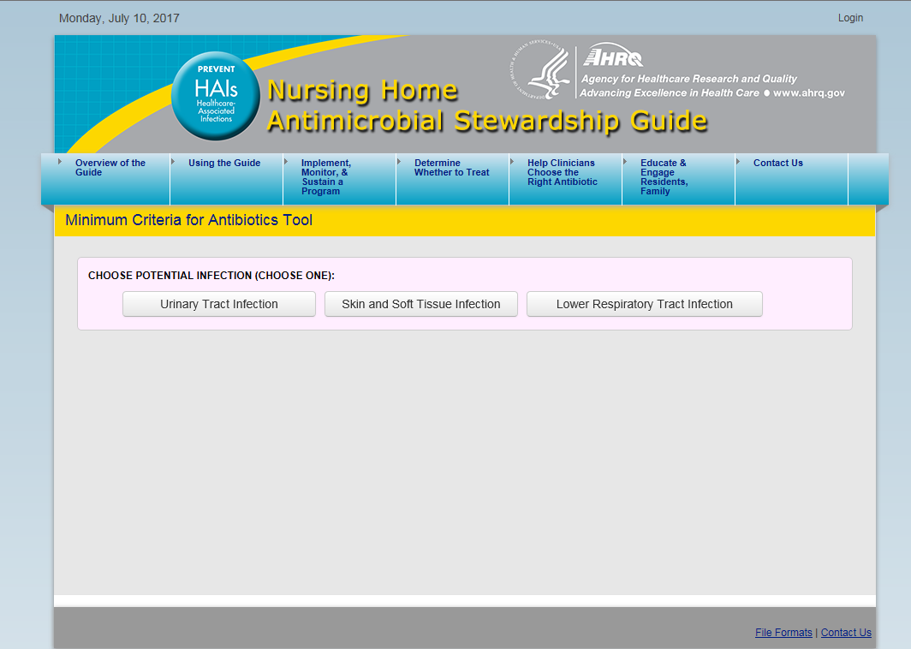
Determining the Need for Antibiotics
Introduce tools, such as the AHRQ Minimum Criteria for Antibiotics interactive tool http://nhguide.airprojects.org/tool3

Slide 15
Supporting Documentation
Notation of onset and description of the symptoms that require a change in the care plan/medical treatment (based on minimum criteria outlined in policy)
Diagnostics – standards for ordering and assessing the reliability of the process for ordering and obtaining a culture before starting antibiotics
Treatment
  If minimum criteria are not met
  If minimum criteria are met
    Duration of antibiotic therapy (recommendations included for key infections)
    Antibiotic timeout (trigger tool to stop and reassess antibiotic therapy – usually 72 hours)
    De-escalation of antibiotic therapy

Slide 16
Support Choosing the Right Antibiotic
ANTIBIOGRAMS
Work with the lab to get an antibiogram report
Develop written instructions for use
Identify champions to drive successful implementation
Inform nursing home staff, prescribing clinicians and local hospitals about plans to use the antibiogram
Plan distribution beforehand
Distribute information to prescribing clinicians and nursing home staff
Monitor use of antibiotics
Keep the antibiogram updated annually

Slide 17
Education and Engagement
Encourage discussion about
  The benefits and risks
  When antibiotics are helpful and when they are not
  Optimal treatment
Make information and tools/materials available
  Nursing home staff
  Prescribing clinicians
  Residents
  Family members

Slide 18
Monitor and Sustain ASP

Slide 19
Tracking
Bring all the data together in one place
  Infection control logs
  Lab results and X-rays
  Organisms
  Names of prescribing clinicians
  Antibiotic therapies
  Whether or not follow-up communication has occurred
    Residents
    Prescribing clinicians
Allows ASP team to see trends and patterns
Notes:
Nursing homes are already collecting some of this information in infection control logs and medical charts, so the next step to using this tool is figuring out how to blend it into existing practices. The process of filling out the Tracking Sheet should fit into the normal workflow and division of duties in the nursing home. A designated staff person should be responsible for completing the Tracking Sheet and nursing staff must have a logical and convenient way of reporting information required (e.g., by dropping off copies of diagnostic forms or antibiotic orders).
Data can be collected on a weekly or monthly basis and can be used to create monthly, quarterly, or annual cumulative reports. By bringing the data together in one tool, the Tracking Sheet allows the antimicrobial stewardship program team to see trends and patterns in infections and antibiotic use that might not be noticed otherwise.

Slide 20
Monitoring and Sustaining
Summarize data on a monthly basis
  Month-to-month comparison of totals over time
  Evaluate use of antibiotics (increasing, decreasing, remaining the same)
  Evaluate progress on other goals
    Decrease in use of antibiotic therapy with residents who do not meet diagnostic criteria
    Decrease use of particular antibiotics that may be a concern
Communicate results to prescribing clinicians

Slide 21
Quality Improvement
Share monthly summary reports with QAA/QAPI
  Potential opportunities for improvement
Consider these elements in choosing areas for improvement
  The frequency of occurrence
  The risk to the well-being of residents; how it impacts quality of life and/or quality of care
  The cost incurred with each occurrence

Slide 22
Continuity of Care Across Providers
Partner with the antibiotic stewardship team at referring hospitals
Optimize antibiotic therapy
Utilize community antibiograms (in partnership with nursing home antibiogram)
Slow the growth of antibiotic resistance (decrease MDROs)
Manage resident/family expectations regarding antibiotic use
Notes:
Despite elevated awareness, publication of guidelines on antimicrobial stewardship,3 and several initiatives, the proportion of resistant strains causing both health care– and community-associated infections continues to increase and the number of new antimicrobials continues to decline.
Antimicrobial stewardship is a coordinated program that promotes the appropriate use of antimicrobials (including antibiotics), improves patient outcomes, reduces microbial resistance, and decreases the spread of infections caused by multidrug-resistant organisms.

Slide 23
Key Points
Nursing homes required to have an antibiotic stewardship program in place by Nov. 28
Optimize antibiotic therapy
  Improve patient outcomes
  Slow antibiotic resistance
  Reduce the risk of citation for F757 Unnecessary Drugs
Partner with the antimicrobial stewardship team from hospitals in your referral network

Slide 24
Questions?

Slide 25
Resources
Centers for Disease Prevention and Control
Agency for Healthcare Research and Quality
Federal Register
Advanced Copy – Appendix PP SOM

Slide 26
Contact Us
Donna Thorson, MS, CPHQ, CPPS
Senior Project Manager
HealthInsight
dthorson@healthinsight.org
Office: 702-933-7327
Mobile: 702-743-8975
This material was prepared by HealthInsight, the Medicare Quality Innovation Network -Quality Improvement Organization for Nevada, New Mexico, Oregon and Utah, under contract with the Centers for Medicare & Medicaid Services (CMS), an agency of the U.S. Department of Health and Human Services. The contents presented do not necessarily reflect CMS policy. 11SOW-CORP-17-110-NV

