Slide 1
Asymptomatic bacteremia and
CDC’s Antimicrobial Resistance Laboratory Network in Nevada
Julia (Julie) A. Kiehlbauch, Ph.D., D(ABMM)

Slide 2
Objectives
At the completion of the presentation, attendees will be able to:
  Compare and contrast bacteremia, sepsis and asymptomatic bacteremia
  Describe asymptomatic bacteremia
  Identify other diagnostic tests that might help distinguish between bacteremia, sepsis and asymptomatic bacteremia
  Identify reasons why asymptomatic bacteremia may not warrant treatment
  Describe occult bacteremia in children and contrast this with asymptomatic bacteremia

Slide 3
What is bacteremia?
2017 ICD-10-CM Diagnosis Code R78.81 Bacteremia
Clinical Information
The presence of viable bacteria circulating in the blood. Fever, chills, tachycardia, and tachypnea are common acute manifestations of bacteremia. The majority of cases are seen in already hospitalized patients, most of whom have underlying diseases or procedures which render their bloodstreams susceptible to invasion.
Symptoms and Signs
Some patients are asymptomatic or have only mild fever.
Development of symptoms such as tachypnea, shaking chills, persistent fever, altered sensorium, hypotension, and GI symptoms (abdominal pain, nausea, vomiting, diarrhea) suggests sepsis or septic shock. Septic shock develops in 25 to 40% of patients with significant bacteremia. Sustained bacteremia may cause metastatic focal infection or sepsis.

Slide 4
Other definitions
Bacteremia
Bacteremia is the presence of bacteria in the blood as evidenced by a positive blood culture. It is often transient and of no consequence; however, sustained bacteremia may lead to widespread infection and sepsis.
Systemic Inflammatory Response Syndrome (SIRS)
Establishes a clinical response to a nonspecific condition of either infectious or noninfectious origin. SIRS criteria include:
Fever of more than 38°C (100.4°F) or less than 36°C (96.8°F)
Heart rate of more than 90 beats per minute
Respiratory rate of more than 20 breaths per minute or arterial carbon dioxide tension (PaCO2) of less than 32mm Hg
Abnormal white blood cell count (>12,000/µL or < 4,000/µL or >10 percent immature [band] forms)
There are two codes for SIRS of a non-infectious origin in ICD-10-CM, with assignment depending on the presence or absence of associated organ dysfunction: R65.10, systemic inflammatory response syndrome (SIRS) of non-infectious origin without acute organ dysfunction and R65.11, systemic inflammatory response syndrome (SIRS) of non-infectious origin with acute organ dysfunction.

Slide 5
More definitions…
Sepsis
Sepsis can be defined as the presence of both an infection and a systemic inflammatory response. The clinical features include two or more of the SIRS criteria occurring as a result of a suspected or documented infection, taking into consideration the entire clinical picture of the patient.
Septicemia
Older term, In ICD-10, May be used as a synonym for sepsis, unspecified organism.
Severe Sepsis
When a patient has sepsis with evidence of organ dysfunction, this is known as severe sepsis

Slide 6
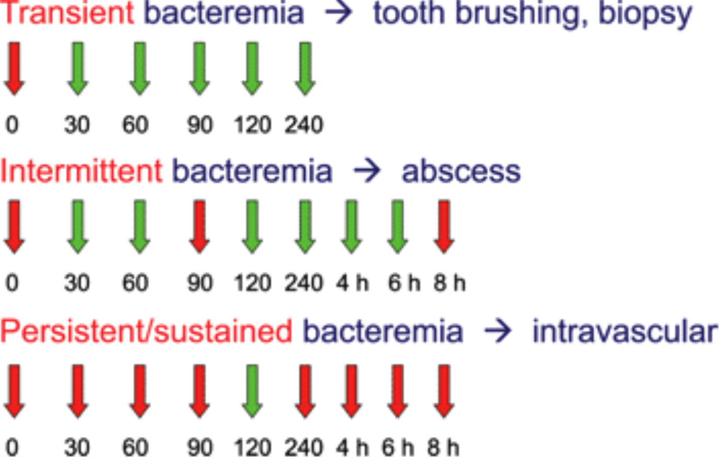
Classification of bacteremias
From: The Clinical Importance of Microbiological Findings in the Diagnosis and Management of Bloodstream Infections
Clin Infect Dis. 2009;48(Supplement_4):S238-S245. doi:10.1086/598188
Clin Infect Dis | © 2009 by the Infectious Diseases Society of America
Notes:
Figure 1 Commonly used classification of bacteremias into 3 categories: transient (bacteremia lasts for a short amount of time and can be caused by actions such as brushing of teeth or after gastrointestinal biopsy), intermittent (recurring bacteremia due to discontinuous seeding of the same organisms, which can be caused by infections such as abscesses), and persistent or sustained (bacteremia occurring over a prolonged period that is usually associated with infections such as infective endocarditis). Red and green arrows indicate the presence and absence, respectively, of bacteria in blood cultures obtained at different time points (in minutes, unless hours [h] is specified).
6

Slide 7
True vs. asymptomatic bacteremia?
Bacteremia is the presence of bacteria in the bloodstream.
May occur spontaneously, during certain tissue infections, with use of indwelling GU or IV catheters, or after dental, GI, GU, wound-care, or other procedures.
Some patients are asymptomatic or have only mild fever.
Differentiate true from asymptomatic bacteremia by looking for development of other symptoms:
  Usually suggests more serious infection, such as sepsis or septic shock
  Look for tachypnea, shaking chills, persistent fever, altered sensorium, hypotension, and GI symptoms (abdominal pain, nausea, vomiting, diarrhea) suggests sepsis or septic shock. Septic shock develops in 25 to 40% of patients with significant bacteremia.
  Sustained bacteremia may cause metastatic infections, including endocarditis, especially in patients with valvular heart abnormalities.
Diagnosis is by blood culture and exclusion of focal infection.

Slide 8
Common causes of asymptomatic bacteremia
Bacteremia may occur during
  Certain ordinary activities e.g. vigorous tooth brushing
  Dental or medical procedures
    Typically after manipulation of nonsterile body sites
      Dental procedures: tooth cleaning, tooth extraction, peridontal work
      Gastrointestinal biopsy
      Rectal or prostate biopsy
      Percutaneous catheterization of the vascular system, bladder, or common bile duct
      Surgical debridement or drainage
  Certain bacterial infections
    May see transient bacteremia in intestinal Campylobacter infection
  Injection of recreational drugs

Slide 9
Diagnosis of bacteremia
Clinical:
  Look for focal infection(s)
  Medical history to see if explanation for bacteremia
Laboratory
  Cultures: blood and any other suspected sites
    Single isolates of known pathogenic bacteria generally considered to be true positive results
    Same pathogen from blood and suspected site highly significant
    How long did it take for the culture to turn positive
    Cultures that grow multiple isolates or nonpathogenic bacteria are considered contaminated
  Consider viral diagnostic studies to rule out typical/seasonal viruses
  (e.g. Influenza)
  Look for other inflammatory markers
    CBC
      WBC
      Absolute Neutrophil Count
    Consider procalcitonin or C-Reactive Protein

Slide 10
Common organisms found in asymptomatic bacteremia
Procedure | Source | Examples
Dental procedure | Oral microflora | Streptococci Enterococci Oral anaerobes
Gastrointestinal/Rectal/Prostate Biopsy | GI flora (including Gram Negative Rods and Anaerobes | Escherichia coli Klebsiella and Enterobacter spp. Bacteroides spp. Prevotella spp.
Percutaneous catheterization of the vascular system, bladder, or common bile duct | Skin flora or genitourinary flora | Staphylococcus aureus Coagulase-negative Staph. Streptococcus spp. Enterococcus spp. Escherichia coli Klebsiella and Enterobacter spp.
Surgical debridement or drainage | Skin flora or microbial flora from infected area | Above organisms plus Pseudomonas aeruginosa Acinetobacter baumannii

Slide 11
Considerations for treatment of asymptomatic bacteremia
If it is truly asymptomatic/transient bacteremia:
Typically would not treat
Important exceptions:
  Is it a classic pathogen (not readily explained) or one that is known to be associated with occult bacteremia
    Neisseria meningitidis
    Staphylococcus aureus
    Streptococcus pneumoniae
    Clostridium septicum
  Patient characteristics:
    Patient is immunocompromised
    Patient has prosthetic
      Valve
      Joint

Slide 12
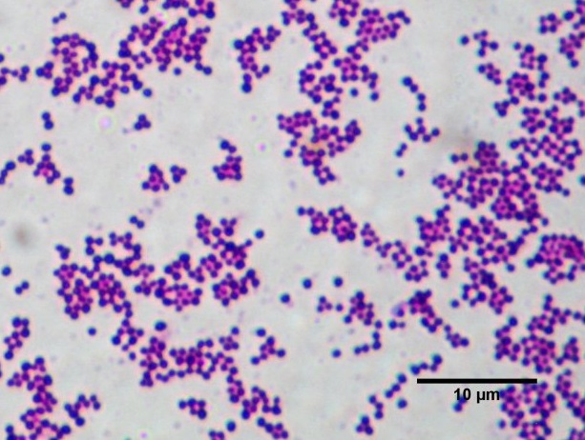
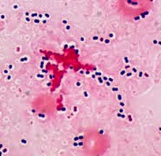
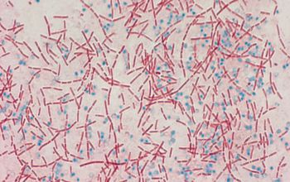
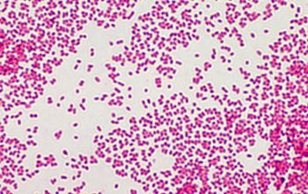
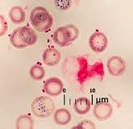
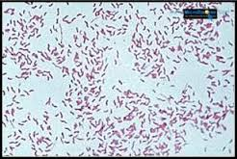
Pay special attention to these organisms
Classic pathogens
Unusual pathogens
Staphylococcus aureus
Streptococcus pneumoniae
Clostridium septicum
Haemophilus influenzae
Neisseria meningitidis
Campylobacter jejuni

Slide 13
If you do consider antimicrobial therapy, consider
Antimicrobial stewardship:
  Optimization of antimicrobial therapy
  Review of microbiology results / revision / de-escalation of empiric prescribing
Goal: Ensure the 5 D’s of optimal antimicrobial therapy:
  Diagnosis: Does the condition require antibiotic therapy?
  Drug: Is the bacteria susceptible?
  Dose: What is the recommended dose?
  Duration: What is the recommended duration?
  De-escalation Can the antibiotic be switched from IV to oral?
Misuse and Consequences
  Antibiotic resistance, multidrug-resistant organisms
  Adverse drug effects or drug interactions
  Secondary infections (Clostridium difficile)
  Increased cost of care

Slide 14
A word of caution about infants and children
Children greater than 3 years of age almost always look ill and have an identifiable (ie, non-occult) focus of infection
However, does not necessarily apply to children, especially those less than 3 years of age
  Before conjugate vaccines, about 3 to 5% of children aged 3 to 36 mo with a febrile illness (temperature ≥ 39° C) and no localizing abnormalities (ie, fever without a source) had occult bacteremia
    80% Streptococcus pneumoniae
    10% Haemophilus influenzae type b
    5% Neisseria meningitidis
  Now rare except in rare except in underimmunized or nonimmunized children, and in children with immunodeficiency
Febrile infants < 3 mo of age have greater risk of serious bacterial infection. Typically:
  group B β-hemolytic Streptococcus, S. pneumoniae, and H. influenzae type b.

Slide 15
Summary
Look for symptoms beyond bacteremia
  Differentiates between asymptomatic bacteremia and sepsis
  Look for foci of infection
  Employ other diagnostic tests including imaging
  Talk to the microbiology laboratory
If simple transient, asymptomatic bacteremia, treatment may not be necessary, but remember the exceptions
If treatment is deemed advisable, then follow guidelines of antimicrobial stewardship

Slide 16
Questions

Slide 17
The CDC Healthcare-Associated Infections and Antimicrobial Resistance Program
Prevent infections (e.g., CDI, CRE, MRSA)
Enhance HAI/AR detection and response infrastructure, establish AR expertise in HAI/AR programs
Promote appropriate antibiotic use
Increase state laboratory capacity for CRE testing
Establish regional laboratories as a national resource for AR testing and characterization

Slide 18
CDC AR Program
Increase state laboratory capacity for CRE testing
Targeted organisms include:
  CRE: Escherichia coli, Enterobacter spp, and Klebsiella spp.
  CRP: non-mucoid Pseudomonas aeruginosa
  CRA: Acinetobacter baumannii
Generally includes ability to test for:
  Antimicrobial resistance
    Either Kirby-Bauer, E-Test, Automated system, or broth microdilution
    For surveillance, doesn’t necessarily include all antibiotics of interest
  Phenotypically test for presence of a carbapenemase
    Either mCIM or CARBA-NP
  Genetically test for the specific carbapenemase
    May prescreen with phenotypic test, if positive then test genetically
      Has advantage that might find novel or unusual resistance
    Either Cepheid Carba-R or CDC (or other in-house developed test)
  Phenotypically screen for colistin resistance
    If positive then test for mobile colistin resistance (mcr) gene

Slide 19
Phenotypically screen for carbapenemases
mCIM
Carba-NP
Modified carbapenem inactivation method
Uses commercially available materials
Use with Enterobacteriaceae and Pseudomonas aeruginosa
Incubate organism with meropenem disk, then plate disk on lawn of E. coli
If carbapenemase present, no/reduced antibiotic remaining in disk
Overnight test
Colorimetric micro tube assay
Not commercially available in US
Use with Enterobacteriaceae, Pseudomonas aeruginosa, Acinetobacter spp.
Detects hydrolysis of imipenem by color change compared to control
Read at time intervals up to 2 hours

Slide 20
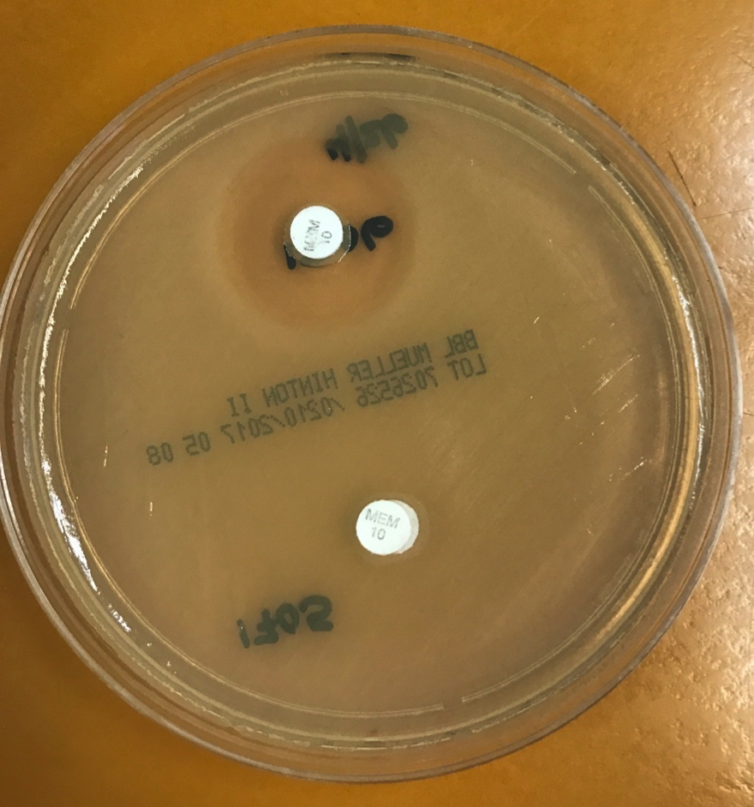
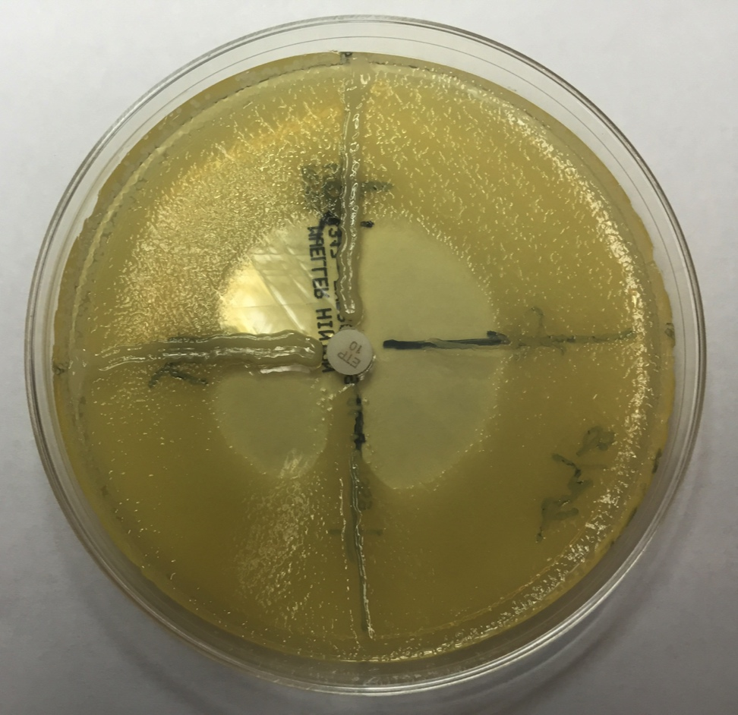
Phenotypic detection of carbapenem
mCIM
Modified Hodge Test (MHT)
Pos = 6 – 15 mm; Neg > 19 mm
Pos: Cloverleaf; Neg: No cloverleaf

Slide 21
More about phenotypic detection
CLSI subcommittee has recommended that MHT be removed in January 2018
mCIM and Carba-NP will be the recommended phenotypic detection methods
Although Carba-NP currently listed for Acinetobacter in CLSI, subcommittee has recommended removal in January 2018, so must test Acinetobacter genetically
If you want to consider adding mCIM:
  Consider validation:
    Request isolates from CDC AR Bank
    Use isolates that you submitted for testing elsewhere (but be careful to compare mCIM against mCIM rather than against previous MHT)

Slide 22
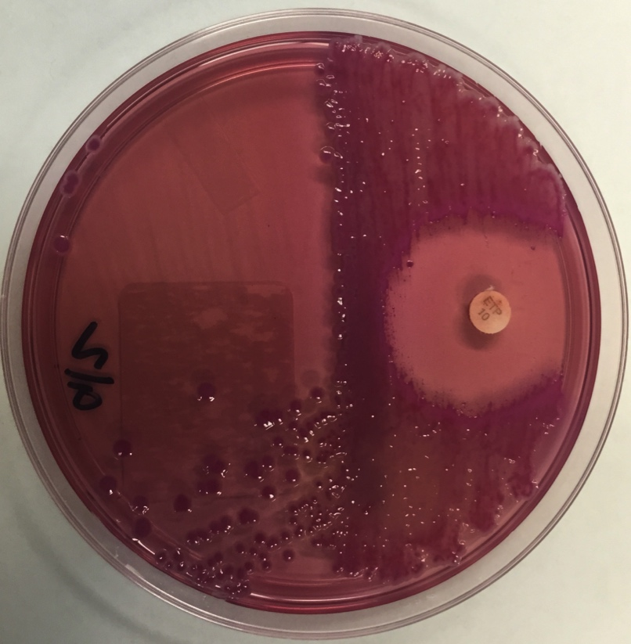
Establish regional laboratories as a national resource for AR testing and characterization
Contact surveillance or point prevalence study
  Cepheid approved by FDA
  Direct plating
Regional Lab
  Broth Microdilution
  Able to detect carbapenemases that Cepheid does not
  Mcr testing
  Help with contact surveillance
  May help with outbreak investigation
CDC resources
  Provide testing for additional antimicrobials
  Help with outbreak investigation if approved
  Will provide epi help and advise re facility investigation/monitoring/surveillance

Slide 23


Key partners for detecting an unusual problem
Astute microbiologist/laboratorian
Astute facility personnel

Slide 24
Questions
Julia Kiehlbauch, Ph.D.
jkiehlbauch@gmail.com
Nevada State Public Health Laboratory
775-688-1335

