Slide 1


Project ECHO Nevada: Telementoring Providers to Help Improve Antimicrobial Stewardship
August 15, 2017

Slide 2
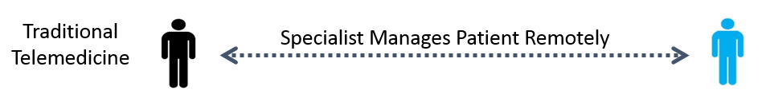
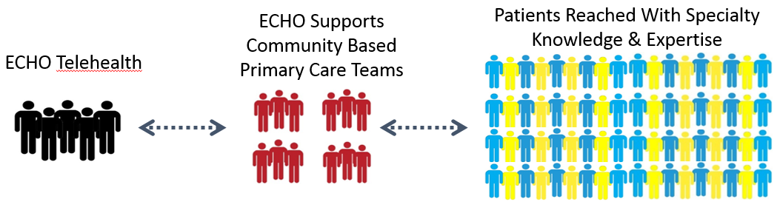


Comparing Telemedicine and the ECHO Model

Slide 3
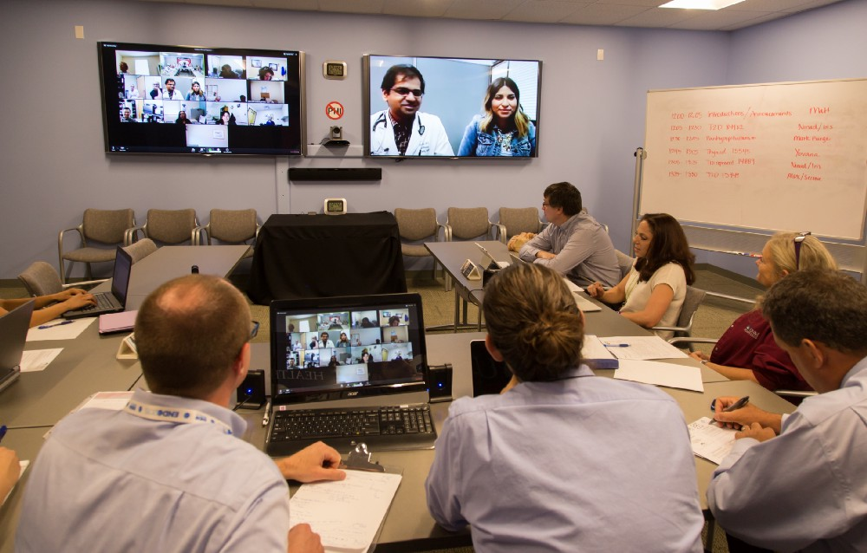
Anytime, Anywhere, Any Device

Slide 4
Project ECHO New Mexico
2003 - Sanjeev Arora identified the need to treat patients with Hepatitis C living in remote NM communities
Envisioned the use of videoconferencing to create a knowledge network of like providers
Received a Health Care Innovation award from RWJ Foundation
Demonstrated improved provider satisfaction and self-efficacy
Proved identical outcomes between care by rural PCPs + ECHO and ordinary care at academic medical center
Published results in NEJM, June, 2011
>100 ECHO hubs world-wide

Slide 5

Project ECHO Nevada Background
Planning began in late 2010
Rural road trips/site visits/needs assessment during July and August 2011
First clinic launched April 2012 – Diabetes ECHO
Currently 11 active ECHO clinics + 3 inactive

Slide 6
Project ECHO Nevada Today
1,900+
50+
350+
CME/CE credits provided for FREE in Nevada
Participating sites
in Nevada
Participating medical professionals including more than 165 primary care providers

Slide 7
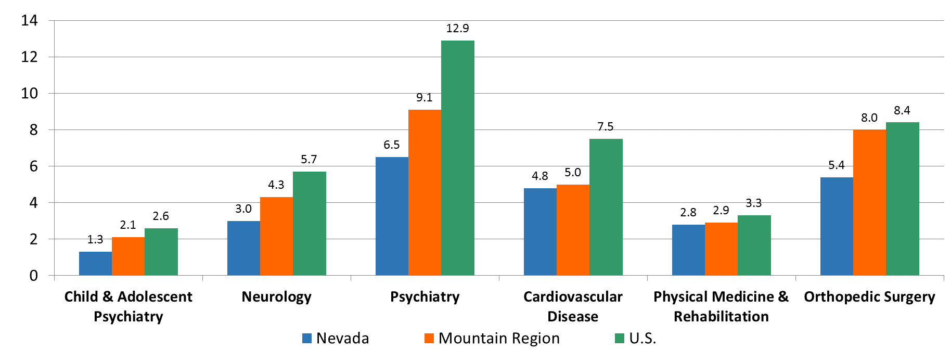
Medical and Surgical Specialties
Number of MDs per 100,000 Population – 2013
Source: AMA. Physician Characteristics and Distribution in the U.S. (2015).

Slide 8
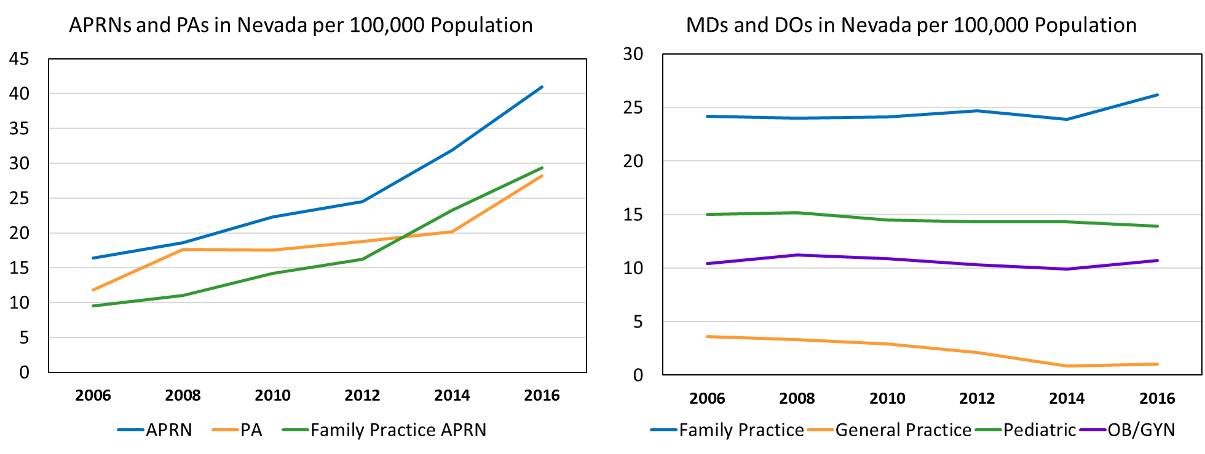
More primary care provided by a lower licensed workforce
Sources: Nevada State Board of Medical Examiners (2016). Nevada State Board of Nursing (2016).
Sources: AMA. Physician Characteristics and Distribution in the U.S. (2015). Unpublished data
from the Nevada State Board of Medical Examiners (2016).

Slide 9
Project ECHO Nevada Clinics for
Primary Care Providers
Antibiotic Stewardship
Behavioral Health in Primary Care*
Diabetes/General Endocrine (x2)*
Gastroenterology
Geriatrics*
Medication Assisted Therapy (MAT) (x2)*
Pain Management (x2)*
Public Health
Sports Medicine
*behavioral health specialist(s) on interdisciplinary team

Slide 10


Contact
Chris Marchand, MPH
Program Coordinator, Project ECHO Nevada
(775) 682-8476
cmarchand@med.unr.edu
@ECHONevada
/ECHONevada

