Slide 1
EMERGENCY MEDICAL SERVICES Non-Training Center Course Request

Slide 2
Introduction
Thank you for being a part of the Nevada EMS Program. This guide is designed to help you through the Course Request process. If you still need some assistance, please contact our office at healthems@health.nv.gov

Slide 3
Content
Initial Certification Course Request
Continuing Education Units (CEU) Course Request
Training Center CEU’s
Refresher Course Request
Training Center Refresher

Slide 4
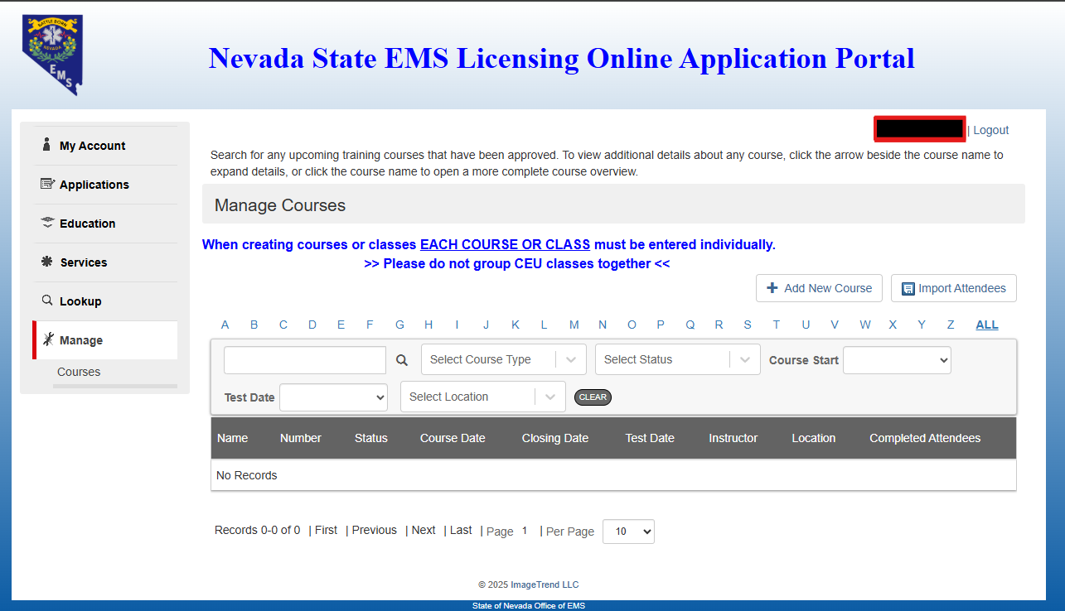
Getting Started
Login to your account
  Click Manage
  Click + Add New Course
2
1

Slide 5
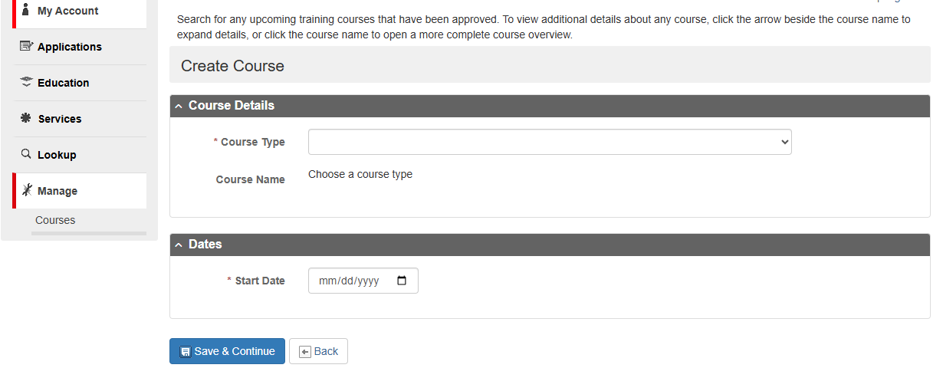
Course Type
Select Course Type
  Non-Training Center
    Initial Certification Course
    Continuing Education (CEU)
    Refresher
  Type Training Center
    Initial Certification Course
    Training Center Continuing Education Course (CEU)
    Training Center Refresher

Slide 6
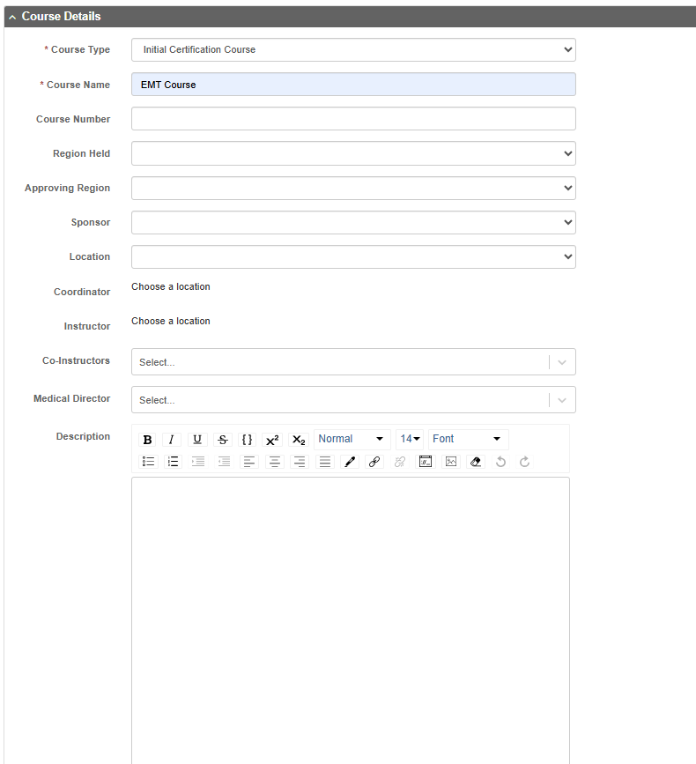
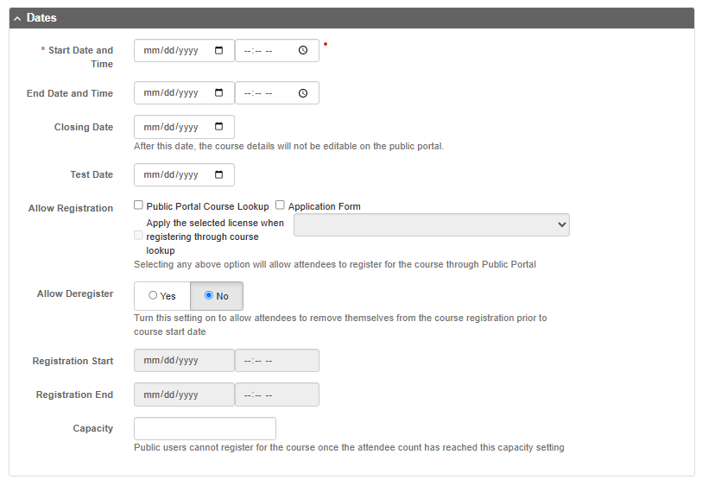
Initial Certification Course
Course Name
  EMR, EMT, AEMT Course
Location
  Your Agency Name
Coordinator
  Program Director/Coordinator
Instructor
  Course Lead Instructor
Medical Director
  Agency Medical Director
Start Date and Time
  First day of course (Must be 20 Business Days from date requested)
End Date and Time
  Last day of Course
Closing Date
  14 Days after the End Date

Slide 7
Initial Certification Course
Credit Hours
  National Education Standards Minimum
    EMR 40-80 Total Hours
    EMT 150-200 Total Hours
    AEMT 200-240 Total Hours
    Paramedic (See CoAEMSP Requirements)
Prerequisites
  BLS Provider
    Required for all Levels
    Can be Built into your first day but cannot count toward min hour requirements
  Nevada EMT
    Required by first day for AEMT & Paramedic
Attendees
  Must be added within 5 days of the course start date
Document Upload Requirements
  Request for Approval of EMS Courses
  Course Outline/Schedule
    Must contain Dates, Times and Instructor(s)
  Syllabus
Test
  N/A
Skills Exam
  N/A

Slide 8
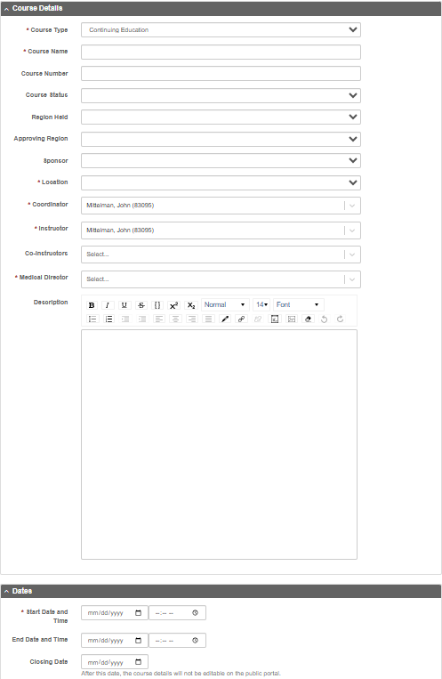
Non-Training Center
Continuing Education Course
Course Name
  Based on topic covered (Skills Pass-off is not an eligible topic)
Location
  Your Agency Name
Coordinator
  Program Director/Coordinator
Instructor
  Course Lead Instructor
Medical Director
  Agency Medical Director
Start Date and Time
  First day of course and start time
End Date and Time
  Last day of Course and end time
Closing Date
  14 Days after the End Date

Slide 9
Non-Training Center
Continuing Education Course
Credit Hours
  Add Topic- Nevada CEU’s
    Enter total hours
Prerequisites
  N/A
Attendees
  Add Attendees
Documents
  Upload Course Description
  Upload Course Objectives (min 3 per hour)
  Upload Course Request Form
Tests
  N/A
Skills Exams
  N/A
Click Finalize Course Creation

Slide 10
Training Center
Continuing Education Course
Course Name
  Based on topic covered (Skills Pass-off is not an eligible topic)
Course Number
  Should Contain TC Number
Location
  Your Agency Name
Coordinator
  Program Director/Coordinator
Instructor
  Course Lead Instructor
Medical Director
  Agency Medical Director
Description
  Course Objectives (Min 3 Per hour)
  Course Description
  Instructor Profile if using Subject Matter Expert
Start Date and Time
  First day of course
End Date and Time
  Last day of Course
Closing Date
  14 Days after the End Date

Slide 11
Training Center
Continuing Education Course
Credit Hours
  Add Topic- Nevada EMS Training Center - CEU’s
    Enter total hours
Prerequisites
  N/A
Attendees
  Add Attendees (See Attendees Slides)
Documents (If not listed in the description section)
  Upload Course Description
  Upload Course Objectives (min 3 per hour)
  Instructor Profile if using a Subject Matter Expert
Tests
  N/A
Skills Exams
  N/A
Click Finalize Course Creation

Slide 12
Refresher Course
Course Name
  EMR, EMT, AEMT, or Paramedic Refresher
    Choose the Highest Level to be completed
  Critical Care Paramedic Refresher
  Community Paramedic Refresher
Location
  Your Agency Name
Coordinator
  Program Director/Coordinator
Instructor
  Course Lead Instructor
Medical Director
  Agency Medical Director
Start Date and Time
  First day of course
  (Must be no less than 20 Business Days from date requested)
End Date and Time
  Last day of Course
Closing Date
  14 Days after the End Date

Slide 13
Refresher Course
Credit Hours
  Nevada Refresher Course Minimums
    EMR 12 Total Hours
    EMT 24 Total Hours
    AEMT 30 Total Hours
    Paramedic 40 Total Hours
    Critical Care Paramedic 48 Total Hours
    Community Paramedicine
      EMT 4 Total Hours
      AEMT 8 Total Hours
      Paramedic 12 Total Hours
Prerequisites
  N/A
Attendees
  Must be added within 5 days of the course start date
Document Upload Requirements
  Request for Approval of EMS Courses
  Course Outline/Schedule
    Must contain Dates, Times and Instructor(s)
Test
  N/A
Skills Exam
  N/A
Total credits required in the National Continued Competency Program (NCCP) 2025 Model (National + Local + Individual) vary by level. EMR = 16, EMT = 40, AEMT = 50, Paramedic = 60

Slide 14
TC Refresher Course
Course Name
  EMR, EMT, AEMT, or Paramedic Refresher
    Choose the Highest Level to be completed
  Critical Care Paramedic Refresher
  Community Paramedic Refresher
Course Number
  Should Contain TC Number
Location
  Your Agency Name
Coordinator
  Program Director/Coordinator
Instructor
  Course Lead Instructor
Medical Director
  Agency Medical Director
Start Date and Time
  First day of course
  (Must be no less than 20 Business Days from date requested)
End Date and Time
  Last day of Course
Closing Date
  14 Days after the End Date

Slide 15
TC Refresher Course
Credit Hours
  Add Topic – Nevada EMS Training Center
  Course Minimums
    EMR 12 Total Hours
    EMT 24 Total Hours
    AEMT 30 Total Hours
    Paramedic 40 Total Hours
    Critical Care Paramedic 48 Total Hours
    Community Paramedicine
      EMT 4 Total Hours
      AEMT 8 Total Hours
      Paramedic 12 Total Hours
Prerequisites
  N/A
Attendees
  Must be added within 5 days of the course start date
Document Upload Requirements
  Request for Approval of EMS Courses
  Course Outline/Schedule
    Must contain Dates, Times and Instructor(s)
Test
  N/A
Skills Exam
  N/A
Total credits required in the National Continued Competency Program (NCCP) 2025 Model (National + Local + Individual) vary by level. EMR = 16, EMT = 40, AEMT = 50, Paramedic = 60

Slide 16
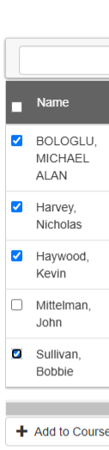
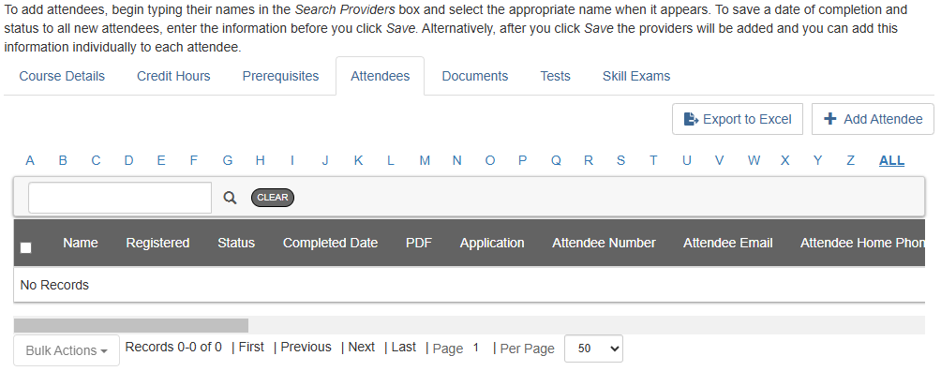
Course Attendees
Department Personnel
Attendee Tab
  + Add Attendee
  Select Service
  Check box next to the name of all Attendees
  Click + Add to Course

Slide 17
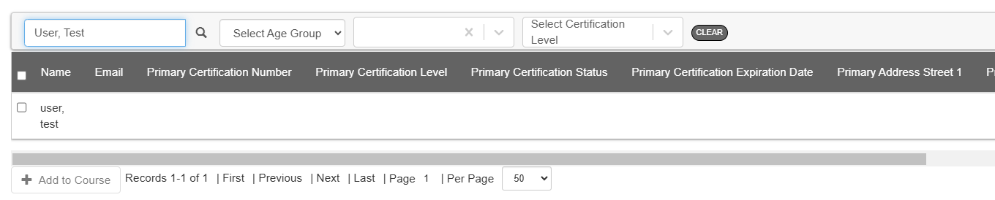
Course Attendees
Non-Department Personnel
Attendee Tab
  + Add Attendee
  Search Name
  Check box next to the name of Attendee
  Click + Add to Course
Non-Department Personnel Must be Added one Attendee at a time.

Slide 18

Post Course
Within 14 days of the Course End Date
Upload to Documents Section
  Course Evaluations
  Course Completion Letter
    Must Contain Student Name and EMS Number
Documents to be Maintained by the Program
  Attendance Roster and Grades
  Course Exams (If uses)
  Skills Sign offs

Slide 19
questions

